Slide 1
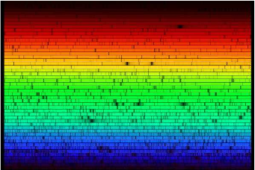
Optical astronomical spectroscopy at the VLT
(Part 1)
F. Pepe
Observatoire de Genève

Slide 2
Course outline
PART 1 - Principles of spectroscopy
  Fundamental parameters
  Overview of spectrometry methods
PART 2 – ‘Modern’ spectrographs
  ‘Simple’ spectroimager
    FORS
  Echelle spectrographs
    UVES
    CRIRES
PART 3 - Spectroscopy on the VLTs
  Multi-Object spectrographs (MOS) and Intergral-Field Units (IFU) and spectro-imagers
    Giraffe
    VIMOS
    Sinfoni
  Future instruments
    X-shooter
    MUSE
    ESPRESSO

Slide 3
The observables
Propagation of light wave from stable source at infinity:
which is a solution of wave equations if:
c_{n} is the speed of light in a medium with refractive index n = n(k)
Independent observables are:
The distance between two spatial maxima of the light wave in a given medium and at fixed t is called wavelength and results to be:

Slide 4
The observables
Astronomical spectroscopy aims at measuring:
At optical wavelength ν=ω/2π is 10¹⁵ Hz, thus too fast to be resolved by detectors. The observable becomes the (surface) brightness or specific intensity I_{ν} or I_{λ}:

Slide 5
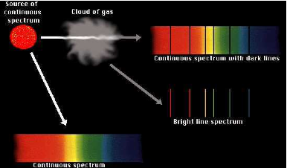
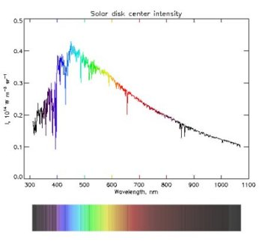
The observables
If we integrate the surface brightness over a given source or sky aperture, we get the spectral flux density F_{ν} or F_{λ} at a given light frequency or wavelength:

Slide 6
Wavelength or frequency?
Frequency (ν, ω), associated to time-evolution of E-field
Fixed location (detect oscillation amplitude as a function of time)
Need for precise clock (time metric)
Need for time resolution (or other tricks, e.g. heterodyne detection)
Wavelength (λ, k), represents light propagation in space
Fixed time (project wave into physical space or spatially separate various spectral components)
Depends on medium ->
Need for precise metrology (space metric) or calibration

Slide 7
Filter spectrometer
Telescope
Filter
Detector (single or array)
Objective
Focal plane

Slide 8
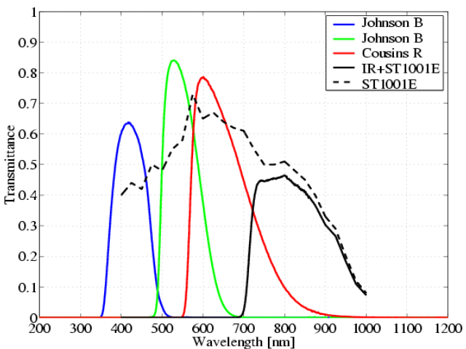
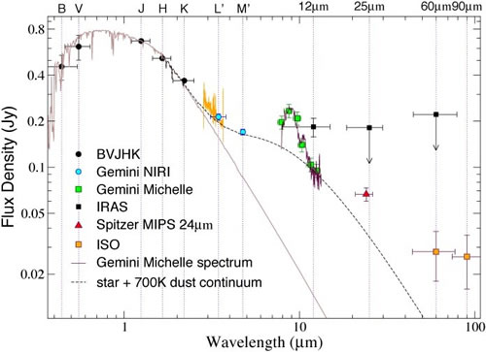
Filter spectrometer
Detector records I_{λ} for a given filter with transmittance t_{c}, central wavelength λ_{c}, and band width Δλ
t_{c}, Δλ and λ_{c} need to be calibrated on standard sources
Appropriate for broad-band spectra
Only one channel per measurement (unless dichroics are used)

Slide 9
Filter spectrometer
Telescope
Objective
Filter 2
Detector (single or array)
Filter 1
Dichroic

Slide 10
Fabry-Pérot spectrometer
Telescope
Fabry-Pérot etalon
Slit
Detector
Focal plane
Collimator
Objective

Slide 11
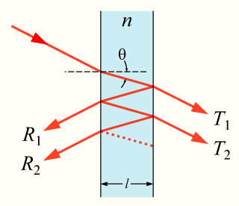
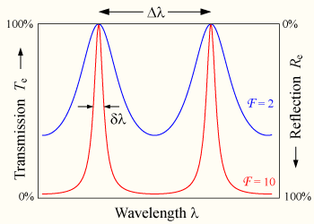
Fabry-Pérot spectrometer
Similar to filter spectrometer, but spacing can be made tunable
Detector records I(λ) as a function of the transmitted wavelength mλ=2l, where m is an integer and enumerates the transmitted order.
Only one spectral channel per measurement
Transmittance and wavelength must be calibrated.
Allows high spectral resolution, if the finesse F or the order m is high. In the latter case, a pre-filtering is required to select only one wavelength (order-selection).

Slide 12
Fabry-Pérot spectrometer
Order-separating filter (e.g. with second FP in 1st order)

Slide 13
Fabry-Pérot spectrometer
Telescope
Fabry-Pérot etalon
Slit
Detector
φ
D
Focal plane
Collimator
Objective
Δ
Real Fabry-Pérot:

Slide 14
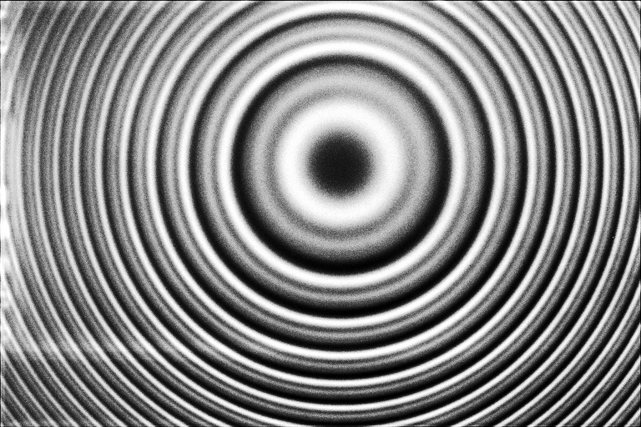
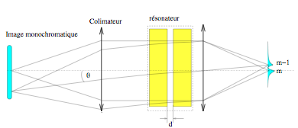
Example of apearture finesse
Transmitted wavelength is unique only for given angle T
If slit is too wide, the aperture (angle cone) is enlarged and the range of transmitted wavelength increased.
The ‘contrast is the reduced, thus the finesse and the spectral resolution

Slide 15
General spectrograph layout
Telescope
Disperser
Slit
Detector
Focal plane
Collimator
Objective
Single detector -> monochromator (may be used with movable part to scan over wavelengths
Array detector -> spectrograph with N wavelength channels (N = number of detectors or pixels)

Slide 16
Dispersers
The disperser separates the wavelengths in angular direction. To avoid angular mixing, the beam is collimated. The disperser is characterized by its angular dispersion:
where β is the deviation angle from the un-dispersed direction

Slide 17
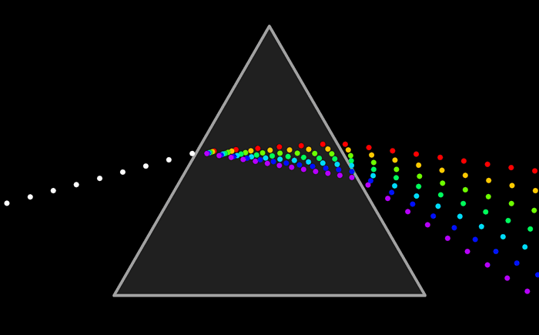
The prism

Slide 18
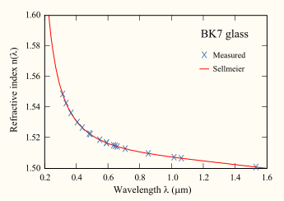
Prism characteristics
-> High transmittance
-> When used at minimum deviation, no anamorphosis (beam dia. compression or enlargement)
-> Produces ‘low’ dispersion
Prism example: BK7 (normal glass), t = 50 mm, D = 100 mm

Slide 19
Prism characteristics
-> Depends mainly on glass material (internal transmittance)
-> Anti-reflection coatings are needed to avoid reflection losses, especially for large apex angles (and large α). The coating must be optimized for the glass and the used angles.
-> Efficiency can be as high as 99%
-> The dispersion increases towards the blue wavelengths. For Crown glasses (contain Potassium) the ratio of the dispersion between blue and red is lower than for Flint glasses (contain lead, titanium dioxide or zirconium dioxide) .

Slide 20
Grating spectrograph
Focal ratios defined as
F_{i} = f_{i} / D_{i}
Camera
Collimator

Slide 21
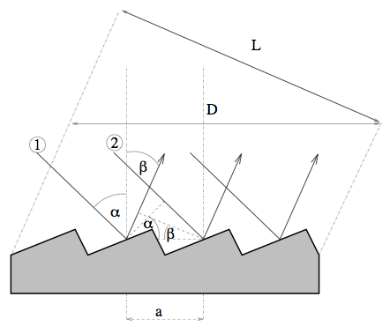
The diffraction grating
Generic grating equation from the condition of positive interference between various ‘grooves’:

Slide 22
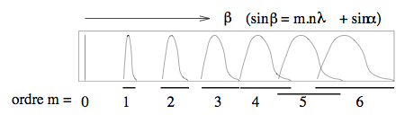
Grating characteristics
-> Several orders result for a given wavelength
-> m = 0 for a grating which acts like a mirror -> no dispersion!
-> Orders overlap spatially -> must be filtered or use at m=1
Typical grating example: m = 1, ρ = 1000 gr/mm, sinα + sinβ = 1, cosβ=1/2
Dispersion typically much higher than for prisms!

Slide 23
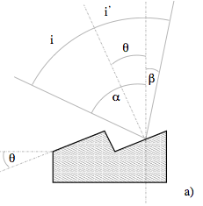
Grism efficiency
Maximum efficiency obtained when specular groove reflection is matches (Blaze condition):

Slide 24
Order overlaps
Effective passband
in 1st order
Don't forget higher orders!
Intensity
1st order
blaze profile
m=1
First and second
orders overlap!
m=2
Passband
in 2nd order
Zero order
matters for MOS
2nd order
blaze profile
Passband
in zero
order
m=0
Wavelength in first order marking position on detector in dispersion direction (if dispersion ~linear)
1st order
0
λ_{L}
λ_{C}
2λ_{L}
λ_{U}
2λ_{U}
(2nd order)
0
λ_{L}
λ_{U}

Slide 25
Resolving power and resolution
Focal ratios defined as
F_{i} = f_{i} / D_{i}
Camera
Collimator

Slide 26
Resolving power and resolution
The objective translates angles into positions on the detector. Each position (pixel) of the detector ‘sees’ a given angle of the parallel (collimated) beam
The collimated beam is never perfectly parallel, because either of the limited diameter of the beam, which produces diffraction δφ = 1.22 λ/D₁, or because of the finite slit, which produces and angular divergence δΘ = s/f_{1.}
The angular divergence is translated into a distance δλ = f₂ δΘ or δλ = f₂ δφ on the CCD. This means that over this distances the wavelengths are mixed (cannot be separated angularly.

Slide 27
Resolving power and resolution
Resolving power is the maximum spectral resolution which can be reached if the slit s = 0 and the angular divergence is limited by diffraction arising from the limited beam diameter. For a given Dispersion D we get the resolving power:
Spectral resolution is the effective spectral resolution which is finally reached when assuming a finite slit s. For a given Dispersion D we get the spectral resolution:

Slide 28
Conservation of the ‘étendue’
The étendue is defined as E=A x O, where A is the area of the beam at a given optical surface and O is the solid angle under which the beam passes through the surface.
When following the optical path of the beam through an optical system, E is constant, in particular, it cannot be reduced
For a telescope, E is the product of the primary mirror surface and the two-dimensional field (in sterad) transmitted by the optical system. Normally, the transmitted field is defines a slit width. When entering spectrograph, the slit x beam aperture at the slit is equal to the etendue E of the telescope. This implies that at fixed spectral resolution, the slit width and the beam diameter cannot be chosen independently, since dΘ depends on both.

Slide 29
Other dispersers
Grisms
VPHG
Echelle grating

Slide 30
Grisms
Transmission grating attached to prism
Allows in-line optical train:
  simpler to engineer
  quasi-Littrow configuration - no variable anamorphism
Inefficient for ρ > 600/mm due to groove shadowing and other effects

Slide 31
Grism equations
Modified grating equation:
Undeviated condition:
  n'= 1, β = −α = φ
Blaze condition: θ = 0 ⇒ λ_{B} = λ_{U}
Resolving power
(same procedure as for grating)
θ = phase difference from centre of one ruling to its edge

Slide 32
Volume Phase Holographic gratings
So far we have considered surface relief gratings
An alternative is VPH in which refractive index varies harmonically throughout the body of the grating:
Don't confuse with 'holographic' gratings (SR)
Advantages:
  Higher peak efficiency than SR
  Possibility of very large size with high ρ
  Blaze condition can be altered (tuned)
  Encapsulation in flat glass makes more robust
Disadvantages
  Tuning of blaze requires bendable spectrograph!
  Issues of wavefront errors and cryogenic use

Slide 33
VPH configurations
Fringes = planes of constant n
Body of grating made from Dichromated Gelatine (DCG) which permanently adopts fringe pattern generated holographically
Fringe orientation allows operation in transmission or reflection

Slide 34
VPH equations
Modified grating equation:
Blaze condition:
= Bragg diffraction
Resolving power:
Tune blaze condition by tilting grating (α)
Collimator-camera angle must also change by 2α ⇒ mechanical complexity

Slide 35
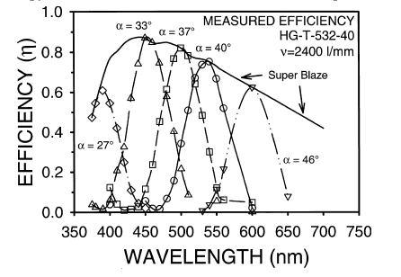
VPH efficiency
Kogelnik's analysis when:
Bragg condition when:
Bragg envelopes (efficiency FWHM):
  in wavelength:
  in angle:
Broad blaze requires
  thin DCG
  large index amplitude
Superblaze
Barden et al. PASP 112, 809 (2000)

Slide 36
Other dispersers
Grisms
VPHG
Echelle grating …

