Slide 1
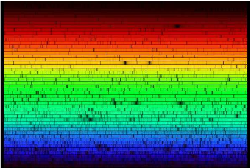
Optical astronomical spectroscopy at the VLT (Part 3)
F. Pepe
Observatoire de Genève

Slide 2
Course outline
PART 1 - Principles of spectroscopy
Fundamental parameters
Overview of spectrometry methods
PART 2 – ‘Modern’ spectrographs
‘Simple’ spectroimager
FORS
Echelle spectrographs
UVES
CRIRES
PART 3 - Spectroscopy on the VLTs
Multi-Object spectrographs (MOS) and Intergral-Field Units (IFU) and spectro-imagers
Giraffe
VIMOS
Sinfoni
Future instruments
X-shooter
MUSE
ESPRESSO

Slide 3
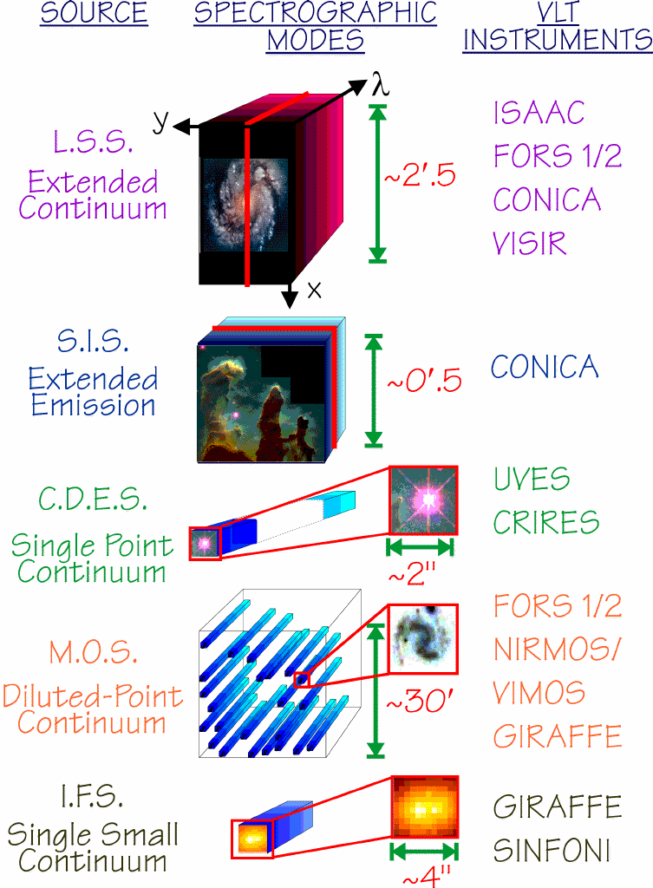

Slide 4
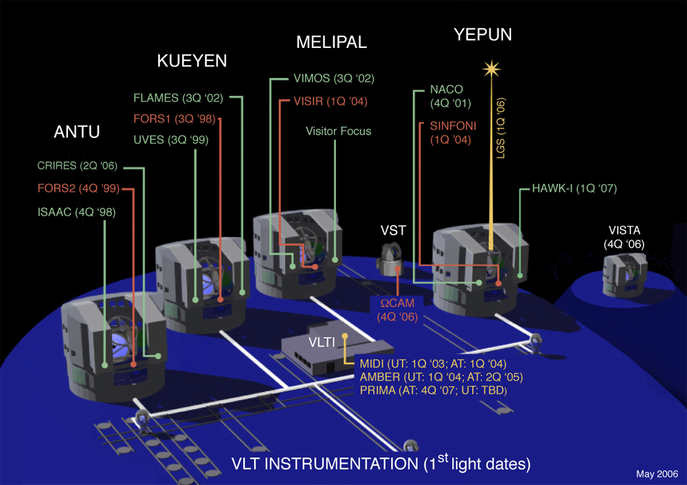
Flames@VLT

Slide 5
Flames – various links
Mode Number of Buttons Fibers per Buttons Sky Buttons Total fibers
UVES 8 1 - 8
Medusa 132 1 - 132
IFU 15 20 15 315
ARGUS 1 14x22 (-8) 15 315
UVES
Giraffe

Slide 6
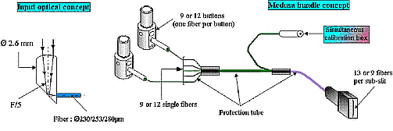
Flames – UVES link
Mode Number of Buttons Fibers per Buttons Sky Buttons Total fibers
UVES 8 1 - 8
Medusa 132 1 - 132
IFU 15 20 15 315
ARGUS 1 14x22 (-8) 15 315

Slide 7
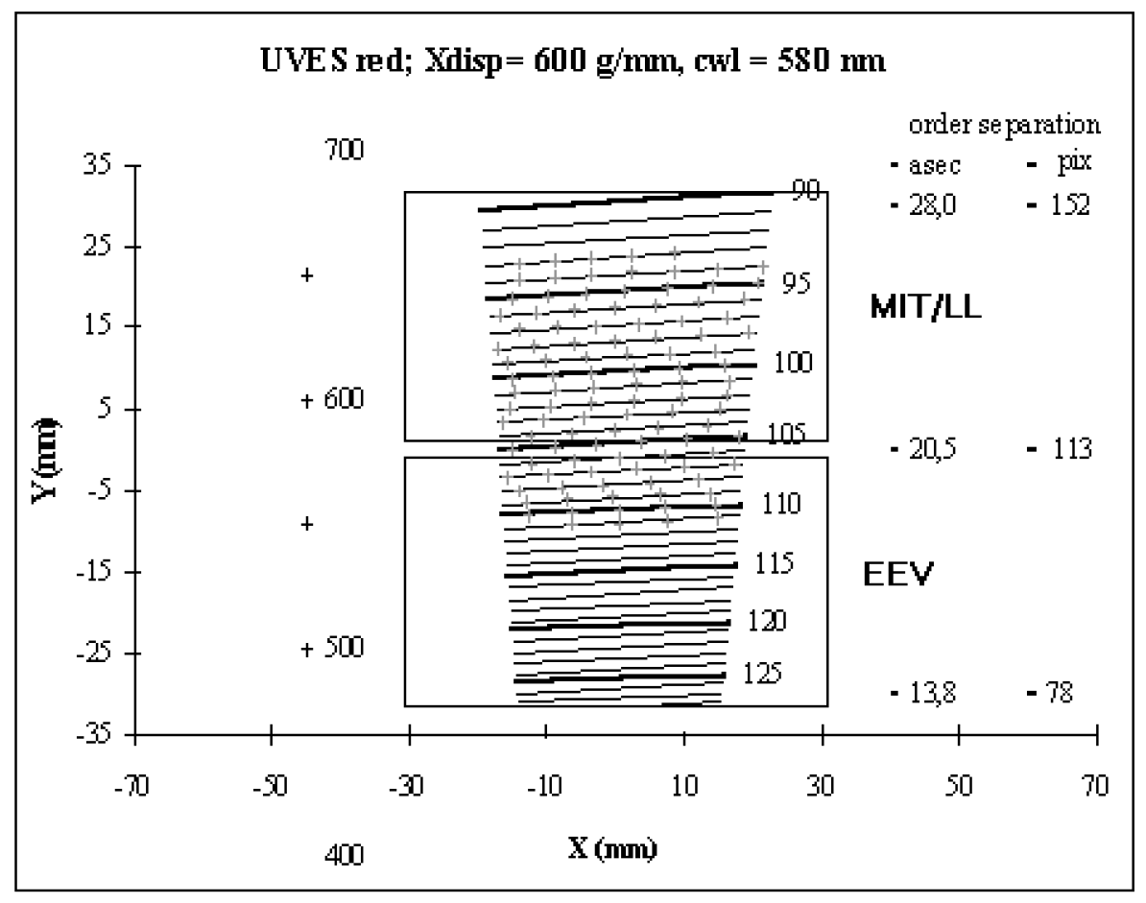
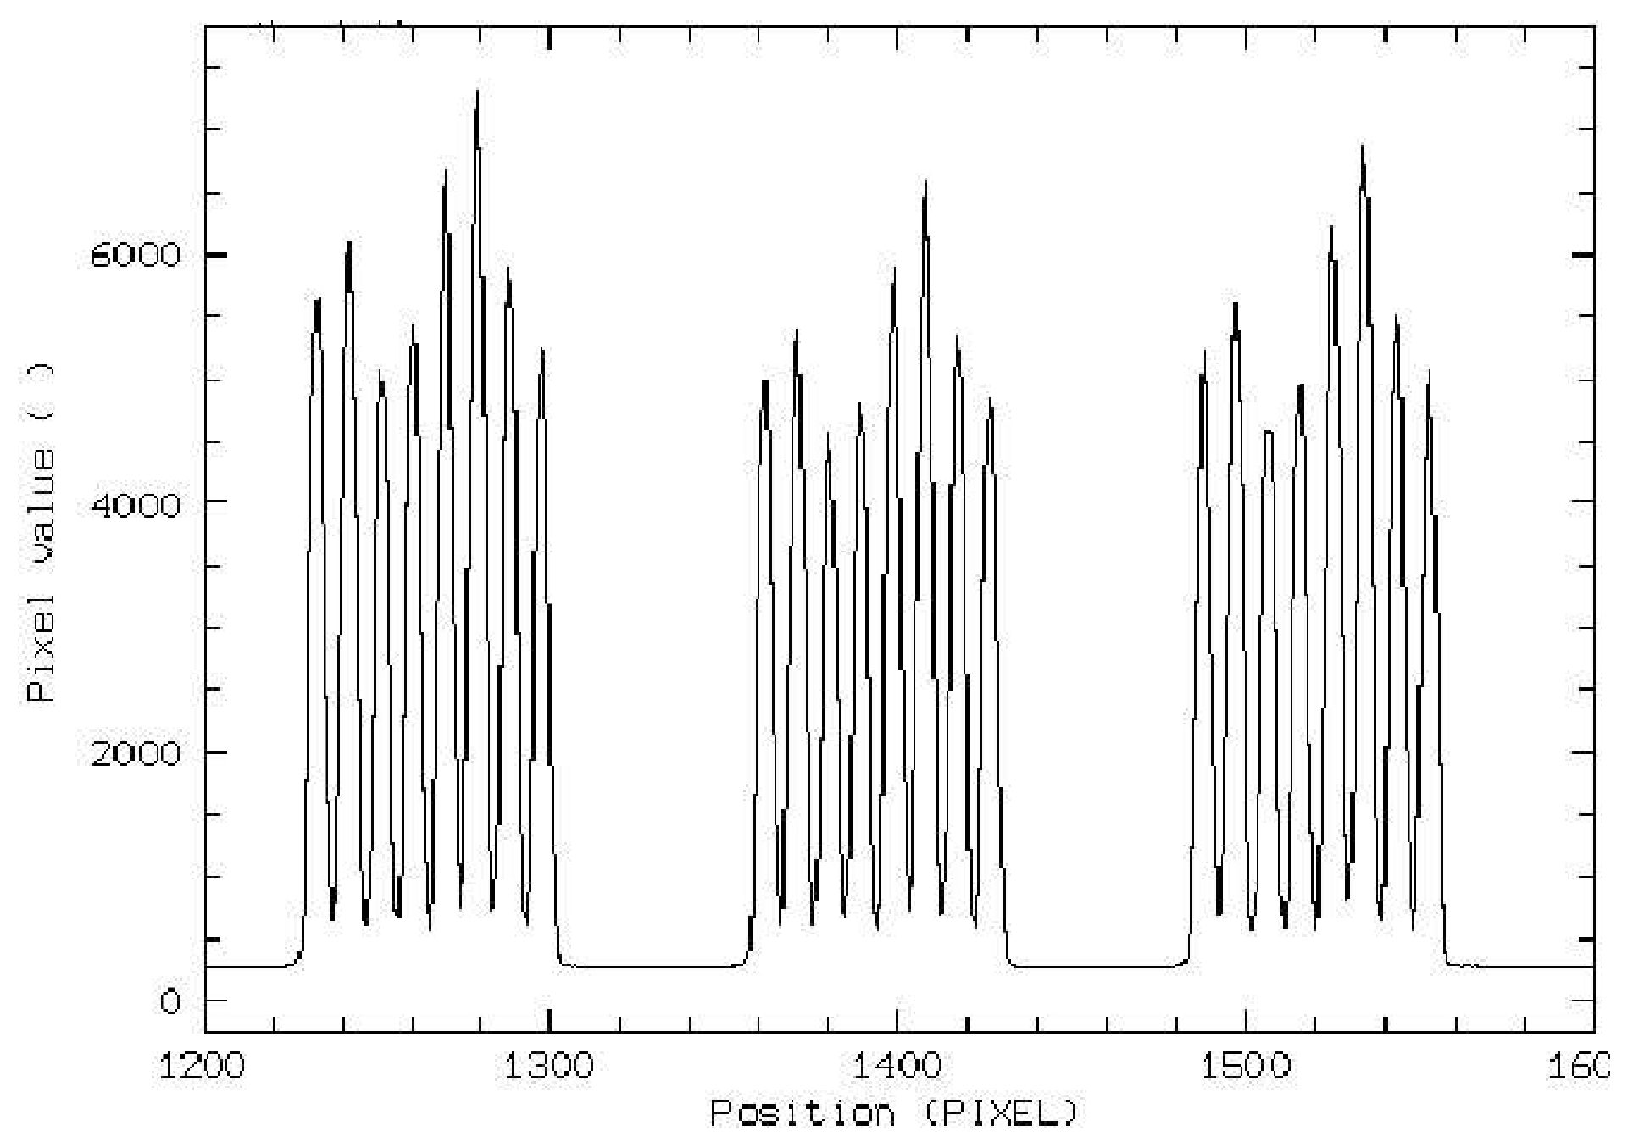
Flames – UVES link
Mode Number of Buttons Fibers per Buttons Sky Buttons Total fibers
UVES 8 1 - 8
Medusa 132 1 - 132
IFU 15 20 15 315
ARGUS 1 14x22 (-8) 15 315

Slide 8
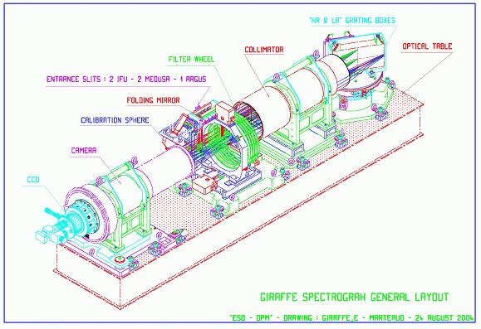
Flames – Giraffe

Slide 9
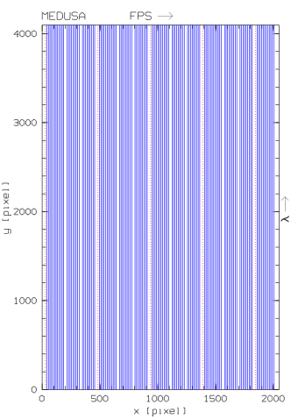
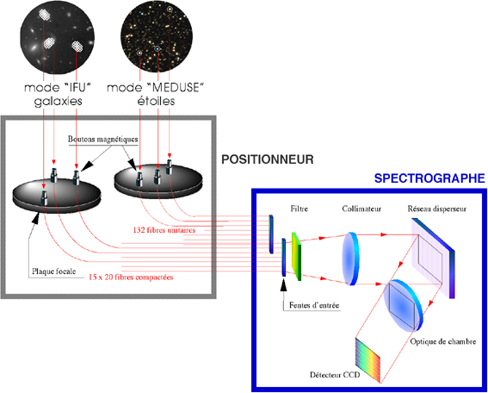
Flames – MEDUSA
Mode Number of Buttons Fibers per Buttons Sky Buttons Total fibers
UVES 8 1 - 8
Medusa 132 1 - 132
IFU 15 20 15 315
ARGUS 1 14x22 (-8) 15 315

Slide 10
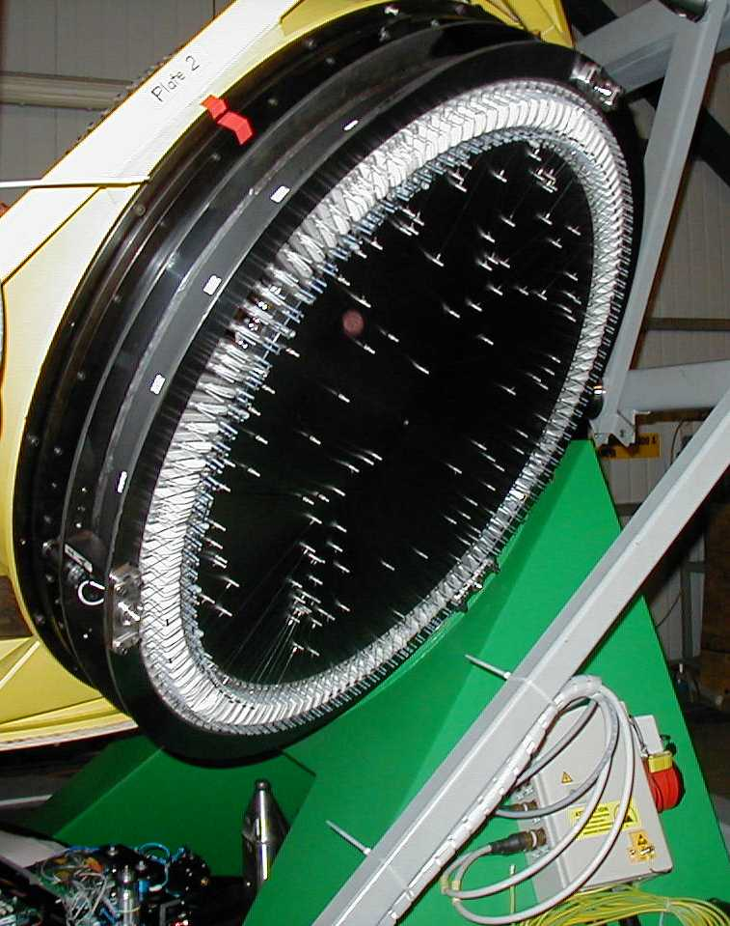
Flames – MEDUSA
OzPoz fiber positioner

Slide 11
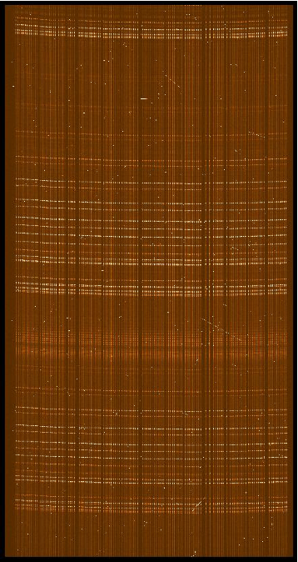
Flames – MEDUSA
Mode Number of Buttons Fibers per Buttons Sky Buttons Total fibers
UVES 8 1 - 8
Medusa 132 1 - 132
IFU 15 20 15 315
ARGUS 1 14x22 (-8) 15 315

Slide 12
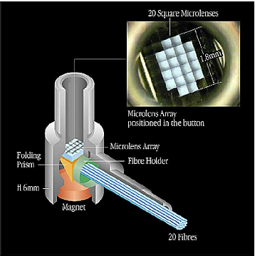
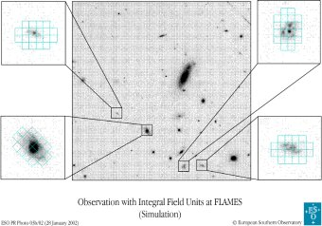
Flames – IFU
Mode Number of Buttons Fibers per Buttons Sky Buttons Total fibers
UVES 8 1 - 8
Medusa 132 1 - 132
IFU 15 20 15 315
ARGUS 1 14x22 (-8) 15 315

Slide 13
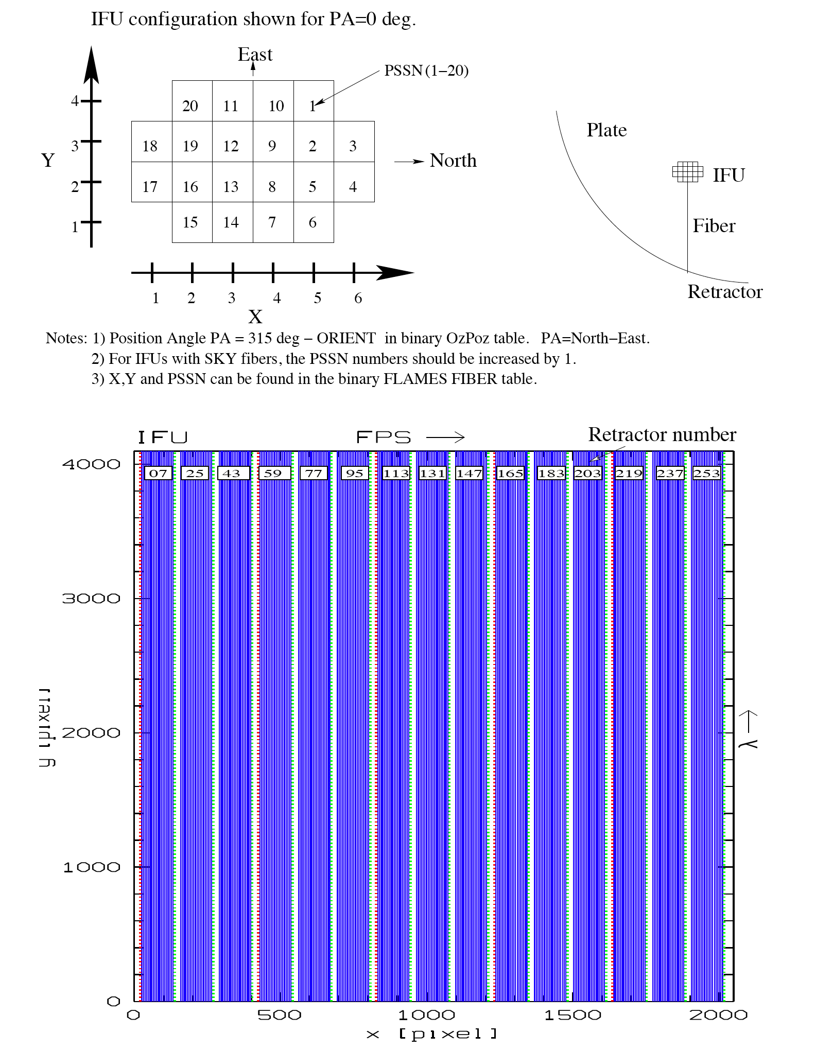
Flames – IFU

Slide 14
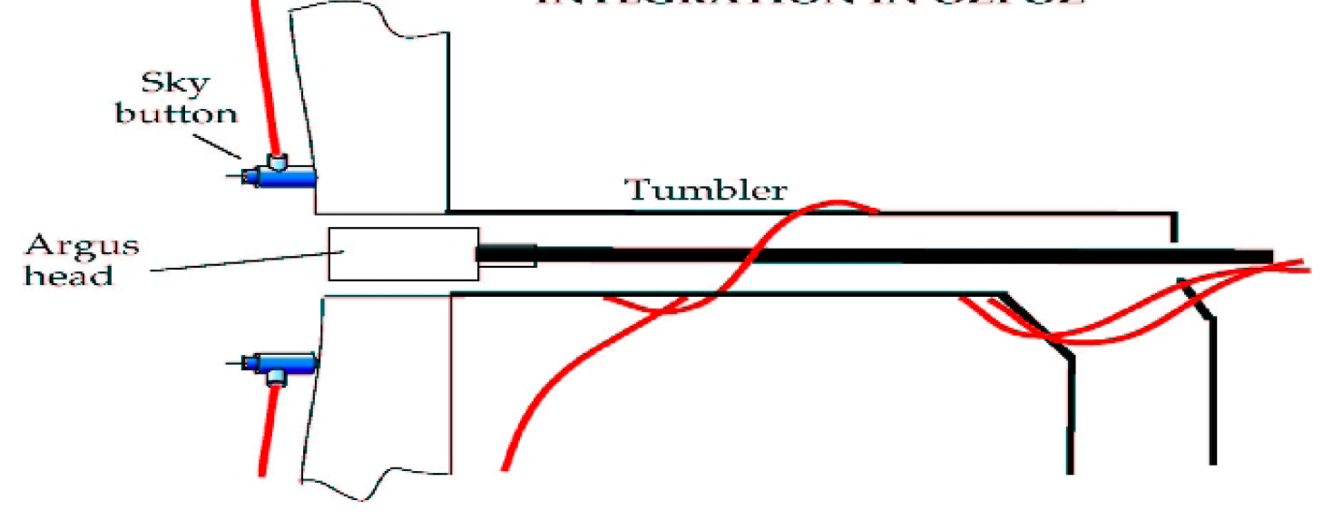
Flames – ARGUS
Mode Number of Buttons Fibers per Buttons Sky Buttons Total fibers
UVES 8 1 - 8
Medusa 132 1 - 132
IFU 15 20 15 315
ARGUS 1 14x22 (-8) 15 315

Slide 15
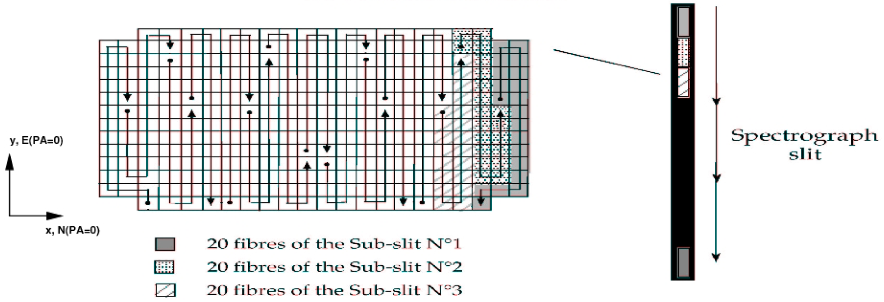
Flames – ARGUS
Mode Number of Buttons Fibers per Buttons Sky Buttons Total fibers
UVES 8 1 - 8
Medusa 132 1 - 132
IFU 15 20 15 315
ARGUS 1 14x22 (-8) 15 315

Slide 16
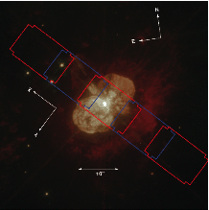
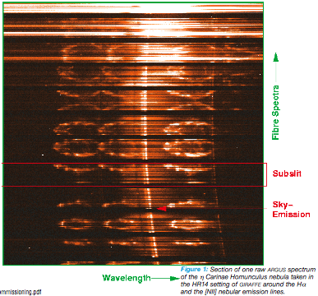
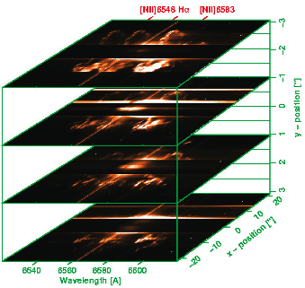
Flames – ARGUS

Slide 17
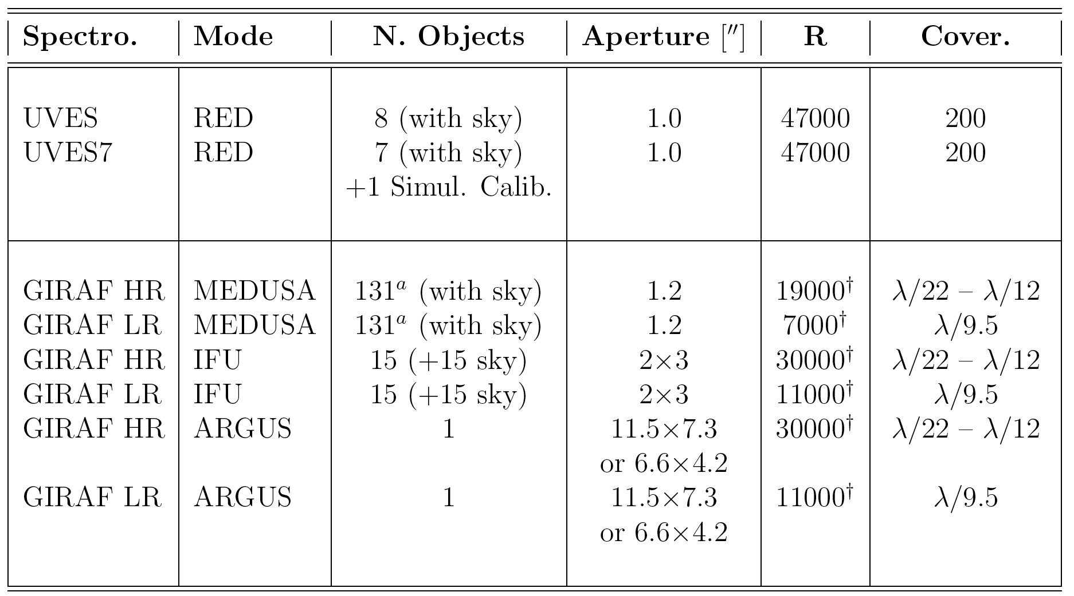
Flames – Summary

Slide 18
Flames – Summary
Field
Slit
Spectrum
Single field
MOS
IFU

Slide 19
VIMOS@VLT

Slide 20
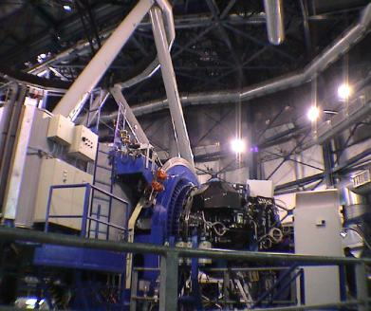
VIMOS@VLT

Slide 21
VIMOS - Modes
IMG: Imaging is possible in UBVRIz filters in a 4 x 7' x 8' field of view.
MOS: Multi-object spectroscopy is carried out using masks (one per quadrant) prepared in Paranal using a laser cutting Mask Manufacturing Unit. Depending on the grism used, the spectral resolution varies from 200 to 2500, and the observable range is from 360 to 1000 nm. The maximum number of slits per mask (quadrant) varies from ~40 at R=2500 to ~150-200 at R=200, for a field of view of 4 x 7' x 8'. (like FORS)
IFU: VIMOS is also equipped with an integral field unit made of 6400 fibers. The scale on the sky can be changed from 0.67" per fiber to 0.33" per fiber and the integral field unit can cover up 13"x 13" up to 54"x54" on sky depending on spectral resolution and spatial magnification. Spectral resolution and coverage are similar to MOS. (like Flames-Argus)

Slide 22
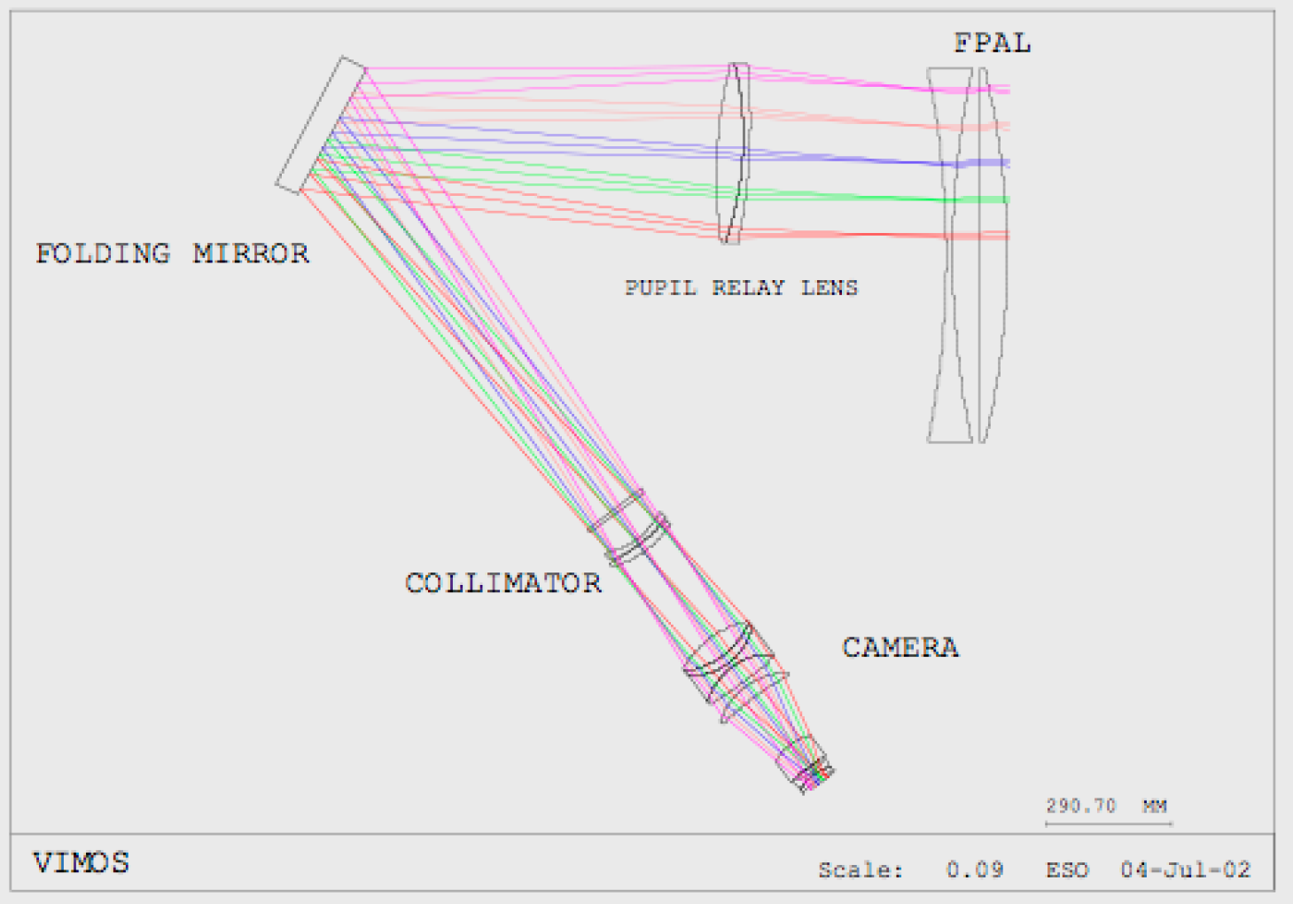
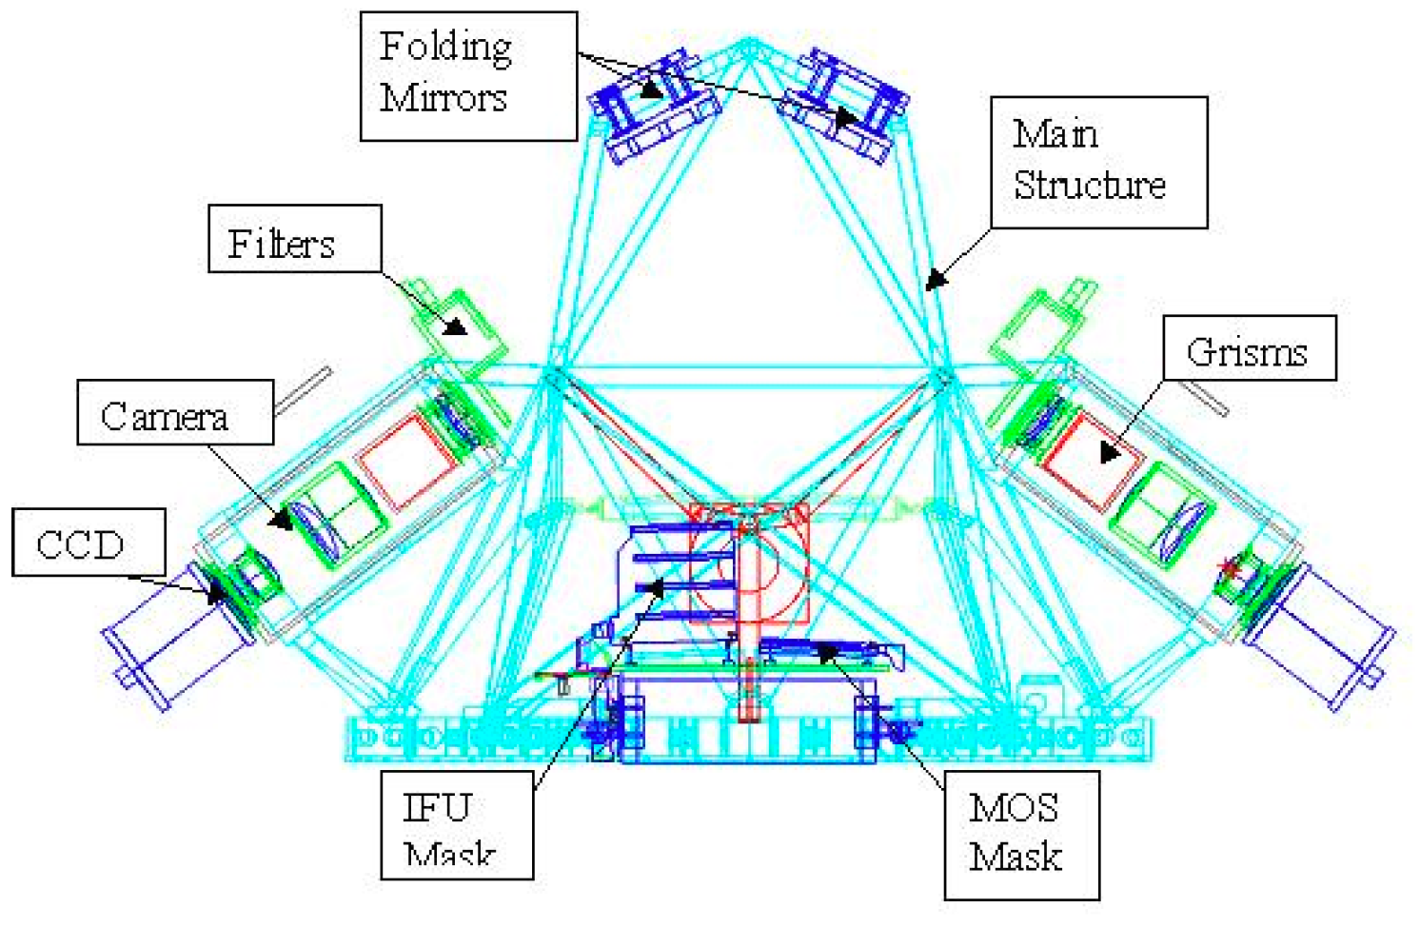
VIMOS instrument

Slide 23
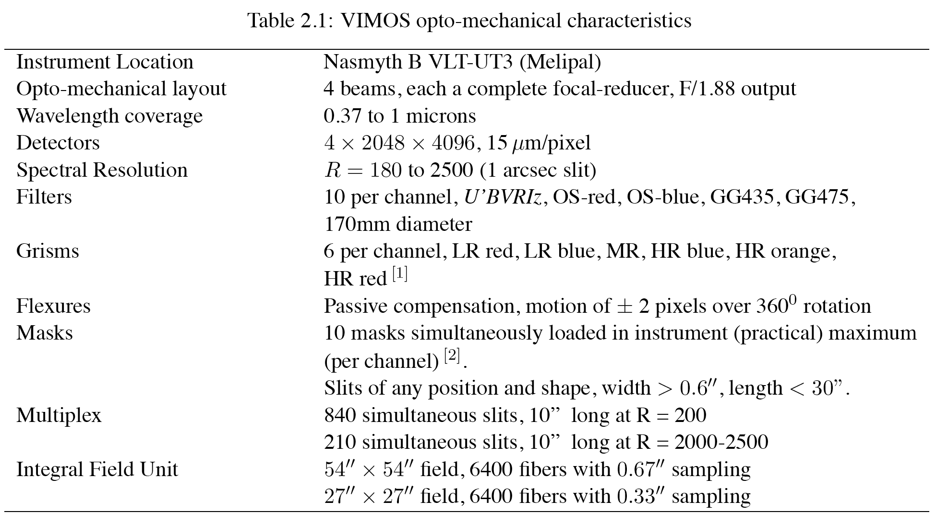
VIMOS instrument

Slide 24
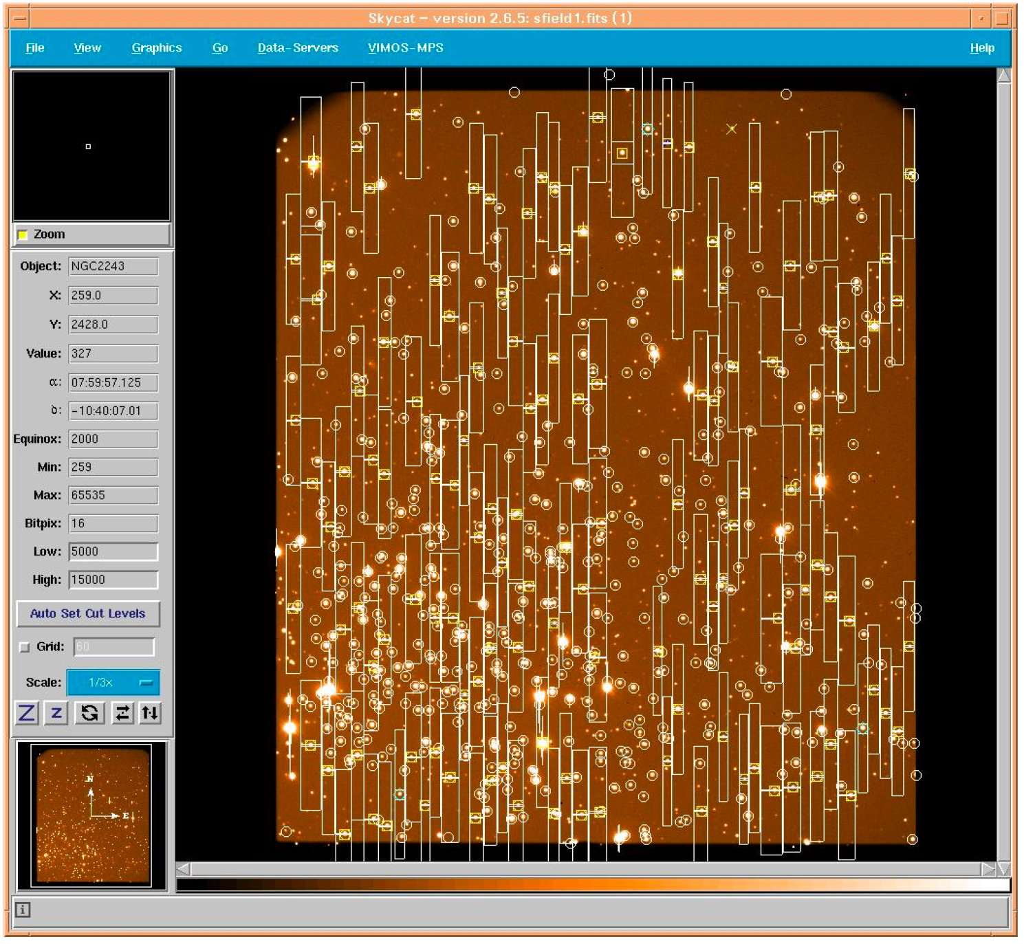
VIMOS MOS

Slide 25
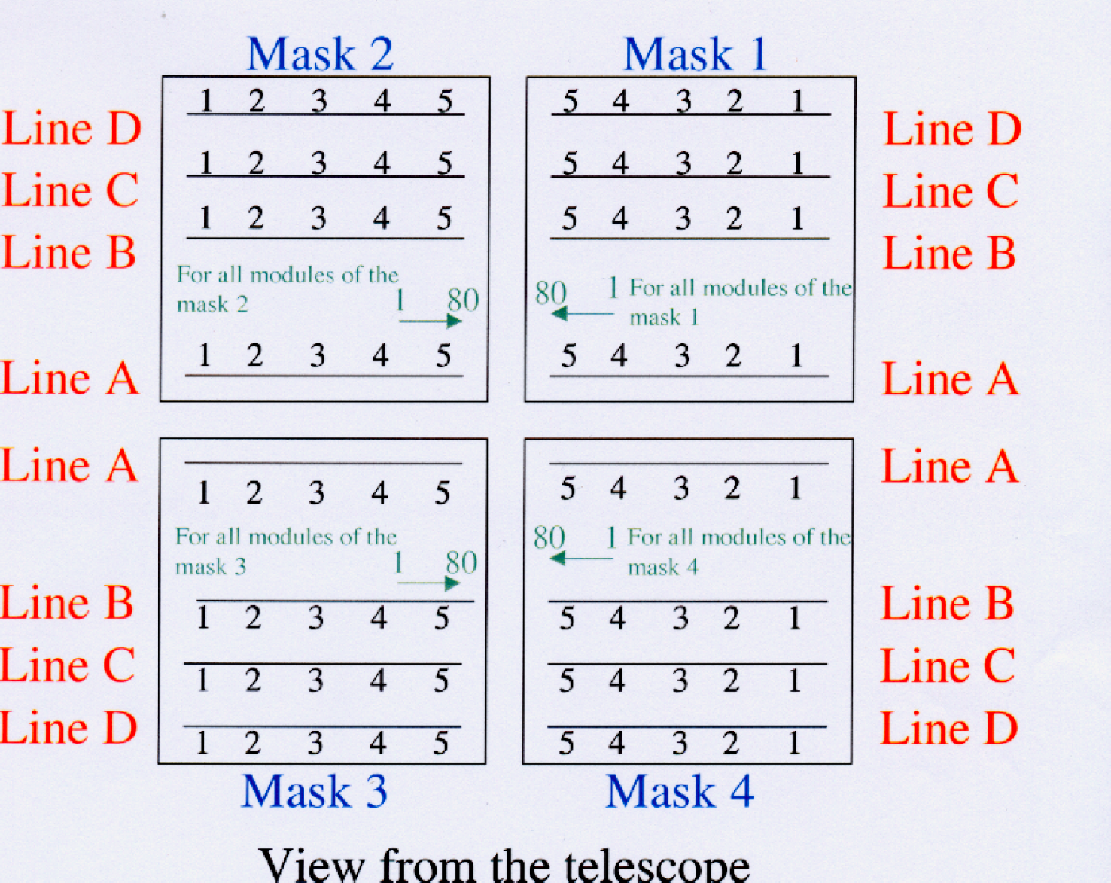
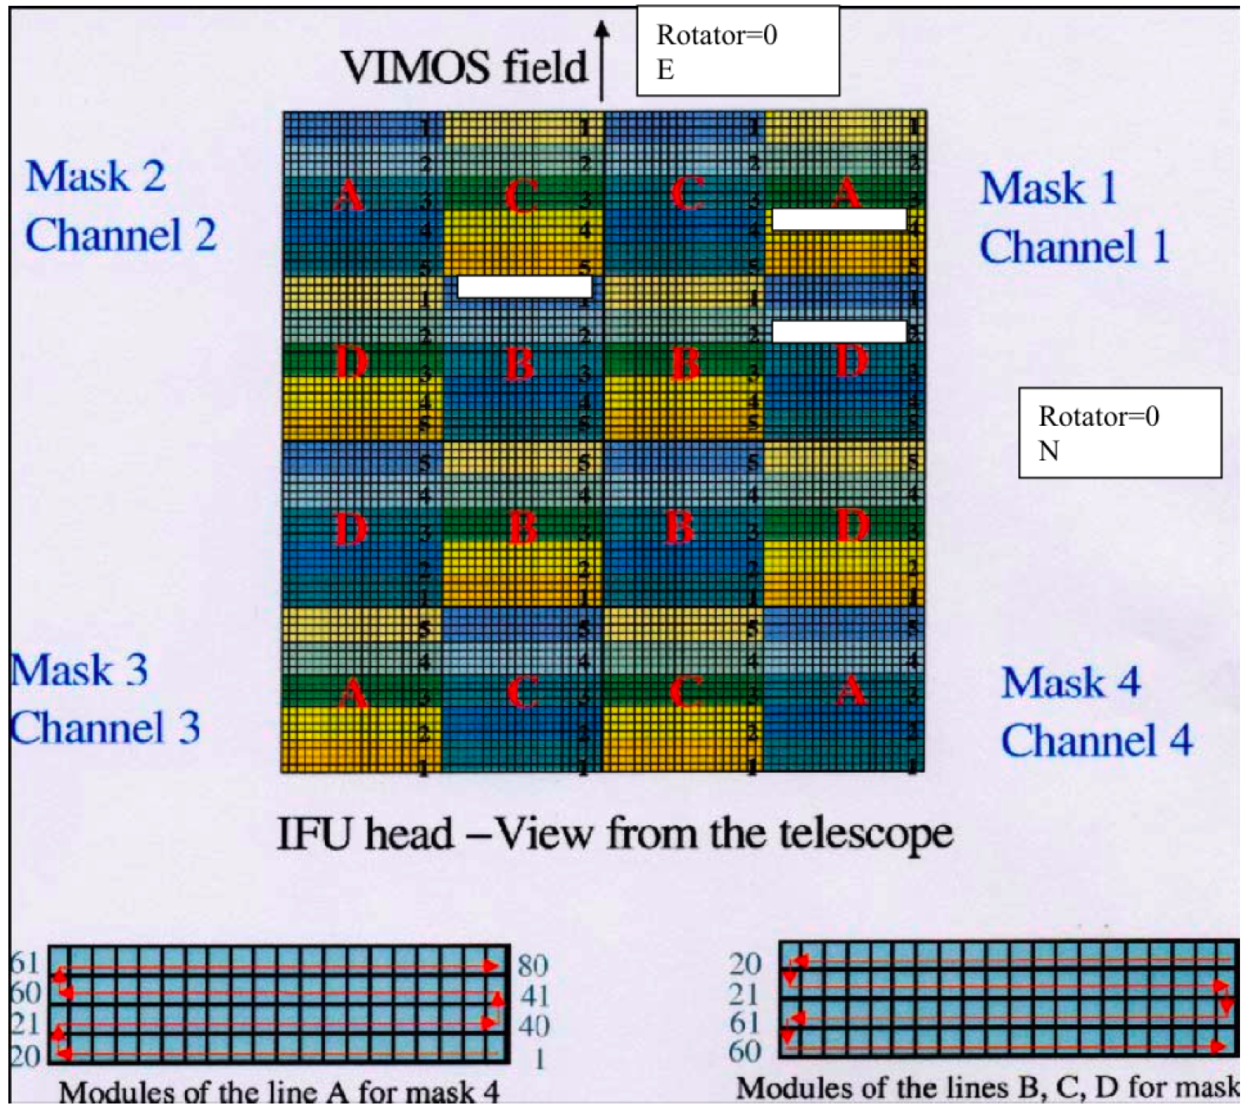
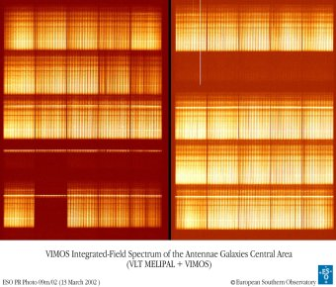
VIMOS IFU

Slide 26
Sinfoni@VLT

Slide 27
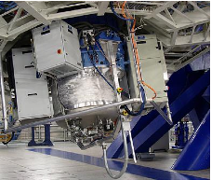
Sinfoni@VLT
Infrared spectrograph (SPIFFI)
Dispersion grating
Cryogenic instrument
Adaptive optics (SINFONI)
-> ‘Small’ instrument
-> enhance faint objects wrt to IR background
IFU module

Slide 28
Sinfoni@VLT
SINFONI is a near-infrared (1.1 - 2.45 μm) integral field spectrograph fed by an adaptive optics module. The spectrograph operates with 4 gratings (J, H, K, H+K) providing a spectral resolution around 2000, 3000, 4000 in J, H, K, respectively, and 1500 in H+K - each wavelength band fitting fully on the 2048 pixels of the Hawaii 2RG (2kx2k) detector in the dispersion direction. The SINFONI field of view on the sky is sliced into 32 slices. The pre-slit optics allows to chose the width of the slices. The choices are 250mas, 100mas and 25mas, leading to field of views on the sky of 8"x8", 3"x3", or 0.8"x0.8" respectively. Each one of the 32 slitlets is imaged onto 64 pixels of the detector. Thus one obtains 32x64 spectra of the imaged region on the sky.

Slide 29
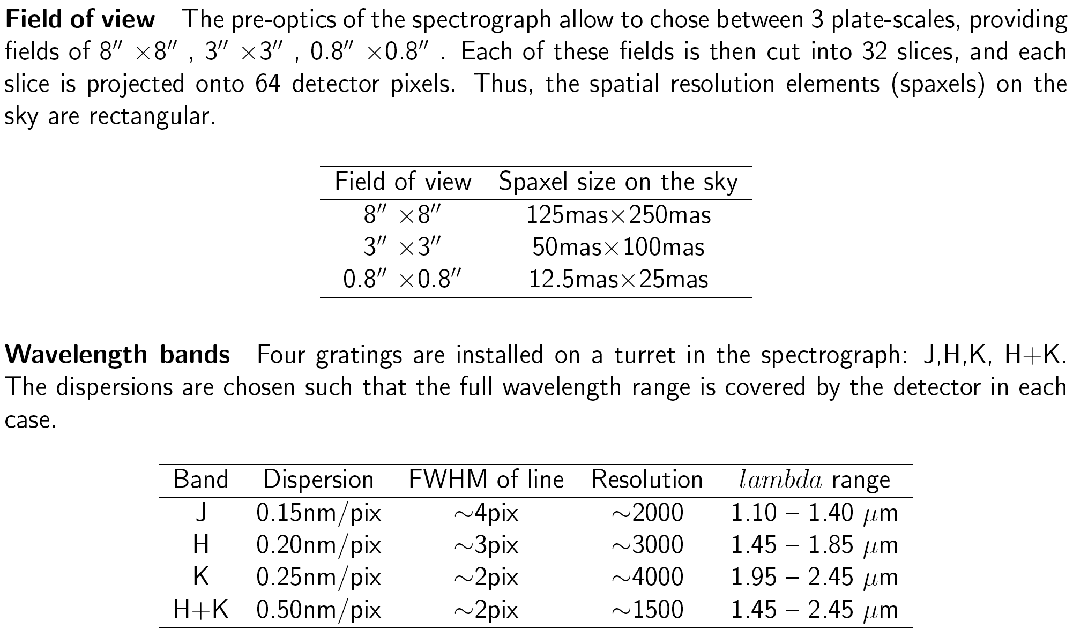
Sinfoni@VLT

Slide 30
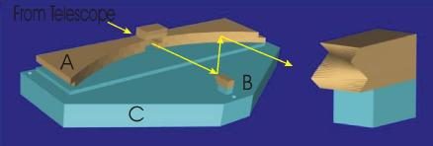
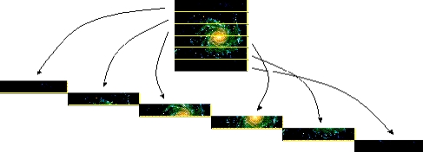
Spiffi’s IFU

Slide 31
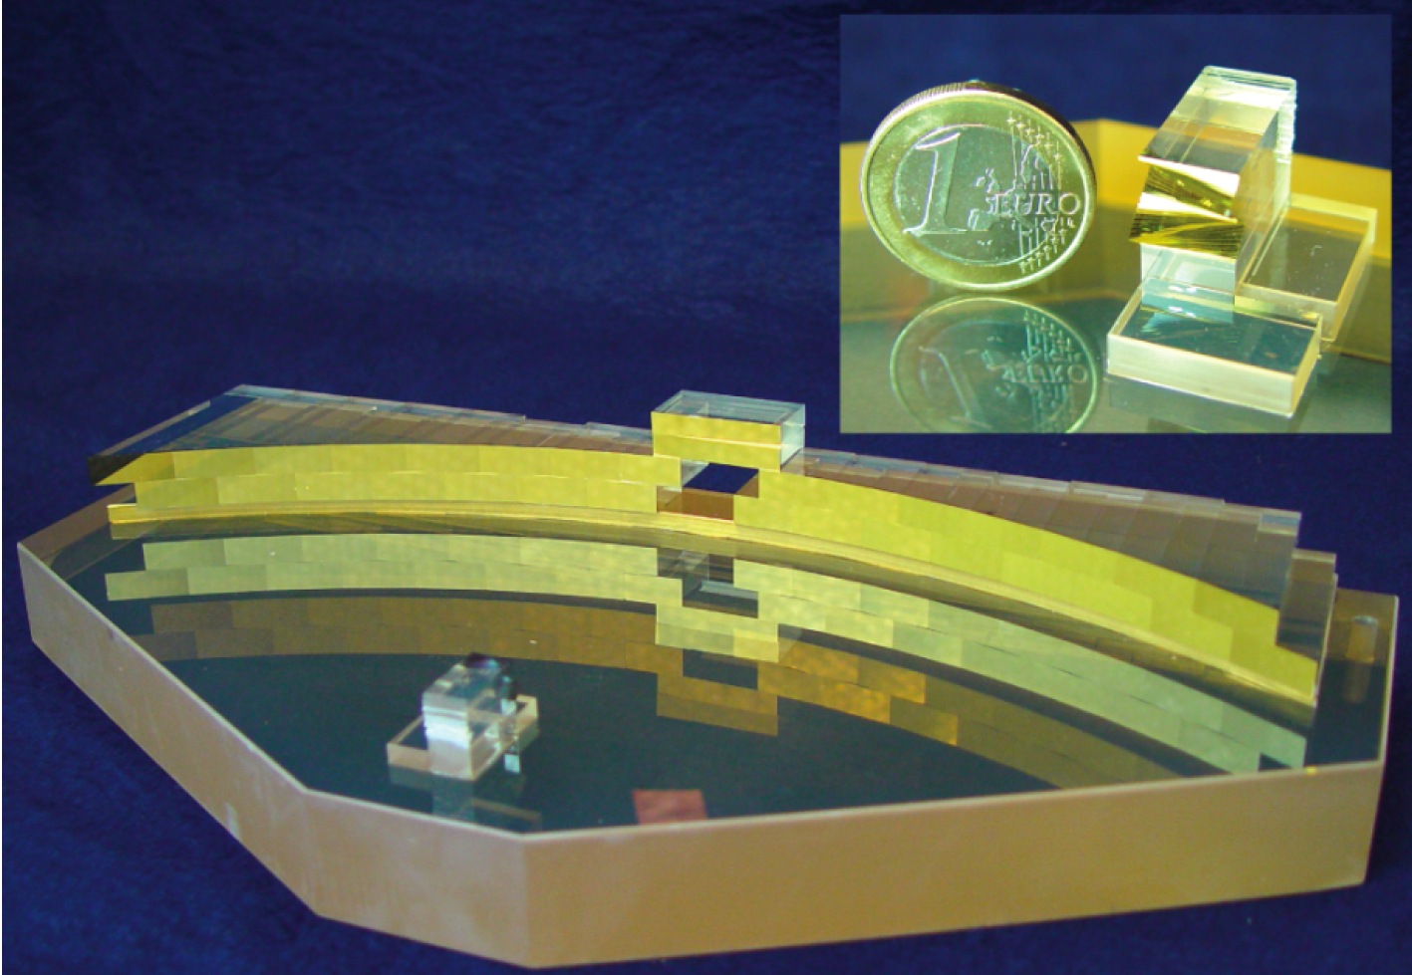

Slide 32
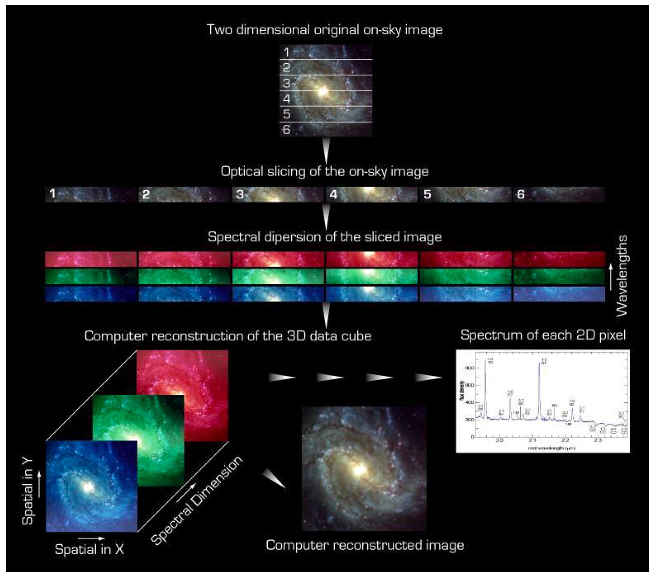
VIMOS IFU

Slide 33
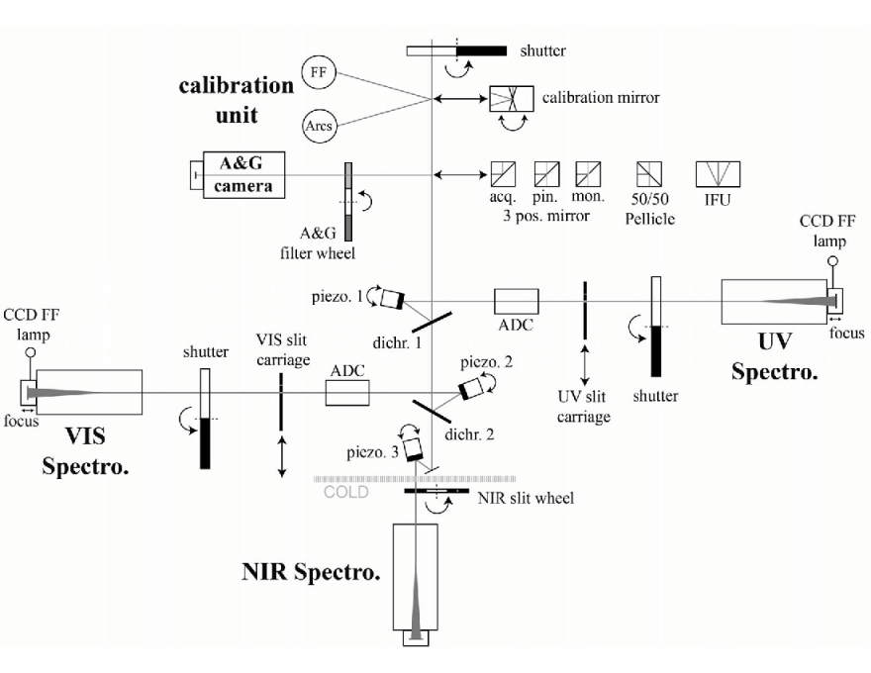
Future VLT spectrographs
X-shooter:
Single-field
Medium resolution
Extreme wavelength range in one shot from 300 nm to 2.5 µm in 3 arms
IFU unit
Already commissioned

Slide 34
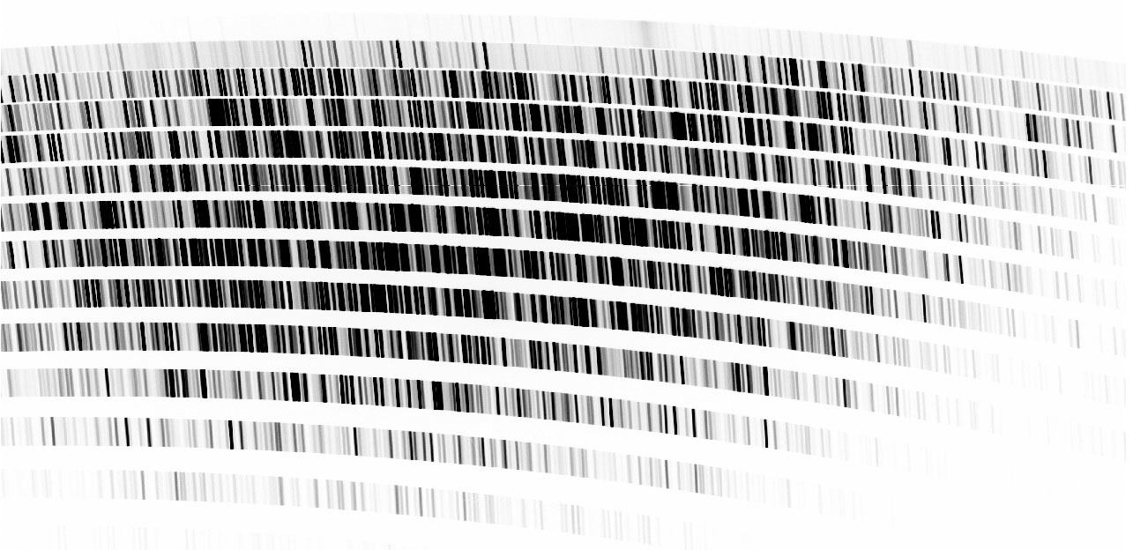
Future VLT spectrographs
X-shooter

Slide 35
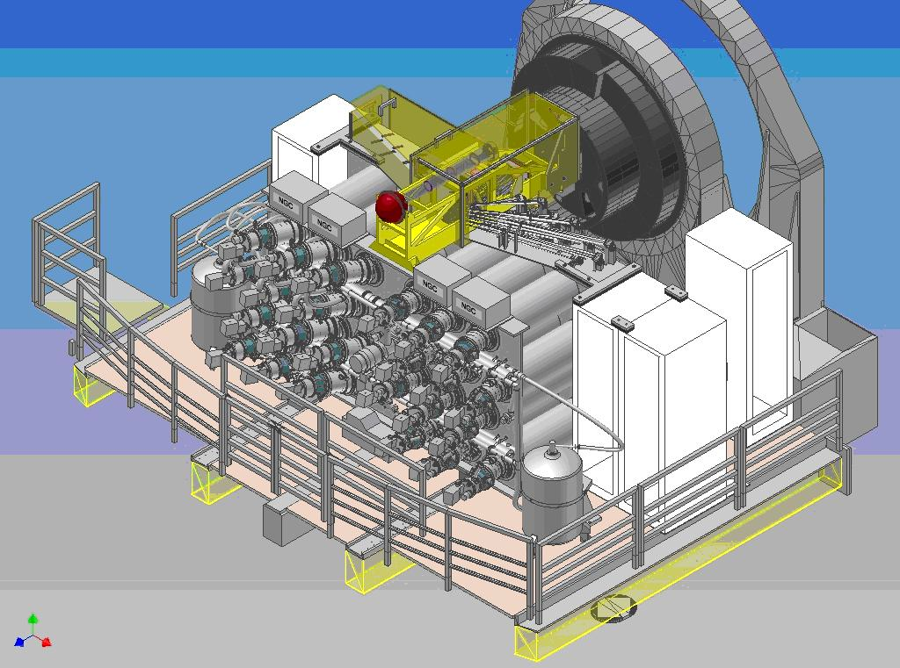
Future VLT spectrographs
MUSE:
AO
IFU with 1’ x 1’ (0,2” sampling) or 7.5” x 7.5” (0,025” sampling)
Array of 24 fields organized in 24 spectrographs
Resolution 2000 – 4000 @ NIR
Available in 2011

Slide 36
Future VLT instruments
Science objectives of MUSE:
Formation of galaxies: high redshift Lyman alpha emitters, flouorescent emission and the cosmic web, reionisation, feedback processes and galaxy formation, ultra-deep surveys using strong gravitational lensing, resolved spectroscopy at intermediate redshifts, Sunyaev-Zeldovich effectlate forming population III objects
Nearby galaxies: supermassive black holes in nearby galaxies, kinematics and stellar populations, interacting galaxies, star formation in nearby galaxies
Stars and resolved stellar populations: early stages of stellar evolution, masive spectroscopy of stellar fields: the Milky Way and the Magellanic Cloudsthe, Local Group and beyond
Solar system: Galilean satellites, Titan surface, heterogeneities of the small bodies, temporal changes in the gas giant planets

Slide 37
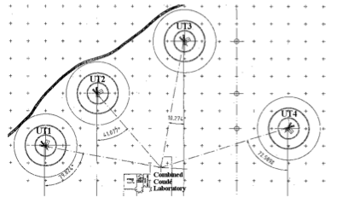
Future VLT spectrographs
ESPRESSO:
No AO
Single field, fiber-fed echelle spectrograph
High spectral resolution (R = 140’000)
Extreme stability for highest RV precision
Uses up to 4 UTs
(first 16-m-equivalent
telescope)
Available in 2014

Slide 38
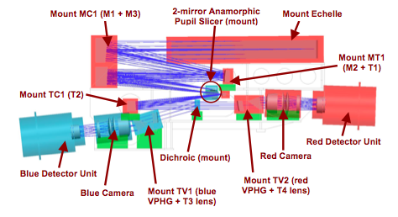
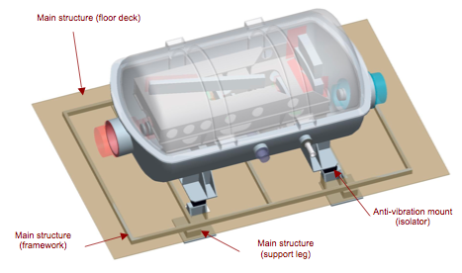
Future VLT spectrographs

Slide 39
Future VLT spectrographs
ESPRESSO Science:
Low-mass and rocky extra-solar planets
Planets around late-type stars
Variability of physical constants
Abundances in near-by galaxies
Etc.

Slide 40
Challenges for ELT spectrographs
Huge telescope -> huge instrumentations (conservation of étendu)
Or, massive adaptive optics (very complex and demanding with increasing telescope size, difficulty increases with D and with ~1/λ
Location of the instruments (trade-off between stability and efficiency)
Costs

