Slide 1
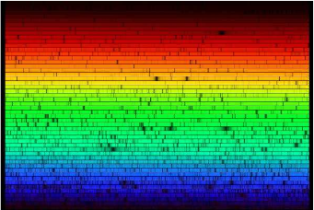
Fondement de l’Astronomie Observationnelle
Instruments and observational techniques – Spectroscopy
F. Pepe
Observatoire de l’Université Genève

Slide 2
Course outline
PART 1 - Principles of spectroscopy
  Fundamental parameters
  Overview of spectrometry methods
PART 2 – ‘Modern’ spectrographs
  ‘Simple’ spectroimager
    FORS
  Echelle spectrographs
    UVES
    CRIRES
PART 3 - Spectroscopy on the VLTs
  Multi-Object spectrographs (MOS) and Intergral-Field Units (IFU) and spectro-imagers
    Giraffe
    VIMOS
    Sinfoni
  Future instruments
    X-shooter
    MUSE
    ESPRESSO

Slide 3
The observables
Propagation of light wave from stable source at infinity:
which is a solution of wave equations if:
c_{n} is the speed of light in a medium with refractive index n = n(k)
Independent observables are:
The distance between two spatial maxima of the light wave in a given medium and at fixed t is called wavelength and results to be:

Slide 4
The observables
Astronomical spectroscopy aims at measuring:
At optical wavelength ν=ω/2π is 10¹⁵ Hz, thus too fast to be resolved by detectors. The observable becomes the (surface) brightness or specific intensity I_{ν} or I_{λ}:

Slide 5
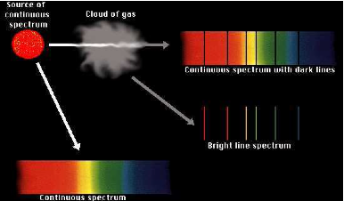
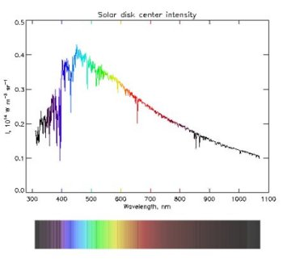
The observables
If we integrate the surface brightness over a given source or sky aperture, we get the spectral flux density F_{ν} or F_{λ} at a given light frequency or wavelength:

Slide 6
Wavelength or frequency?
Frequency (ν, ω), associated to time-evolution of E-field
Fixed location (detect oscillation amplitude as a function of time)
Need for precise clock (time metric)
Need for time resolution (or other tricks, e.g. heterodyne detection)
Wavelength (λ, k), represents light propagation in space
Fixed time (project wave into physical space or spatially separate various spectral components)
Depends on medium ->
Need for precise metrology (space metric) or calibration

Slide 7
Filter spectrometer
Telescope
Filter
Detector (single or array)
Objective
Focal plane

Slide 8
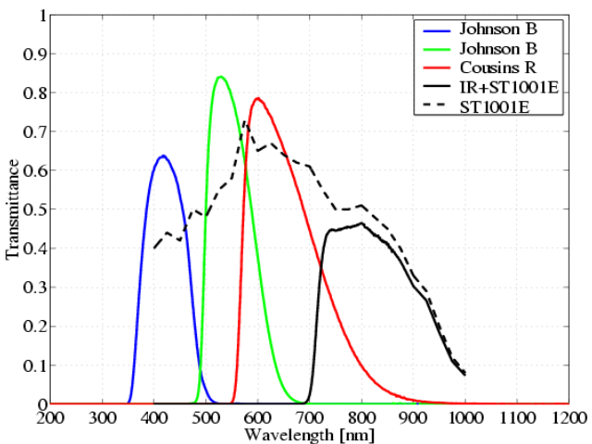
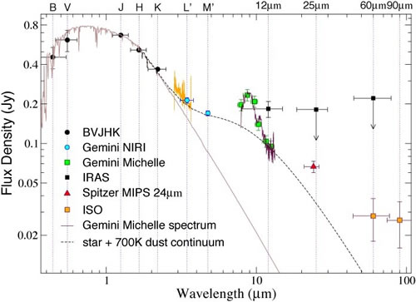
Filter spectrometer
Detector records I_{λ} for a given filter with transmittance t_{c}, central wavelength λ_{c}, and band width Δλ
t_{c}, Δλ and λ_{c} need to be calibrated on standard sources
Appropriate for broad-band spectra
Only one channel per measurement (unless dichroics are used)

Slide 9
Filter spectrometer
Telescope
Objective
Filter 2
Detector (single or array)
Filter 1
Dichroic

Slide 10
Fabry-Pérot spectrometer
Telescope
Fabry-Pérot etalon
Slit
Detector
Focal plane
Collimator
Objective

Slide 11
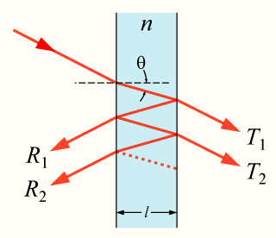
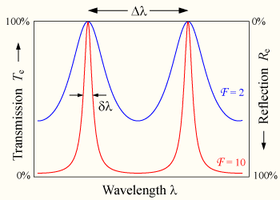
Fabry-Pérot spectrometer
Similar to filter spectrometer, but spacing can be made tunable
Detector records I(λ) as a function of the transmitted wavelength mλ=2l, where m is an integer and enumerates the transmitted order.
Only one spectral channel per measurement
Transmittance and wavelength must be calibrated.
Allows high spectral resolution, if the finesse F or the order m is high. In the latter case, a pre-filtering is required to select only one wavelength (order-selection).

Slide 12
Fabry-Pérot spectrometer
Order-separating filter (e.g. with second FP in 1st order)

Slide 13
Fabry-Pérot spectrometer
Telescope
Fabry-Pérot etalon
Slit
Detector
φ
D
Focal plane
Collimator
Objective
Δ
Real Fabry-Pérot:

Slide 14
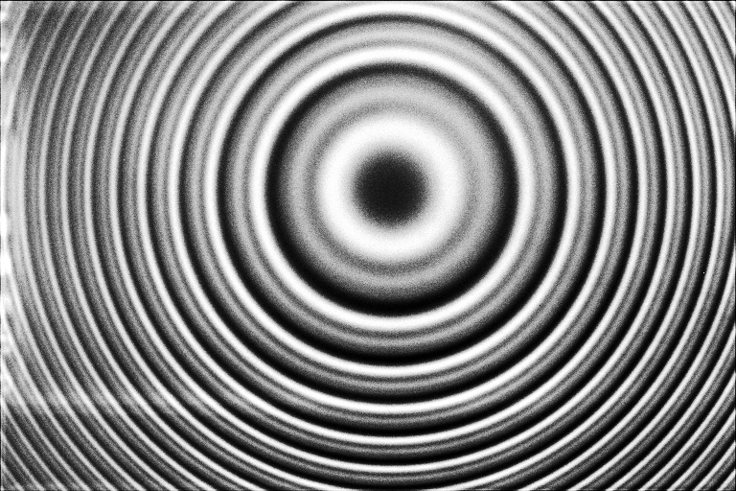
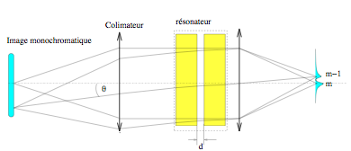
Example of apearture finesse
Transmitted wavelength is unique only for given angle T
If slit is too wide, the aperture (angle cone) is enlarged and the range of transmitted wavelength increased.
The ‘contrast is the reduced, thus the finesse and the spectral resolution

Slide 15
General spectrograph layout
Telescope
Disperser
Slit
Detector
Focal plane
Collimator
Objective
Single detector -> monochromator (may be used with movable part to scan over wavelengths
Array detector -> spectrograph with N wavelength channels (N = number of detectors or pixels)

Slide 16
Dispersers
The disperser separates the wavelengths in angular direction. To avoid angular mixing, the beam is collimated. The disperser is characterized by its angular dispersion:
where β is the deviation angle from the un-dispersed direction

Slide 17
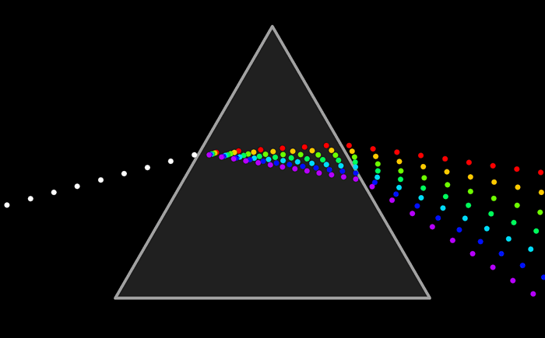
The prism

Slide 18
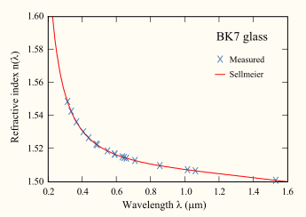
Prism characteristics
-> High transmittance
-> When used at minimum deviation, no anamorphosis (beam dia. compression or enlargement)
-> Produces ‘low’ dispersion
Prism example: BK7 (normal glass), t = 50 mm, D = 100 mm

Slide 19
Prism characteristics
-> Depends mainly on glass material (internal transmittance)
-> Anti-reflection coatings are needed to avoid reflection losses, especially for large apex angles (and large α). The coating must be optimized for the glass and the used angles.
-> Efficiency can be as high as 99%
-> The dispersion increases towards the blue wavelengths. For Crown glasses (contain Potassium) the ratio of the dispersion between blue and red is lower than for Flint glasses (contain lead, titanium dioxide or zirconium dioxide) .

Slide 20
Grating spectrograph
Focal ratios defined as
F_{i} = f_{i} / D_{i}
Camera
Collimator

Slide 21
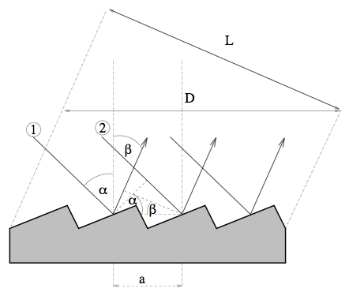
The diffraction grating
Generic grating equation from the condition of positive interference between various ‘grooves’:

Slide 22
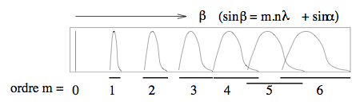
Grating characteristics
-> Several orders result for a given wavelength
-> m = 0 for a grating which acts like a mirror -> no dispersion!
-> Orders overlap spatially -> must be filtered or use at m=1
Typical grating example: m = 1, ρ = 1000 gr/mm, sinα + sinβ = 1, cosβ=1/2
Dispersion typically much higher than for prisms!

Slide 23
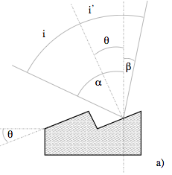
Grism efficiency
Maximum efficiency obtained when specular groove reflection is matches (Blaze condition):

Slide 24
Order overlaps
Effective passband
in 1st order
Don't forget higher orders!
Intensity
1st order
blaze profile
m=1
First and second
orders overlap!
m=2
Passband
in 2nd order
Zero order
matters for MOS
2nd order
blaze profile
Passband
in zero
order
m=0
Wavelength in first order marking position on detector in dispersion direction (if dispersion ~linear)
1st order
0
λ_{L}
λ_{C}
2λ_{L}
λ_{U}
2λ_{U}
(2nd order)
0
λ_{L}
λ_{U}

Slide 25
Resolving power and resolution
Focal ratios defined as
F_{i} = f_{i} / D_{i}
Camera
Collimator

Slide 26
Resolving power and resolution
The objective translates angles into positions on the detector. Each position (pixel) of the detector ‘sees’ a given angle of the parallel (collimated) beam
The collimated beam is never perfectly parallel, because either of the limited diameter of the beam, which produces diffraction δφ = 1.22 λ/D₁, or because of the finite slit, which produces and angular divergence δΘ = s/f_{1.}
The angular divergence is translated into a distance δλ = f₂ δΘ or δλ = f₂ δφ on the CCD. This means that over this distances the wavelengths are mixed (cannot be separated angularly.

Slide 27
Resolving power and resolution
Resolving power is the maximum spectral resolution which can be reached if the slit s = 0 and the angular divergence is limited by diffraction arising from the limited beam diameter. For a given Dispersion D we get the resolving power:
Spectral resolution is the effective spectral resolution which is finally reached when assuming a finite slit s. For a given Dispersion D we get the spectral resolution:

Slide 28
Conservation of the ‘étendue’
The étendue is defined as E=A x O, where A is the area of the beam at a given optical surface and O is the solid angle under which the beam passes through the surface.
When following the optical path of the beam through an optical system, E is constant, in particular, it cannot be reduced
For a telescope, E is the product of the primary mirror surface and the two-dimensional field (in sterad) transmitted by the optical system. Normally, the transmitted field is defines a slit width. When entering spectrograph, the slit x beam aperture at the slit is equal to the etendue E of the telescope. This implies that at fixed spectral resolution, the slit width and the beam diameter cannot be chosen independently, since dΘ depends on both.

Slide 29
Other dispersers
Grisms
VPHG
Echelle grating

Slide 30
Grisms
Transmission grating attached to prism
Allows in-line optical train:
  simpler to engineer
  quasi-Littrow configuration - no variable anamorphism
Inefficient for ρ > 600/mm due to groove shadowing and other effects

Slide 31
Grism equations
Modified grating equation:
Undeviated condition:
  n'= 1, β = −α = φ
Blaze condition: θ = 0 ⇒ λ_{B} = λ_{U}
Resolving power
(same procedure as for grating)
θ = phase difference from centre of one ruling to its edge

Slide 32
Volume Phase Holographic gratings
So far we have considered surface relief gratings
An alternative is VPH in which refractive index varies harmonically throughout the body of the grating:
Don't confuse with 'holographic' gratings (SR)
Advantages:
  Higher peak efficiency than SR
  Possibility of very large size with high ρ
  Blaze condition can be altered (tuned)
  Encapsulation in flat glass makes more robust
Disadvantages
  Tuning of blaze requires bendable spectrograph!
  Issues of wavefront errors and cryogenic use

Slide 33
VPH configurations
Fringes = planes of constant n
Body of grating made from Dichromated Gelatine (DCG) which permanently adopts fringe pattern generated holographically
Fringe orientation allows operation in transmission or reflection

Slide 34
VPH equations
Modified grating equation:
Blaze condition:
= Bragg diffraction
Resolving power:
Tune blaze condition by tilting grating (α)
Collimator-camera angle must also change by 2α ⇒ mechanical complexity

Slide 35
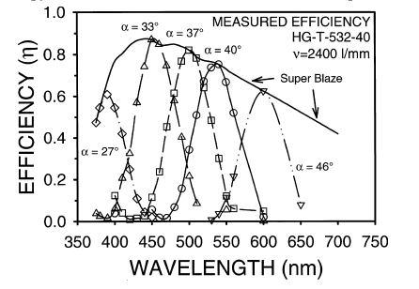
VPH efficiency
Kogelnik's analysis when:
Bragg condition when:
Bragg envelopes (efficiency FWHM):
  in wavelength:
  in angle:
Broad blaze requires
  thin DCG
  large index amplitude
Superblaze
Barden et al. PASP 112, 809 (2000)

Slide 36
Resolving power and resolution
The objective translates angles into positions on the detector. Each position (pixel) of the detector ‘sees’ a given angle of the parallel (collimated) beam
The collimated beam is never perfectly parallel, because either of the limited diameter of the beam, which produces diffraction δφ = 1.22 λ/D₁, or because of the finite slit, which produces and angular divergence δΘ = s/f_{1.}
The angular divergence is translated into a distance δλ = f₂ δΘ or δλ = f₂ δφ on the CCD. This means that over this distances the wavelengths are mixed (cannot be separated angularly.

Slide 37
Resolving power and resolution
Resolving power is the maximum spectral resolution which can be reached if the slit s = 0 and the angular divergence is limited by diffraction arising from the limited beam diameter. For a given Dispersion D we get the resolving power:
Spectral resolution is the effective spectral resolution which is finally reached when assuming a finite slit s. For a given Dispersion D we get the spectral resolution:

Slide 38
Example of spectrographs
Basic Parameters
Telescope diameter: D_{T}
Source/seeing/slit: s_{sky}
Collimated beam of the spectrograph: D₁
Other parameters:
Telescope focal length: f_{T}
Telescope F-number (focal ratio): F_{T} = F = f_{T}/D_{T}
Physical slit/fiber width: s = f_{T} x s_{sky}
Collimator focal length: f₁
Objective focal length: f₂

Slide 39
Grating spectrograph
Focal ratios defined as
F_{i} = f_{i} / D_{i}
Camera
Collimator

Slide 40
Example of simple spectrographs
Spectral resolution:
where

Slide 41
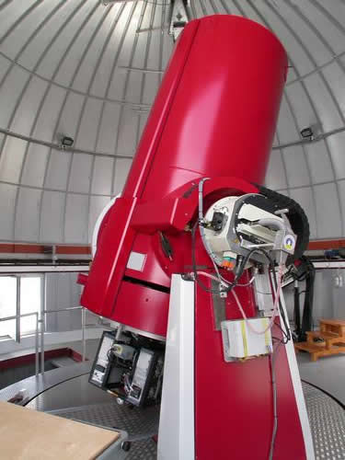
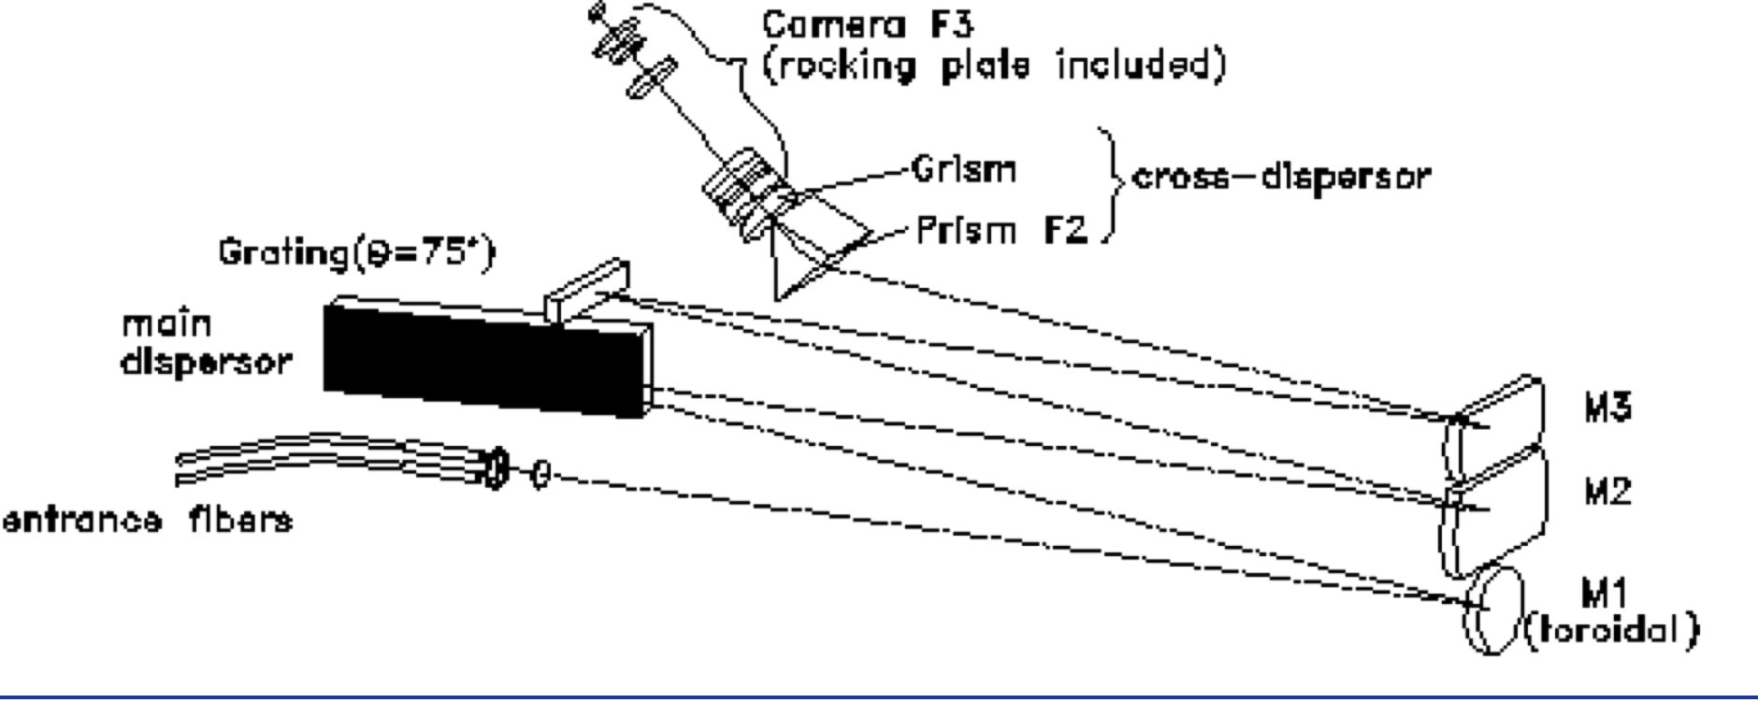
Example of ‘simple’ spectrographs
Coralie@Euler:
Telescope diameter: D_{T} = 1.2 m
Source/seeing/slit: s_{sky} = 1 arcsec
Collimated beam of the spectrograph: D₁ = 75 mm

Slide 42
Example of ‘simple’ spectrographs
With prism: BK7 (normal glass), t = 50 mm
With grism: m = 1, ρ = 150 gr/mm, cosβ=1

Slide 43
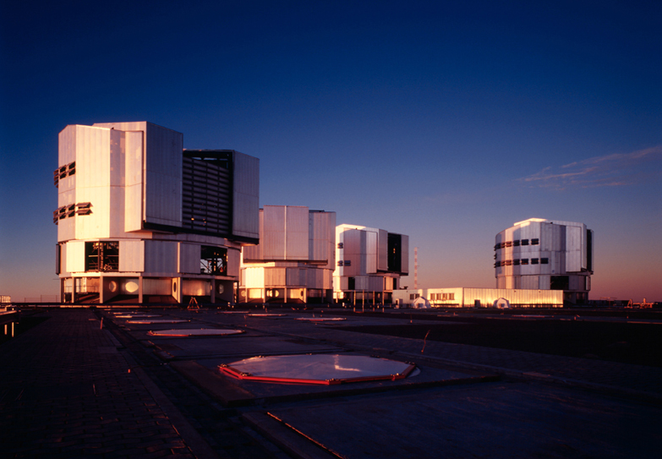
FORS@VLT

Slide 44
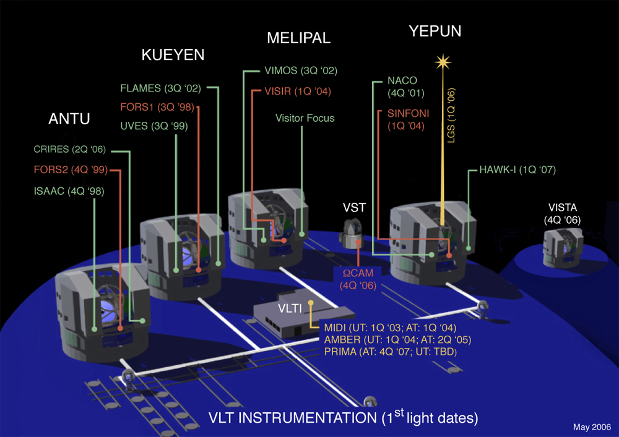
FORS@VLT

Slide 45
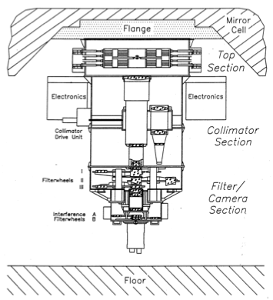
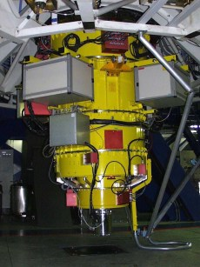
FORS@VLT

Slide 46
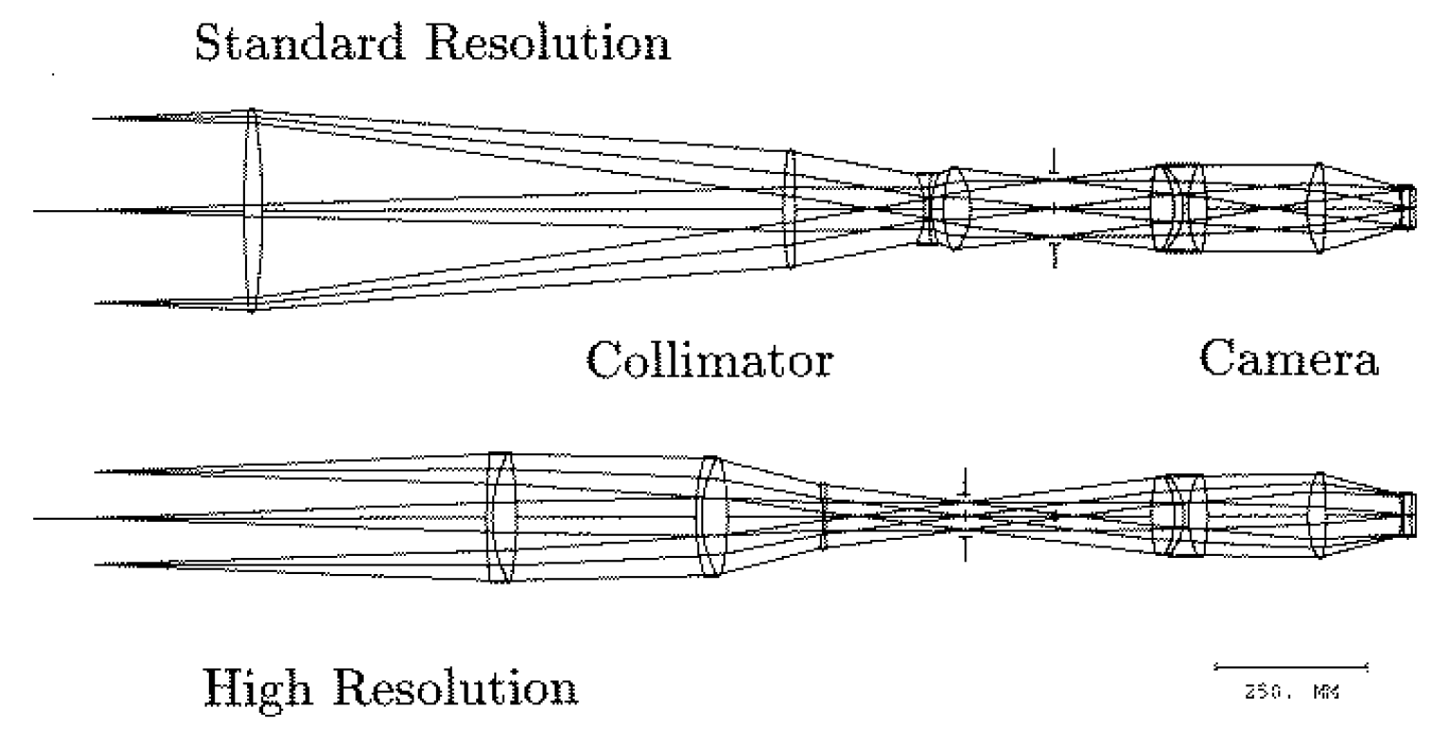
FORS@VLT

Slide 47
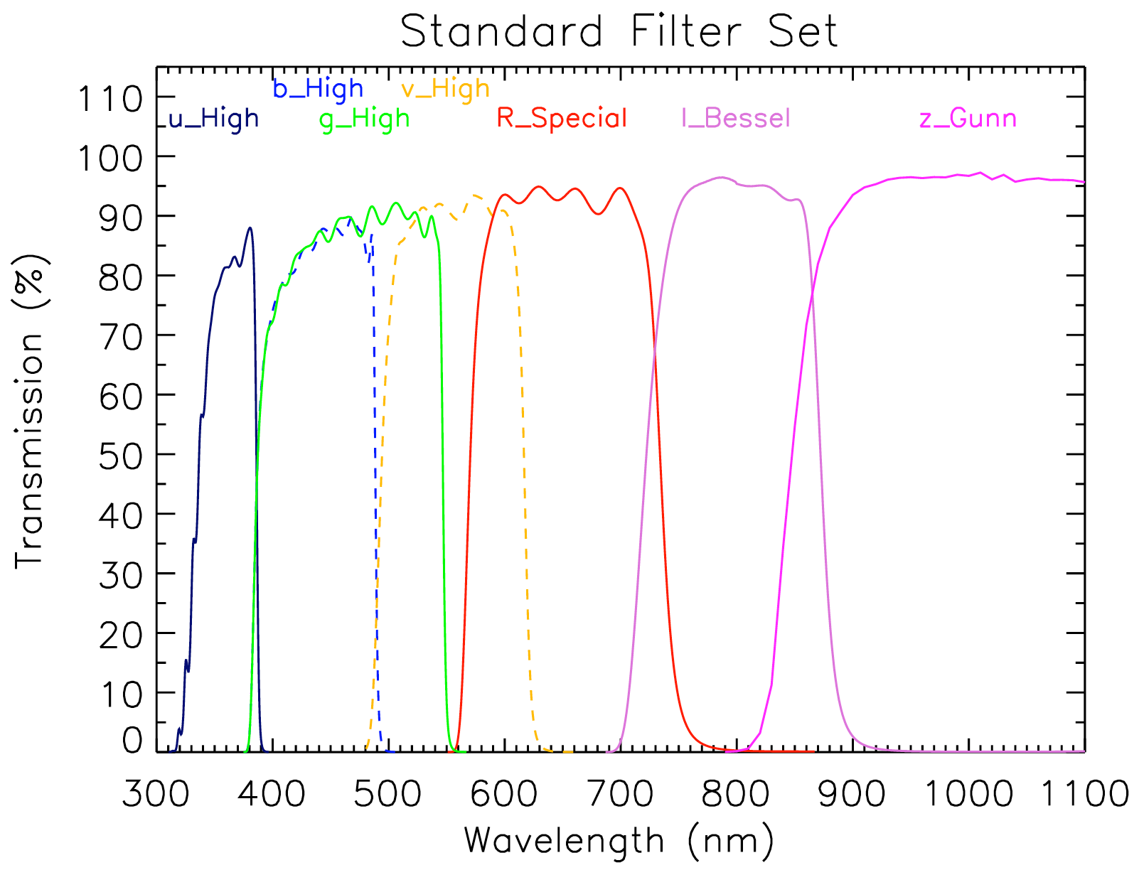
FORS: Filter mode

Slide 48
FORS: Grism mode
Grisms from 150 gr/mm to 1400 gr/mm
Spectroscopic modes
  ‘slitless’ MOS mode (R is given by seeing)
  Mask with up to 9 ‘long slits’ of 0.3” x 6.8’
  Up to 19 movable ‘slitlets’ of 0.3” x 22.5”
  MOS-MXU: Laser-cut masks (any format)
Spectral resolution depends on grism dispersion and slit width in dispersion direction.

Slide 49
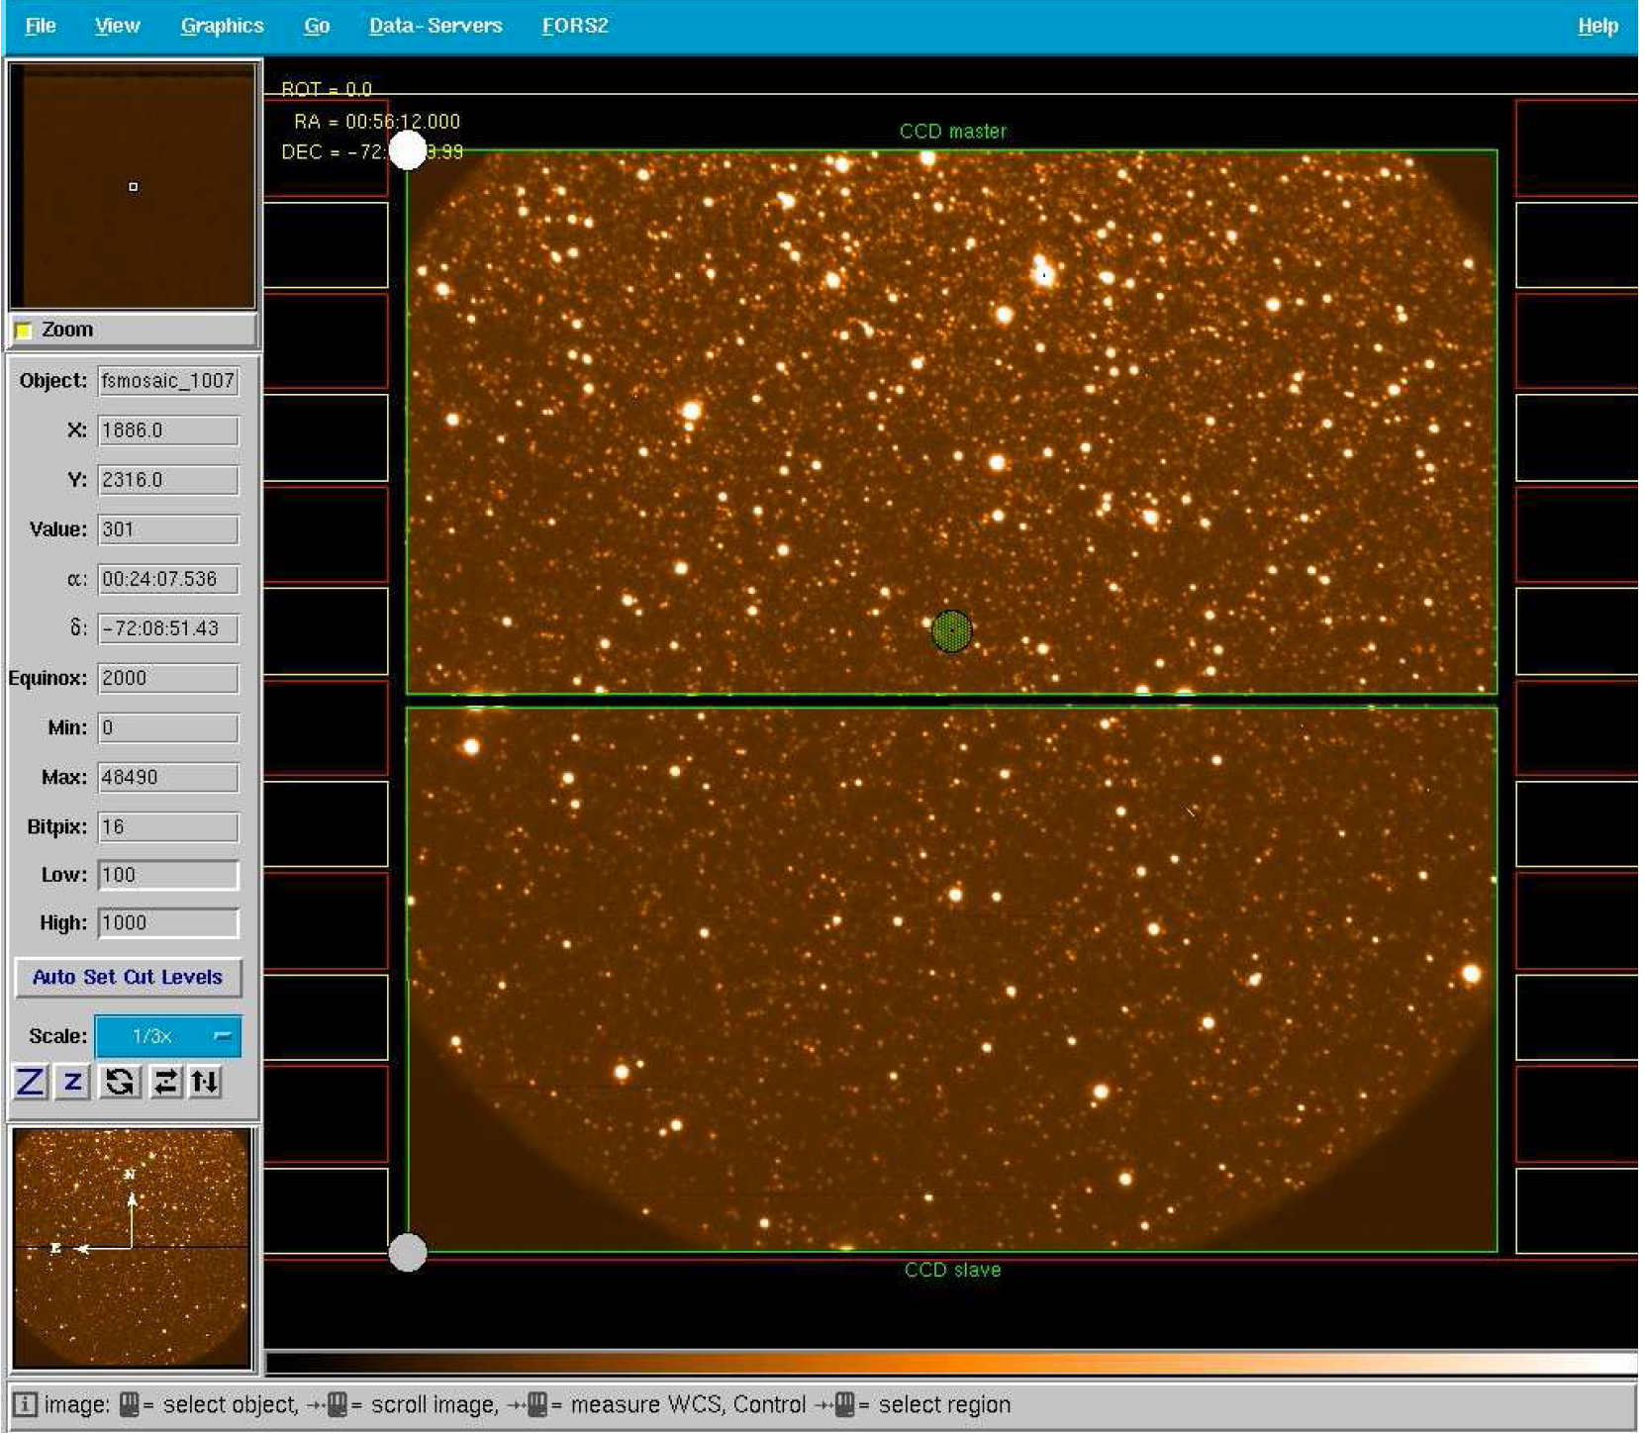
FORS: Grism mode
Movable slilets (localized sourcess in ‘crowded fields)
Long slit (extended sources, 1-D image + spectrum)

Slide 50
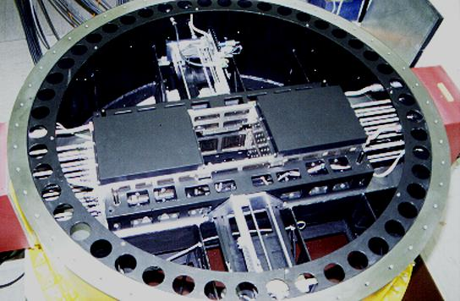
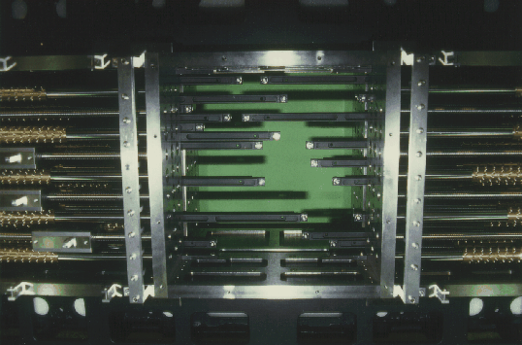
FORS: MOS mode

Slide 51
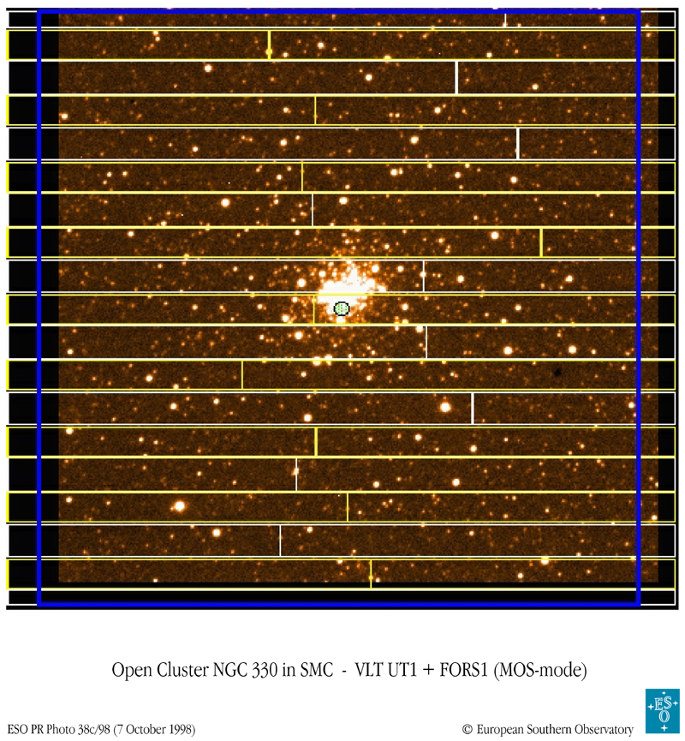
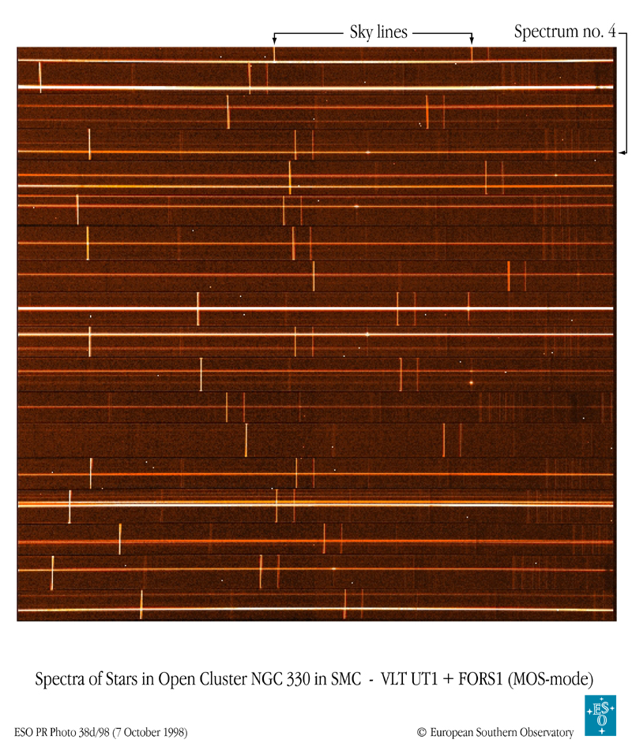
FORS@VLT

Slide 52
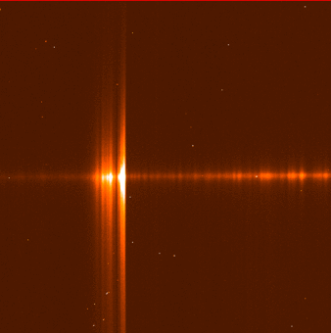
FORS@VLT
This image shows the first spectrum obtained of the comet 1995 Q1. The spectral coverage extends from about 3650 Angstrom (left) to 4100 Angstrom (right) in the violet region. The spectrograph slit was oriented along the main tail at position angle ~ 145 degrees. The total slit length was 5.6 arcminutes. The spectrum is typical for a comet at Comet Bradfield's current distance from the Sun (0.5 A.U., or about 75 million kilometres).

Slide 53
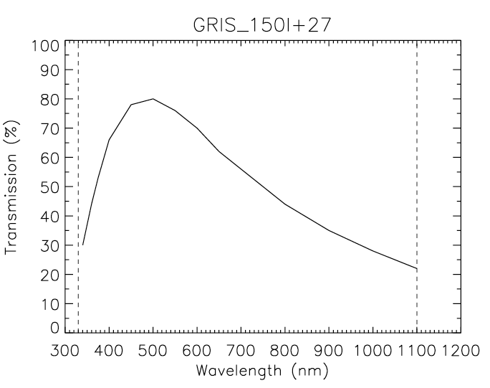
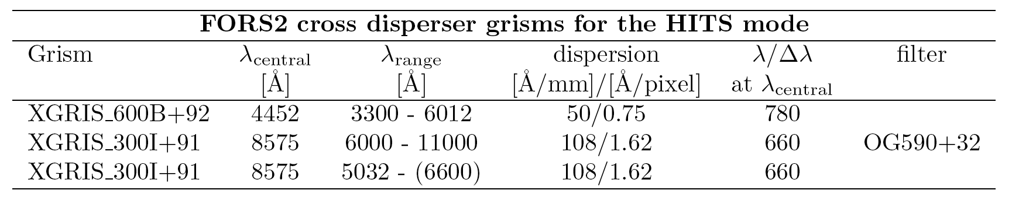
FORS: Spectral resolution
Telescope diameter: D_{T} = 8.2 m
Source/seeing/slit: s_{sky} = 0.3 arcsec
Collimated beam : D₁ = 125 mm
With grism: m = 1, ρ = 1400 gr/mm, cosβ=1

Slide 54
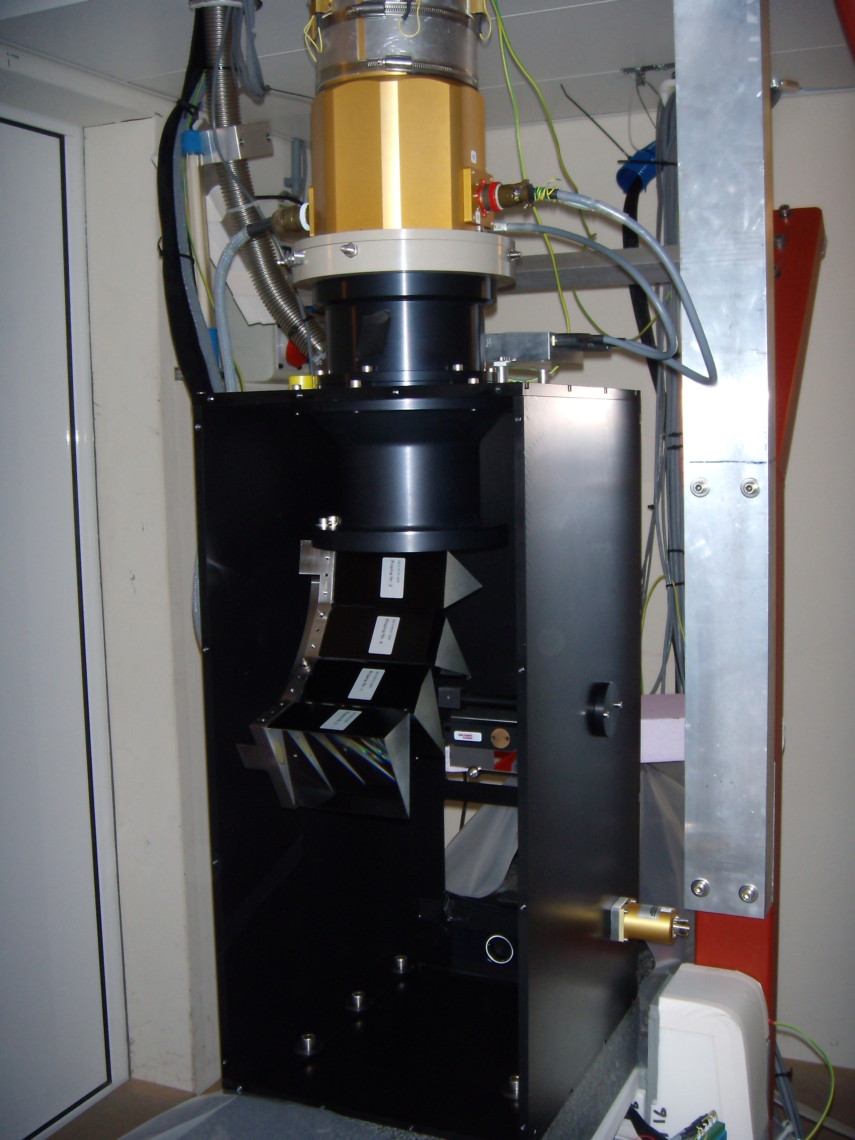
Example of ‘simple’ spectrographs
With single prisms resolution remains small
Possibility to increase dispersion by adding up several prisms
With gratings or grisms, the spectral resolution is up to several 1000 but still modest.
Other ‘tricks’ required

Slide 55
Echelle grating
Increase dispersion of the ordinary greating by increasing the difference between entrance and exit angle
The use in Littrow condition will make the mounting symmetric and maximize α + β, since a is set equal to β: α = β
Use in blaze condition for maximum efficiency: Groove angle γ = β

Slide 56
Echelle grating
From the grating equation we derive the dispersion law of an echelle grating:
Example: R = 4 grating:

Slide 57
Characteristics of Echelle grating
High dispersion -> high resolution
Spectrum becomes VERY long and efficiency drops because of blaze function
Alternative: use at high order, e.g. m = 100 (ρ = 30 gr/mm)
-> Orders overlap spacially and must be separated (filtering, pre-dispersion or cross-dispersion)
Free spectral range:
Numbers of orders for full ‘octave’:

Slide 58
Multiple orders
Many orders to cover desired λλ: Free spectral range
F_{λ}= λ/m
Orders lie on top of each other:
λ(m) = λ(n)× (n/m)
Solution:
  use narrow passband filter to isolate one order at a time
  cross-disperse to fill detector with many orders at once
Blaze condition fulfilled
Cross dispersion may use prisms or low dispersion grating

Slide 59
Monochromatic image of the slit
Cross dispersion (prism, grism, grating) ->
Main dispersion (echelle grating) ->

Slide 60
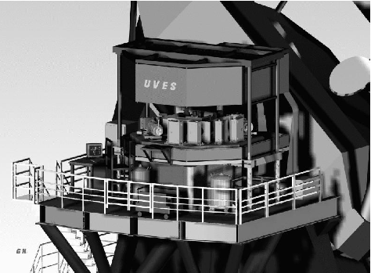
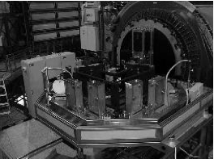
UVES@VLT

Slide 61
UVES@VLT

Slide 62
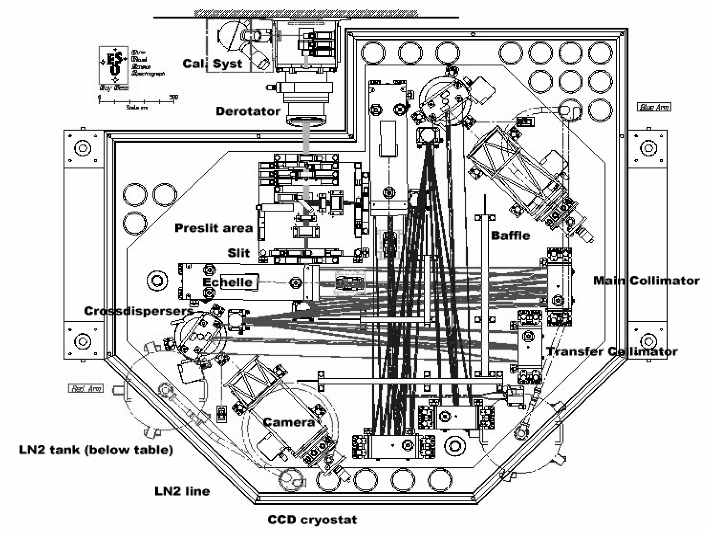
UVES@VLT

Slide 63
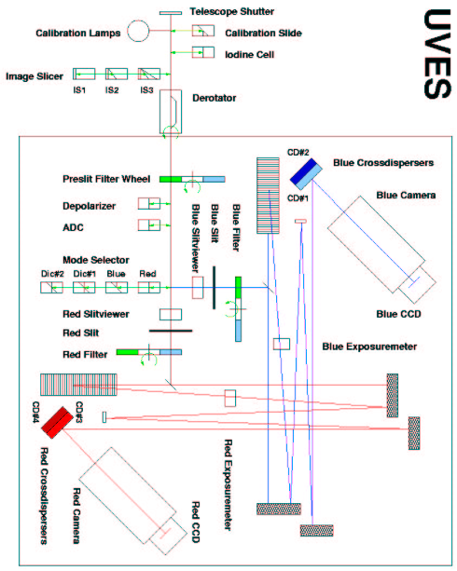
Coralie@Euler

Slide 64
UVES@VLT

Slide 65
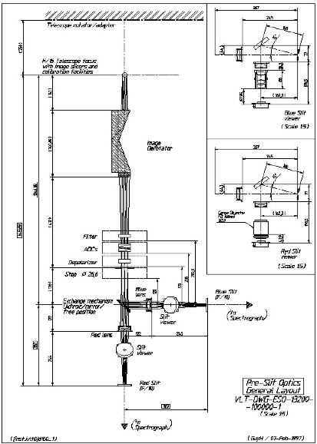

Slide 66
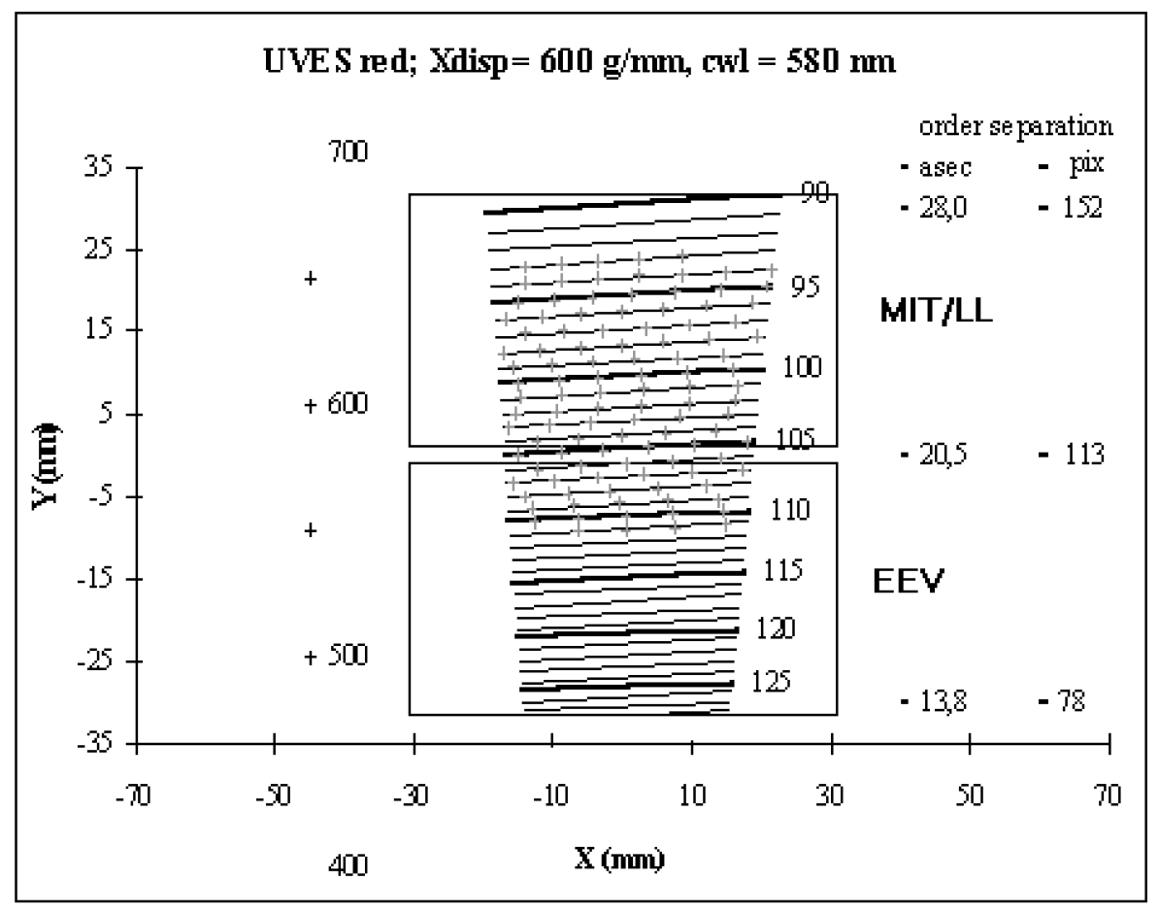
UVES: Spectral format

Slide 67
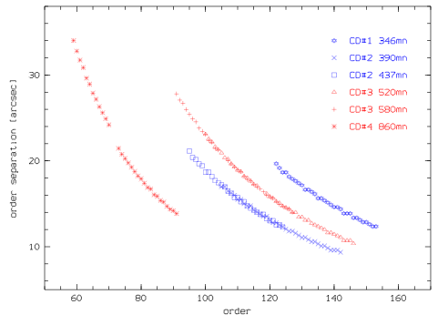
UVES: Order separation

Slide 68
UVES: Spectral resolution
Telescope diameter: D_{T} = 8.2 m
Source/seeing/slit: s_{sky} = 0.3 arcsec
Collimated beam of the spectrograph: D₁ = 200 mm
Echelle grating: R4 -> tanβ = 4, D₁ = 200 mm

Slide 69
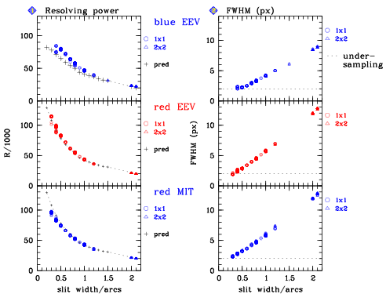
UVES: Sampling and resolution

Slide 70

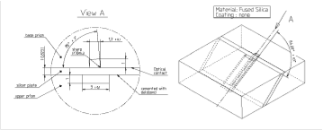
UVES: Image slicer ‘trick’
Long slit
Image slicer
Increase of efficiency at give R, or vice versa

Slide 71
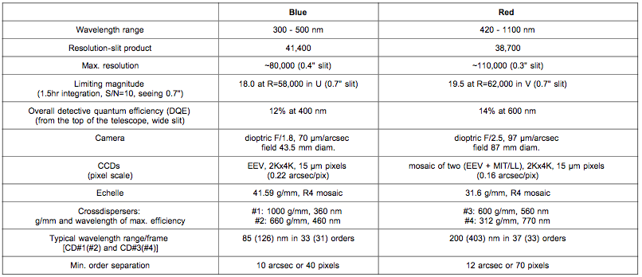
UVES params

Slide 72
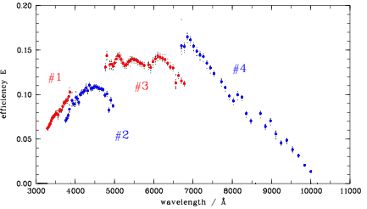
UVES: Efficiency

Slide 73
CRIRES@VLT

Slide 74
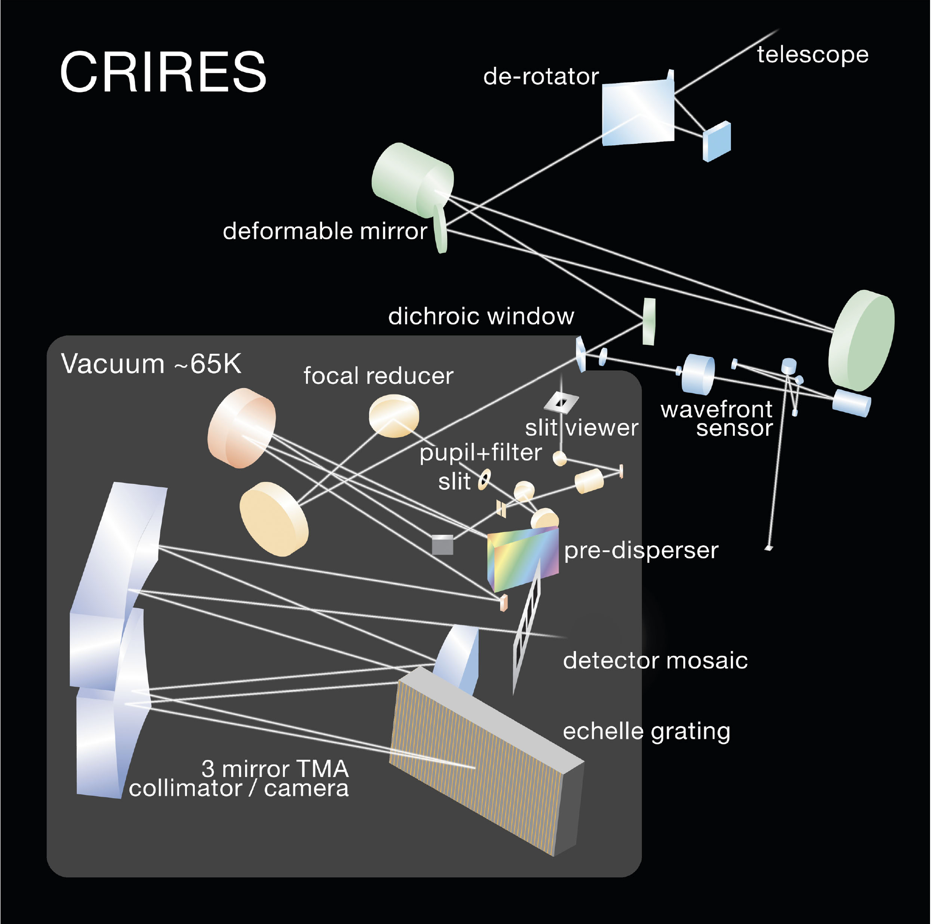
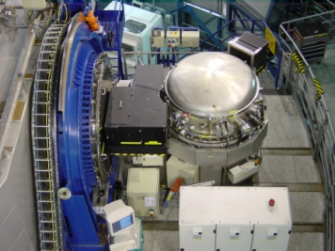
CRIRES@VLT
Same as UVES, but:
For IR (λ = 1 – 5.4 µm)
Can use adaptive optics
Cryogenics needed
No cross-disperser. Only 1 order at a time! -> Pre-disperser

Slide 75
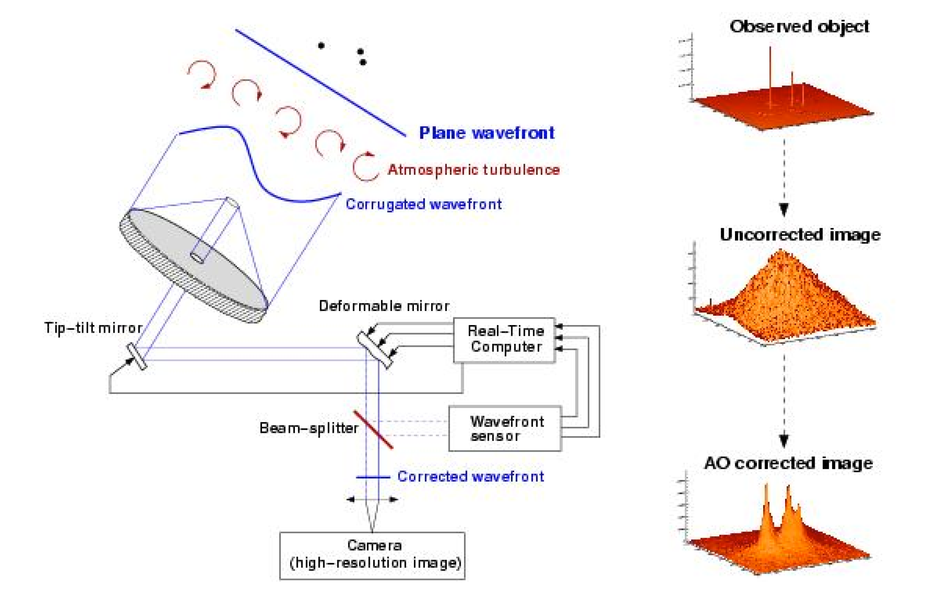
CRIRES@VLT, AO

Slide 76
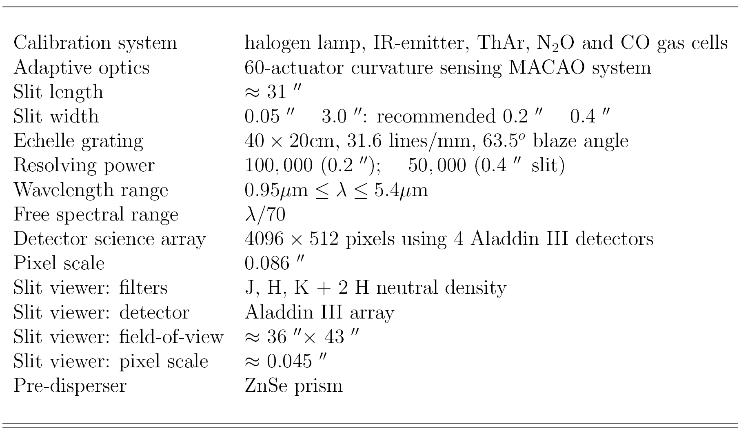
CRIRES: Characteristics

Slide 77
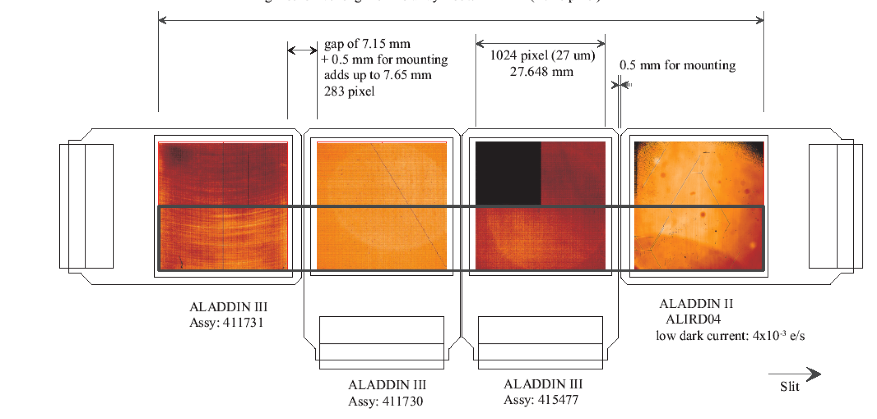
CRIRES: Spectral format

Slide 78
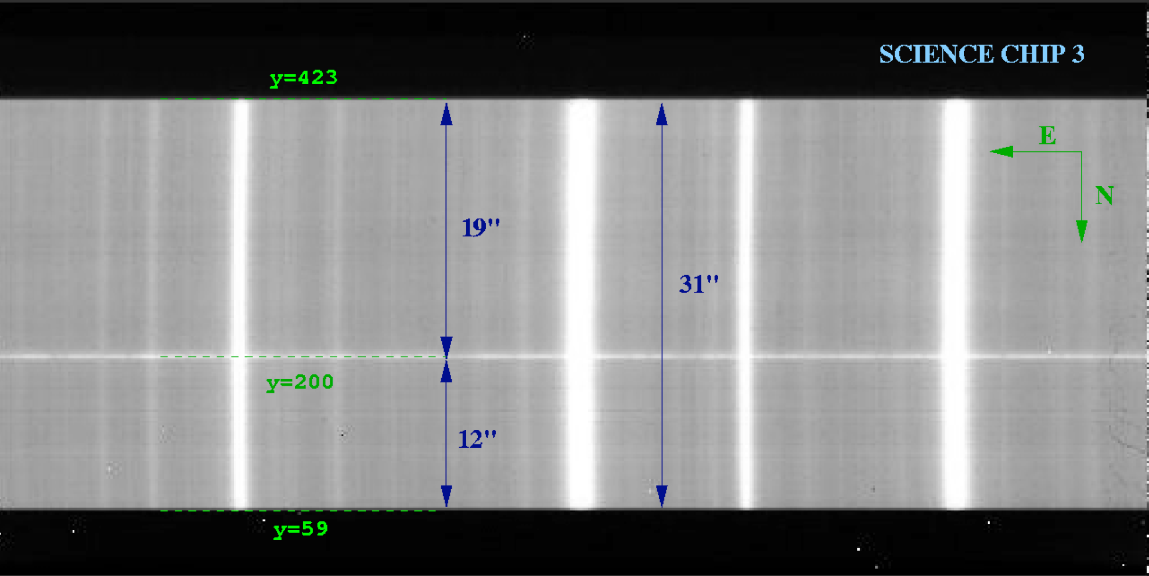
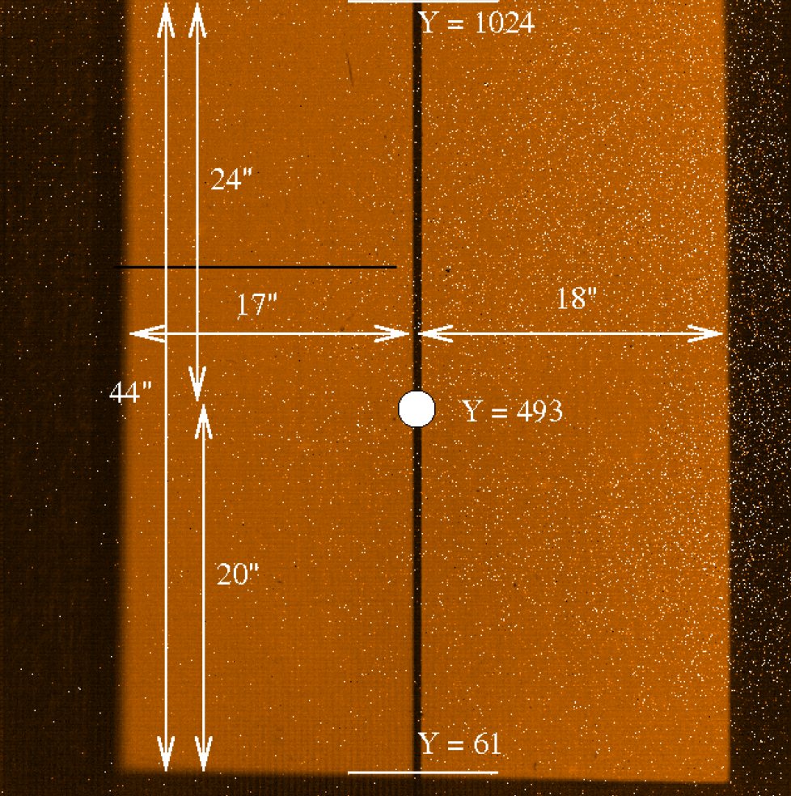
CRIRES: Long slit

Slide 79
CRIRES@VLT
Peculiarities of the IR domain:
Detector technology (no Si-CCDs, behavior less ‘ideal’ in terms of noise, flat-field stability, etc.)
Thermal and sky back-ground -> remove e.g. by ‘nodding’ over long slit and put instrument ‘cold’
Atmospheric absorption and emission features
Advantage: Use of adaptive optics to reduce slit width.

Slide 80

CRIRES@VLT

Slide 81


Slide 83
Flames@VLT

Slide 84
Flames – various links
Mode Number of Buttons Fibers per Buttons Sky Buttons Total fibers
UVES 8 1 - 8
Medusa 132 1 - 132
IFU 15 20 15 315
ARGUS 1 14x22 (-8) 15 315
UVES
Giraffe

Slide 85

Flames – UVES link
Mode Number of Buttons Fibers per Buttons Sky Buttons Total fibers
UVES 8 1 - 8
Medusa 132 1 - 132
IFU 15 20 15 315
ARGUS 1 14x22 (-8) 15 315

Slide 86

Flames – UVES link
Mode Number of Buttons Fibers per Buttons Sky Buttons Total fibers
UVES 8 1 - 8
Medusa 132 1 - 132
IFU 15 20 15 315
ARGUS 1 14x22 (-8) 15 315

Slide 87

Flames – Giraffe

Slide 88


Flames – MEDUSA
Mode Number of Buttons Fibers per Buttons Sky Buttons Total fibers
UVES 8 1 - 8
Medusa 132 1 - 132
IFU 15 20 15 315
ARGUS 1 14x22 (-8) 15 315

Slide 89

Flames – MEDUSA
OzPoz fiber positioner

Slide 90

Flames – MEDUSA
Mode Number of Buttons Fibers per Buttons Sky Buttons Total fibers
UVES 8 1 - 8
Medusa 132 1 - 132
IFU 15 20 15 315
ARGUS 1 14x22 (-8) 15 315

Slide 91


Flames – IFU
Mode Number of Buttons Fibers per Buttons Sky Buttons Total fibers
UVES 8 1 - 8
Medusa 132 1 - 132
IFU 15 20 15 315
ARGUS 1 14x22 (-8) 15 315

Slide 92

Flames
– IFU

Slide 93

Flames – ARGUS
Mode Number of Buttons Fibers per Buttons Sky Buttons Total fibers
UVES 8 1 - 8
Medusa 132 1 - 132
IFU 15 20 15 315
ARGUS 1 14x22 (-8) 15 315

Slide 94

Flames – ARGUS
Mode Number of Buttons Fibers per Buttons Sky Buttons Total fibers
UVES 8 1 - 8
Medusa 132 1 - 132
IFU 15 20 15 315
ARGUS 1 14x22 (-8) 15 315

Slide 95



Flames – ARGUS

Slide 96

Flames – Summary

Slide 97

Flames – Summary
Field
Slit
Spectrum
Single field
MOS
IFU

Slide 98
VIMOS@VLT

Slide 99

VIMOS@VLT

Slide 100
VIMOS - Modes
IMG: Imaging is possible in UBVRIz filters in a 4 x 7' x 8' field of view.
MOS: Multi-object spectroscopy is carried out using masks (one per quadrant) prepared in Paranal using a laser cutting Mask Manufacturing Unit. Depending on the grism used, the spectral resolution varies from 200 to 2500, and the observable range is from 360 to 1000 nm. The maximum number of slits per mask (quadrant) varies from ~40 at R=2500 to ~150-200 at R=200, for a field of view of 4 x 7' x 8'. (like FORS)
IFU: VIMOS is also equipped with an integral field unit made of 6400 fibers. The scale on the sky can be changed from 0.67" per fiber to 0.33" per fiber and the integral field unit can cover up 13"x 13" up to 54"x54" on sky depending on spectral resolution and spatial magnification. Spectral resolution and coverage are similar to MOS. (like Flames-Argus)

Slide 101


VIMOS instrument

Slide 102

VIMOS instrument

Slide 103

VIMOS MOS

Slide 104



VIMOS IFU

Slide 105
Sinfoni@VLT

Slide 106

Sinfoni@VLT
Infrared spectrograph (SPIFFI)
Dispersion grating
Cryogenic instrument
Adaptive optics (SINFONI)
-> ‘Small’ instrument
-> enhance faint objects wrt to IR background
IFU module

Slide 107
Sinfoni@VLT
SINFONI is a near-infrared (1.1 - 2.45 μm) integral field spectrograph fed by an adaptive optics module. The spectrograph operates with 4 gratings (J, H, K, H+K) providing a spectral resolution around 2000, 3000, 4000 in J, H, K, respectively, and 1500 in H+K - each wavelength band fitting fully on the 2048 pixels of the Hawaii 2RG (2kx2k) detector in the dispersion direction. The SINFONI field of view on the sky is sliced into 32 slices. The pre-slit optics allows to chose the width of the slices. The choices are 250mas, 100mas and 25mas, leading to field of views on the sky of 8"x8", 3"x3", or 0.8"x0.8" respectively. Each one of the 32 slitlets is imaged onto 64 pixels of the detector. Thus one obtains 32x64 spectra of the imaged region on the sky.

Slide 108

Sinfoni@VLT

Slide 109


Spiffi’s IFU

Slide 110


Slide 111

VIMOS IFU

Slide 112

Future VLT spectrographs
X-shooter:
Single-field
Medium resolution
Extreme wavelength range in one shot from 300 nm to 2.5 µm in 3 arms
IFU unit
Already commissioned

Slide 113

Future VLT spectrographs
X-shooter

Slide 114

Future VLT spectrographs
MUSE:
AO
IFU with 1’ x 1’ (0,2” sampling) or 7.5” x 7.5” (0,025” sampling)
Array of 24 fields organized in 24 spectrographs
Resolution 2000 – 4000 @ NIR
Available in 2011

Slide 115
Future VLT instruments
Science objectives of MUSE:
Formation of galaxies: high redshift Lyman alpha emitters, flouorescent emission and the cosmic web, reionisation, feedback processes and galaxy formation, ultra-deep surveys using strong gravitational lensing, resolved spectroscopy at intermediate redshifts, Sunyaev-Zeldovich effectlate forming population III objects
Nearby galaxies: supermassive black holes in nearby galaxies, kinematics and stellar populations, interacting galaxies, star formation in nearby galaxies
Stars and resolved stellar populations: early stages of stellar evolution, masive spectroscopy of stellar fields: the Milky Way and the Magellanic Cloudsthe, Local Group and beyond
Solar system: Galilean satellites, Titan surface, heterogeneities of the small bodies, temporal changes in the gas giant planets

Slide 116

Future VLT spectrographs
ESPRESSO:
No AO
Single field, fiber-fed echelle spectrograph
High spectral resolution (R = 140’000)
Extreme stability for highest RV precision
Uses up to 4 UTs
(first 16-m-equivalent
telescope)
Available in 2014

Slide 117


Future VLT spectrographs

Slide 118
Future VLT spectrographs
ESPRESSO Science:
Low-mass and rocky extra-solar planets
Planets around late-type stars
Variability of physical constants
Abundances in near-by galaxies
Etc.

Slide 119
Challenges for ELT spectrographs
Huge telescope -> huge instrumentations (conservation of étendu)
Or, massive adaptive optics (very complex and demanding with increasing telescope size, difficulty increases with D and with ~1/λ
Location of the instruments (trade-off between stability and efficiency)
Costs

