Slide 1
Astronomie et astrophysique pour physiciens
CUSO 2012
Instruments and observational techniques – Image formation
F. Pepe
Observatoire de l’Université Genève
F. Courbin and P. Jablonka, EPFL

Slide 2
The observables
Propagation of light wave from stable source at infinity:
which is a solution of wave equations if:
c_{n} is the speed of light in a medium with refractive index n = n(k)
Independent observables are:
The distance between two spatial maxima of the light wave in a given medium and at fixed t is called wavelength and results to be:

Slide 3
The observables
Astronomical spectroscopy aims at measuring:
At optical wavelength ν=ω/2π is 10¹⁵ Hz, thus too fast to be resolved by detectors. The observable becomes the (surface) brightness or specific intensity I_{ν} or I_{λ}:

Slide 4
The observables
Morphology: I(α,δ) and dI/dt(α,δ)
  Source geometry and dynamics
  Time variations
  Interactions by gravity and radiation
  Cosomology
Imaging

Slide 5
Imaging
Galileo Galilei, 1609

Slide 6
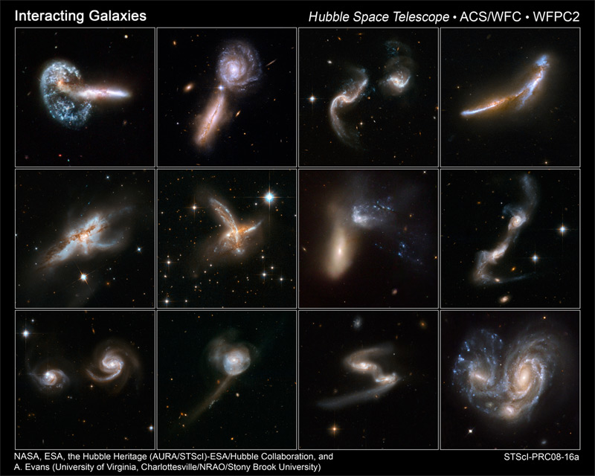
Imaging

Slide 7
The observables
Intensity/flux: I_{α,δ}(t) and dI_{α,δ}(t)/dt
  Variability due to physics or perturbing obejct
  Periodic events
  Luminosity/distance/mass (‘standard candle’)
Photometry

Slide 8
Photometry

Slide 9
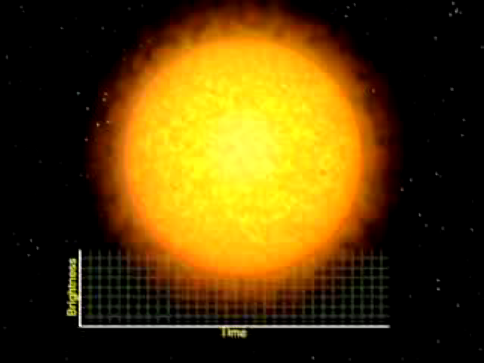
Photometry

Slide 10
The observables
Polarisation: I_{P,S}(α,δ,ν) and I_{P,S} (α,δ,ν) /dt
  Magnetic fields
  Physics of emitting medium
  Physics of intermediate medium
Polarimetry

Slide 11
The observables
Position: α_{S}, δ_{S} and dα_{S}/dt, dδ_{S}/dt
  Parallaxes -> distances
  Proper motion
  Kinematics and dynamics
Astrometry

Slide 12
Astrometry
Callisto
Io
Ganimede
Europa
Galileo Galilei, 1609

Slide 13
The observables
Spectrum: Flux density (integrated surface brightness)
  Temperature
  Chemical composition and processes
  Source velocity and rotation (Doppler effect)
Spectroscopy

Slide 14
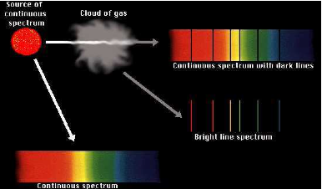
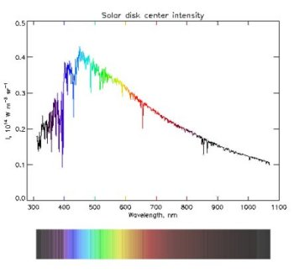
Spectroscopy

Slide 15
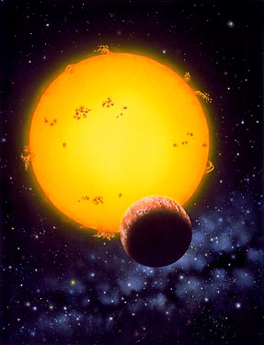
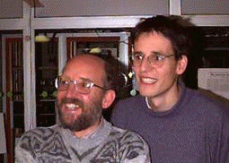
(Doppler) Spectroscopy
1995
Discovery of 51Pegb
Queloz & Mayor

Slide 16
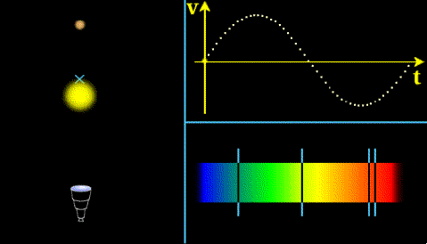
(Doppler) Spectroscopy

Slide 17
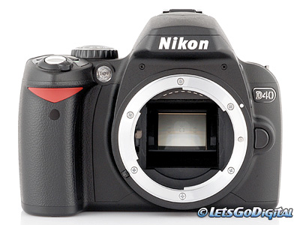
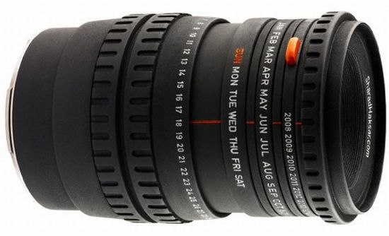
Observing with a telescope
Goals:
Collect as much light as possible
Resolve spatial ‘details’ (form an image)
The telescope is the ‘lens’ and the instrument/detector is the ‘chip’ of your ‘camera’.

Slide 18
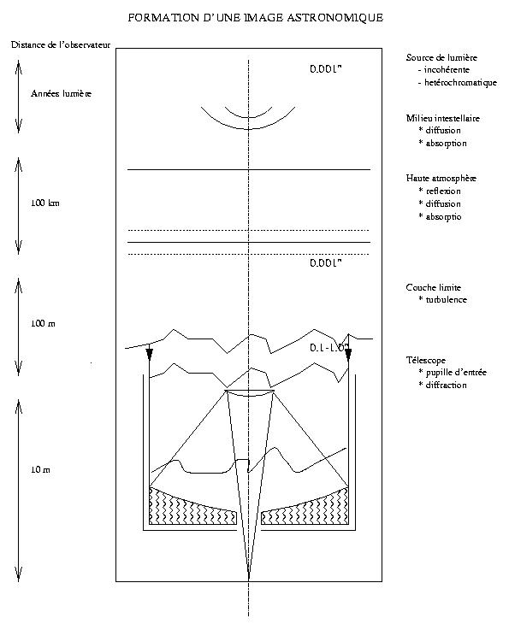
Acquiring the image
Cours Blecha 2003

Slide 19
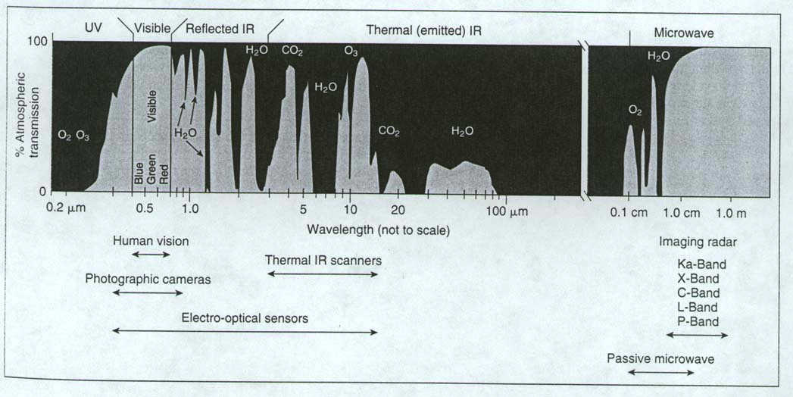
Atmospheric absorption
Cours Blecha, Unige 2003

Slide 20
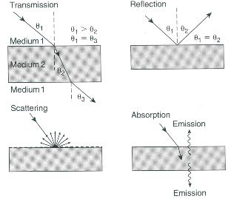
Effects of the atmosphere
Cours Blecha, Unige 2003

Slide 21
Telescope definition
Focal plane
(x,y)
Telescope
Focal distance f
FOV
θ
(0,0,z)
Detector
Pupil plane
Field of View: FOV [arcsec]
Telescope diameter (collecting area): D [m]
Focal length: f [m]
Source angular position: θ [arcsec]
Transmittance (efficiency): ε
Image quality: IQ
Collecting area: S = π D²/4 [m²]
F-number: f/D
Numerical aperture: NA = D/2f
Scale factor: Δx/Δθ [mm/arcsec]
Δθ = FWHM (full-width at half maximum)
= angular (spatial) resolution = 1.22 λ/D

Slide 22
Geometrical image
Object at infinity -> Image on detector
Angular position -> Position on detector
(k_{x},k_{y}) -> (x,y)
f
(k_{x},k_{y})
(0,0)
θ
(x,y)

Slide 23
Telescope classes
Refractor:
  Uses lenses
  Good AR coatings
  Chromatic
  ‘Easier’ to manufacture
  Lower optical power
  longer
Reflector:
  Uses mirror
  Expensive reflective coat.
  Achromatic
  More expensive
  Higher optical power
  More compact

Slide 24
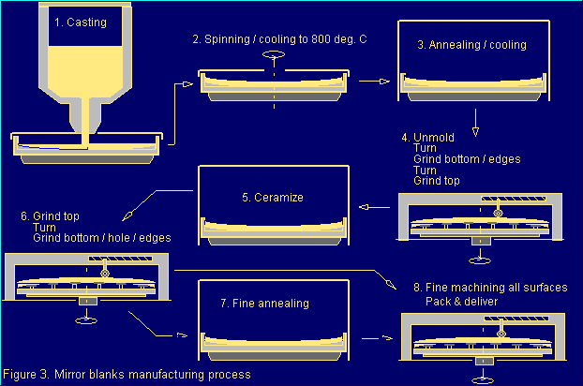
Mirror manufacturing
Cours Blecha 2003

Slide 25
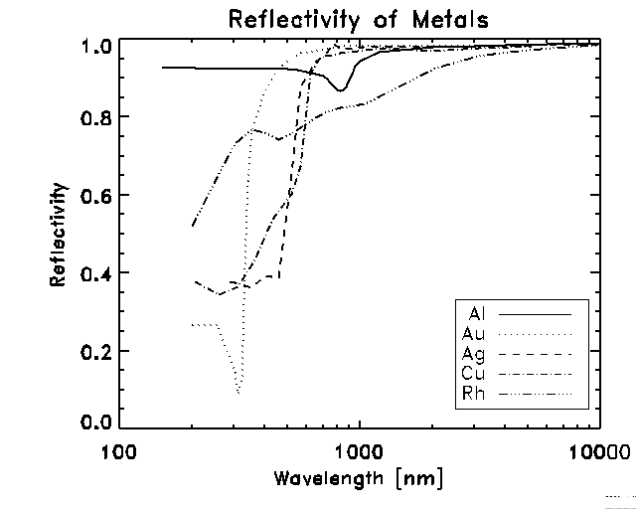
Reflective coatings
Cours Blecha, Unige 2003

Slide 26
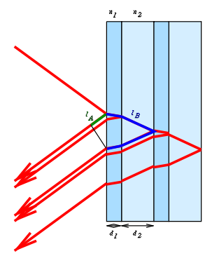
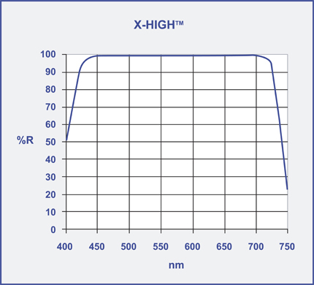
Dielectric coatings
OpcoLab
Wikipedia

Slide 27
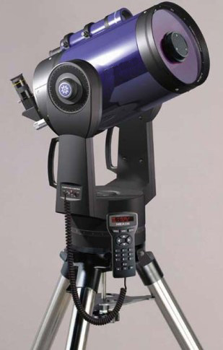
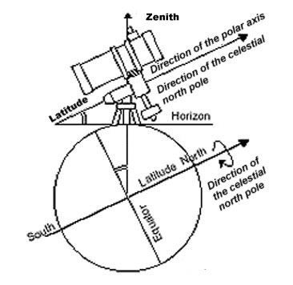
Telescope mounting classes
Equatorial
  Simple control
  Heavier and bigger mechanics
Horizontal
  Simpler and more compact
  Requires computer control

Slide 28
Basic telescope
Cours Blecha, Unige 2003

Slide 29
Cassegrain telescope
Cours Blecha, Unige 2003

Slide 30
Newton telescope
Cours Blecha, Unige 2003

Slide 31
Schmidt-Cassegrain
Cours Blecha, Unige 2003

Slide 32
Telescope focii
Cours Blecha, Unige 2003

Slide 33
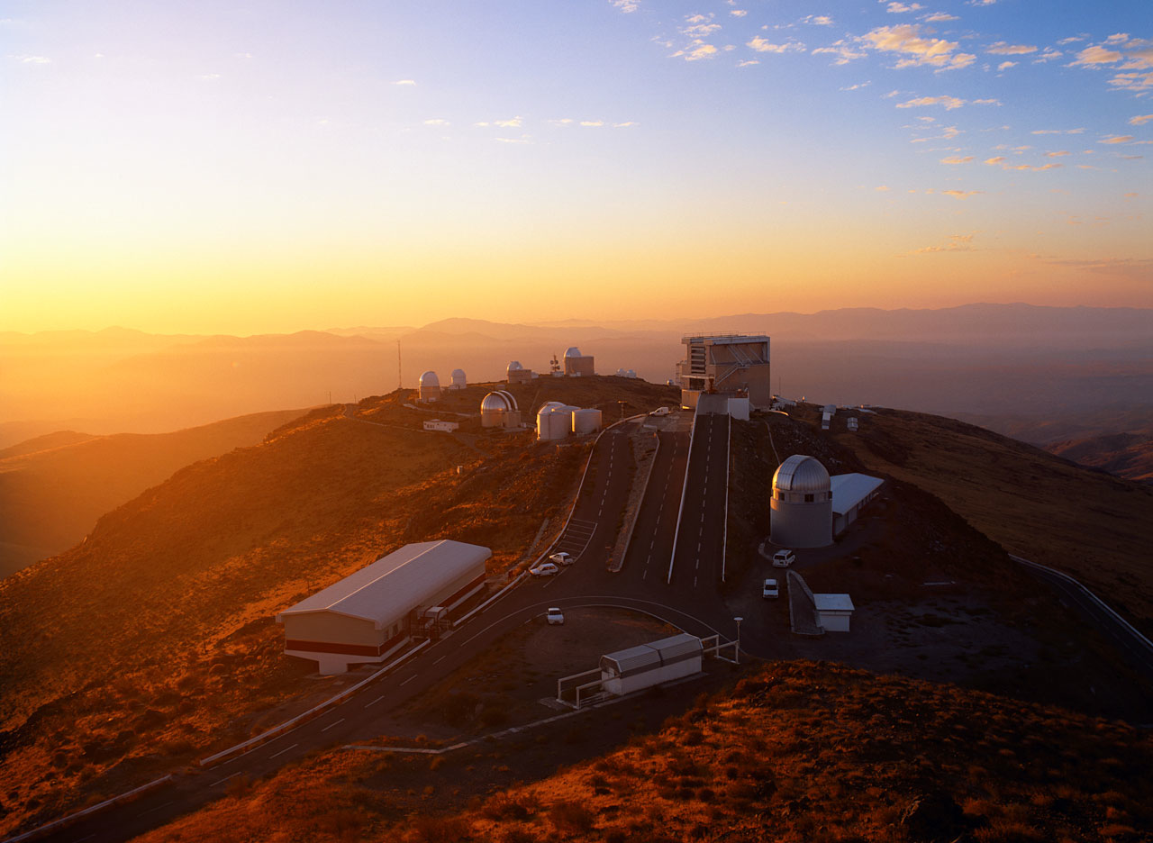
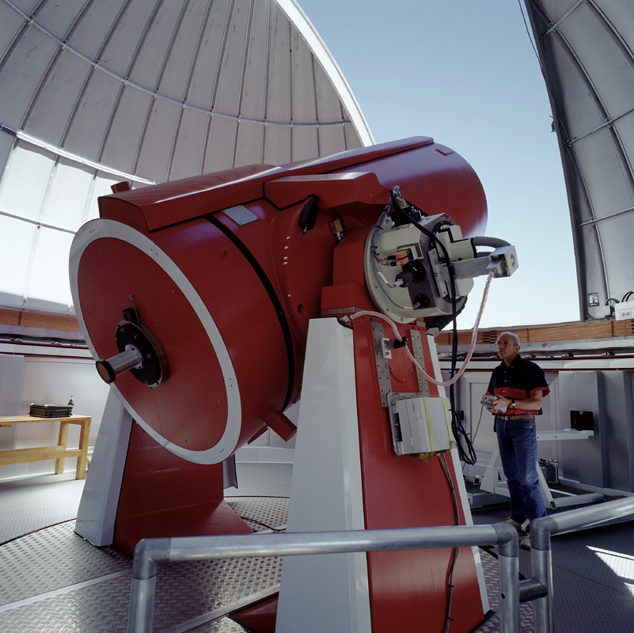
Swiss Euler@ La Silla

Slide 34
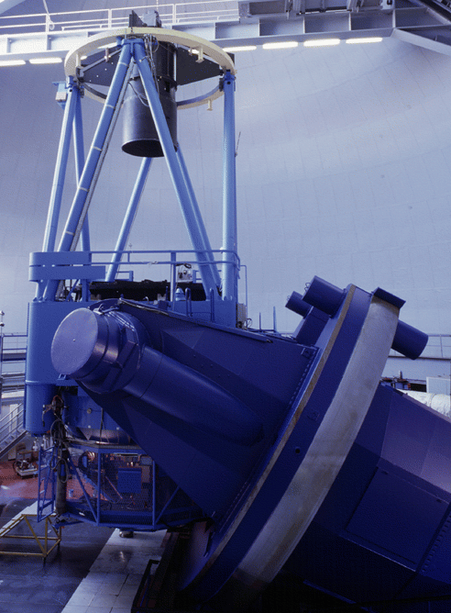
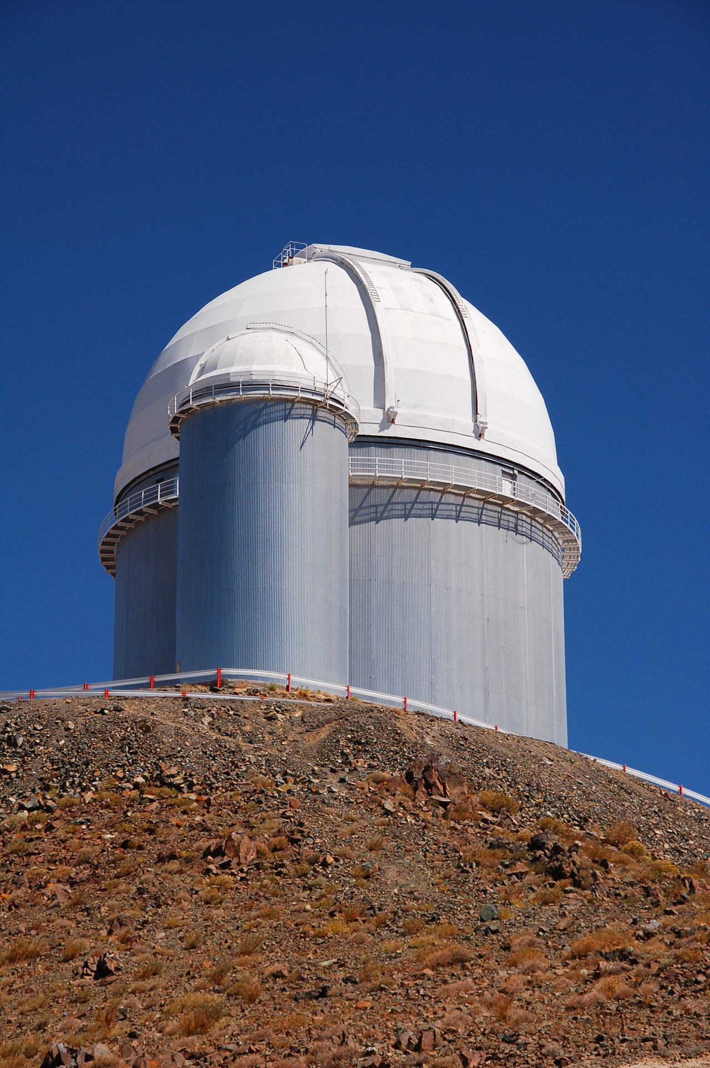
ESO 3.6-m@ La Silla

Slide 35
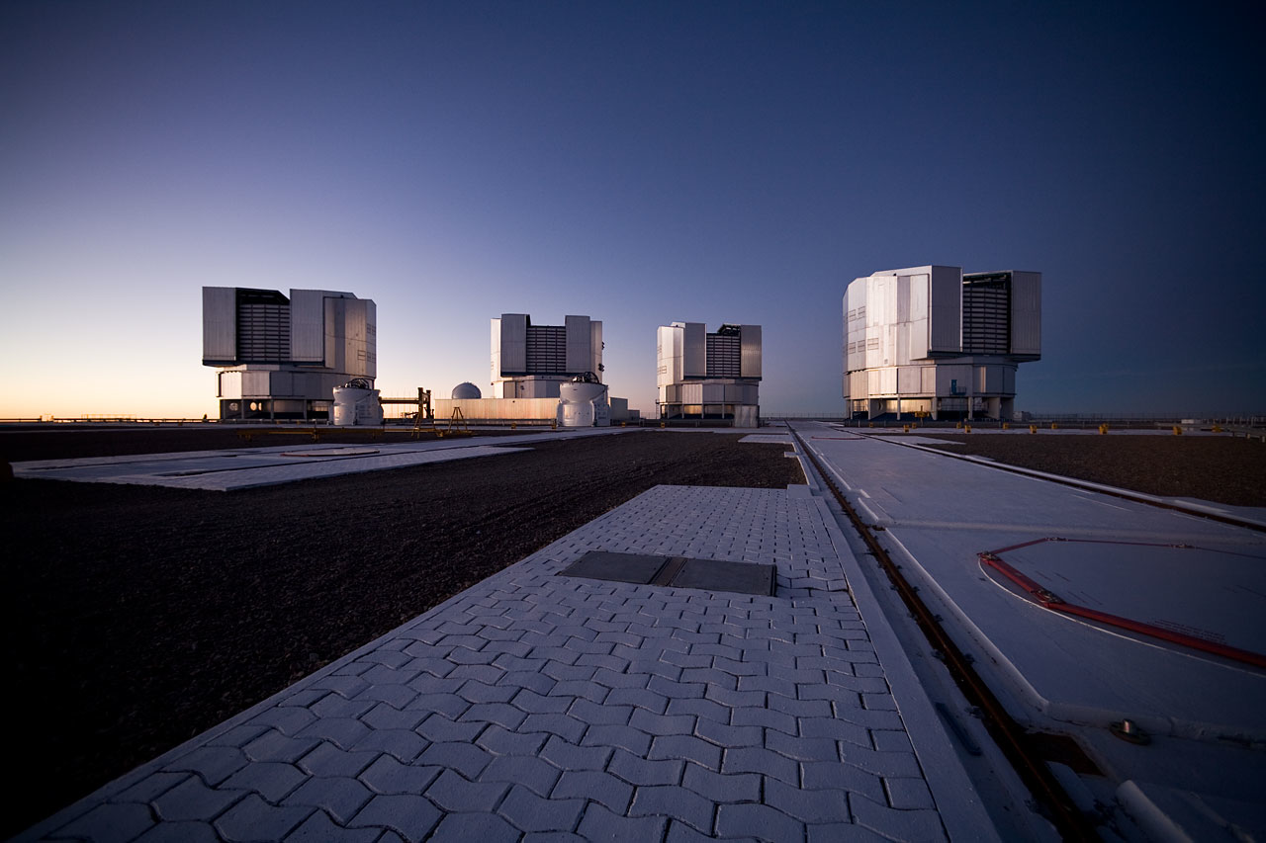
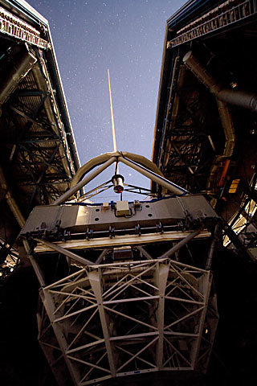
ESO VLT@Paranal

Slide 36
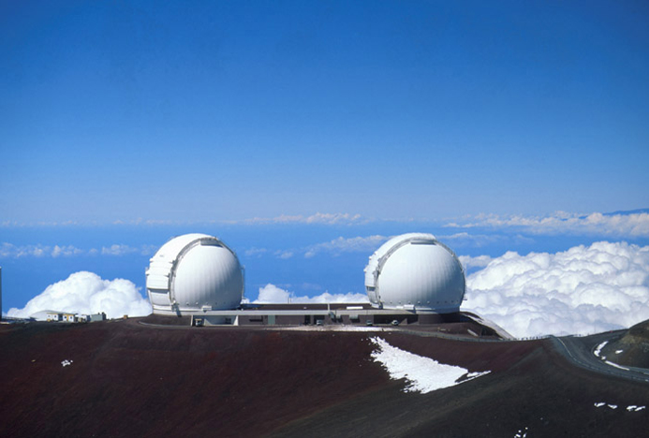
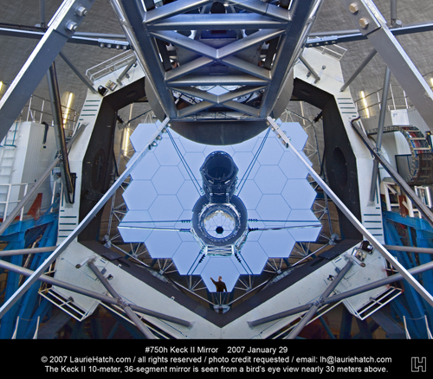
Keck@Mauna Kea

Slide 37

Future E-ELT@ESO

Slide 38
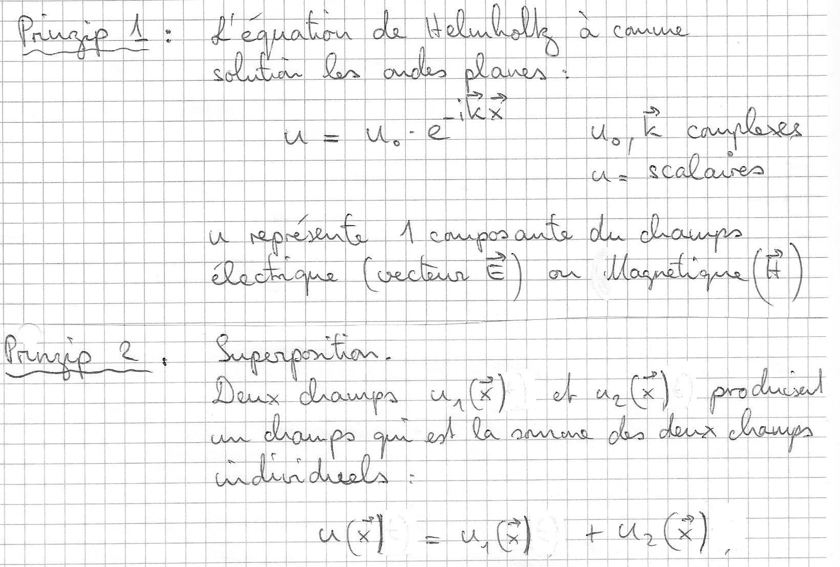
Fourier optics

Slide 39
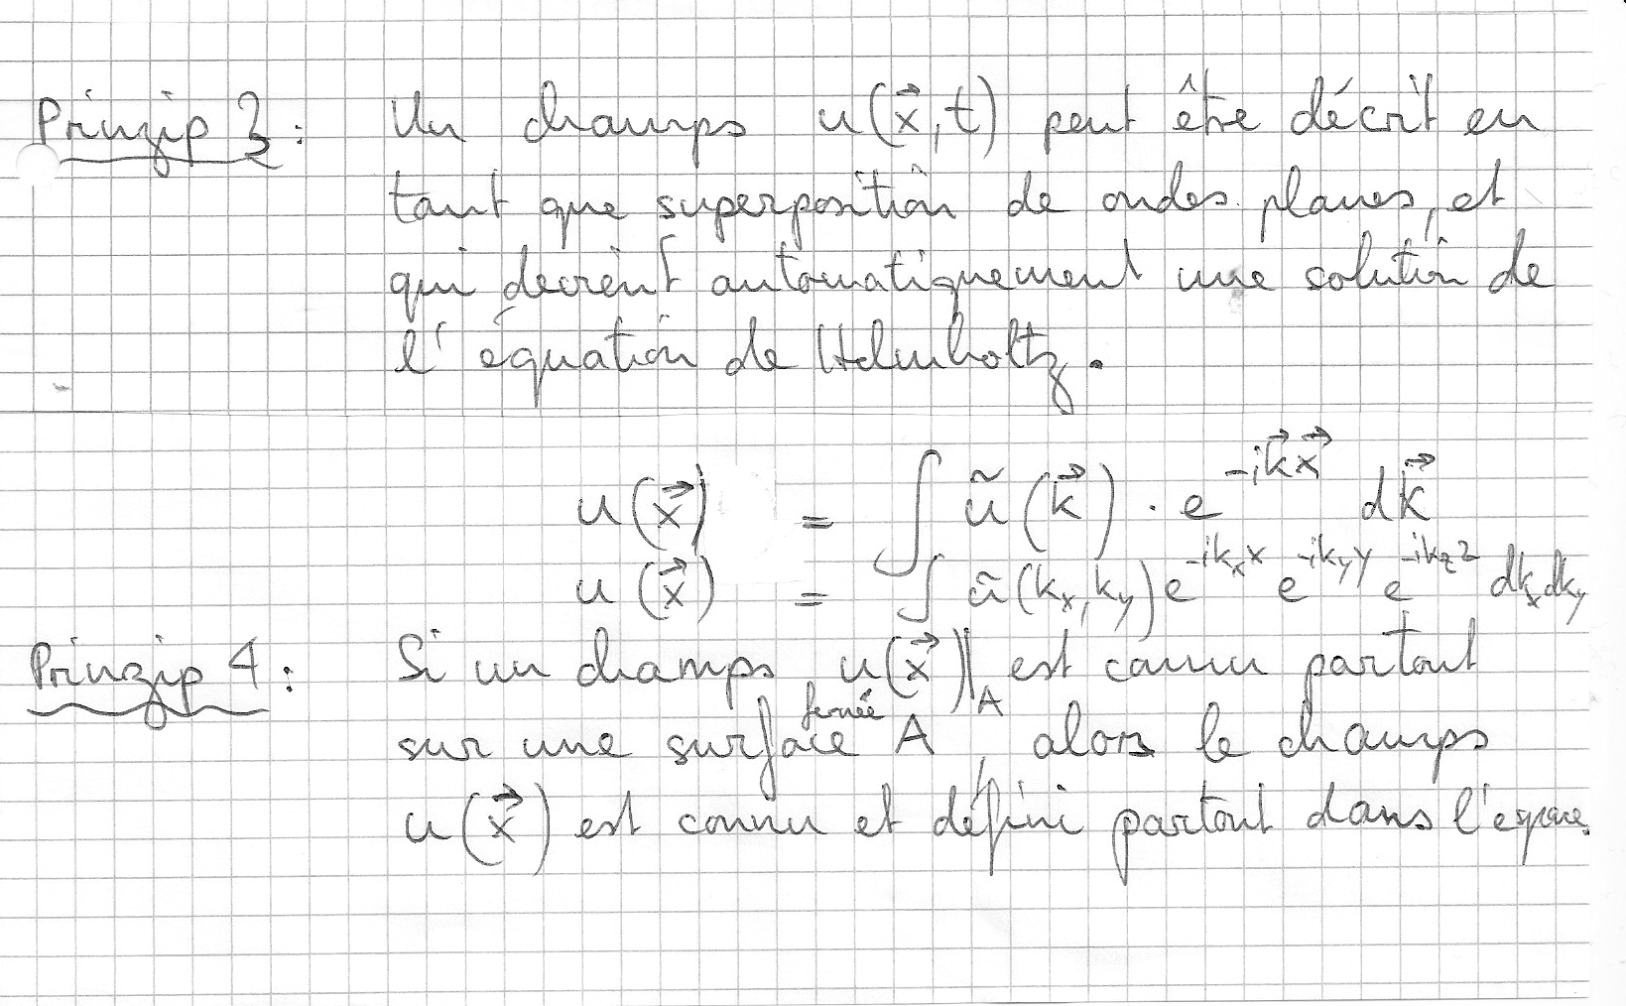
Fourier optics

Slide 40
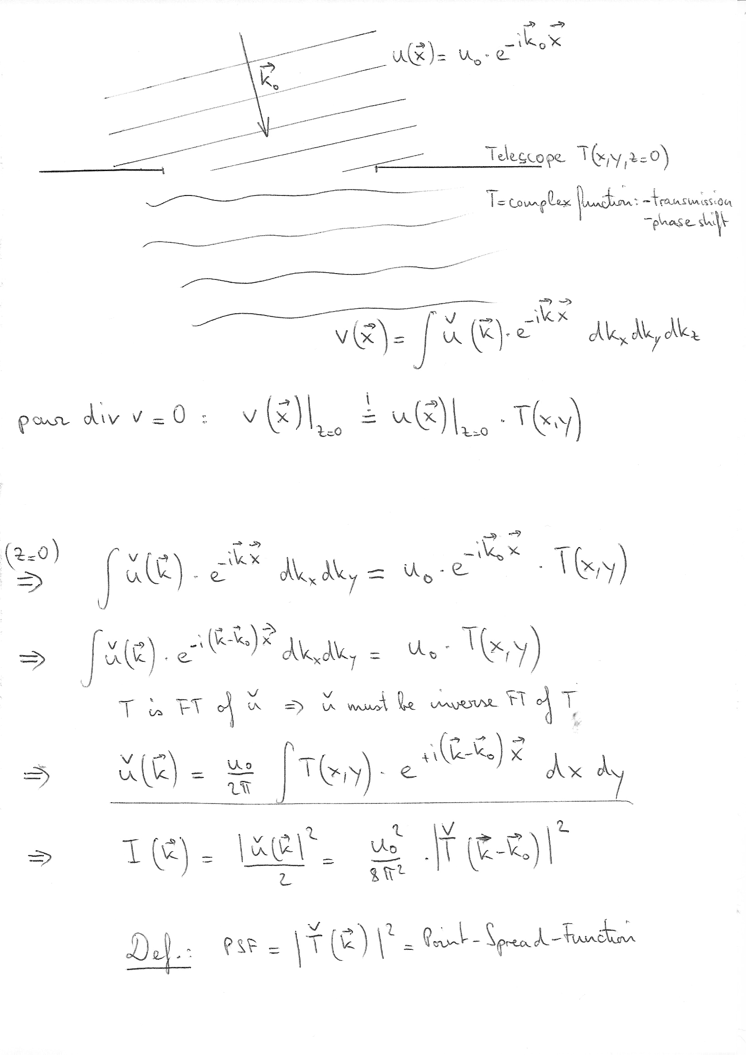
Image of point-like source

Slide 41
Image of point-like source

Slide 42
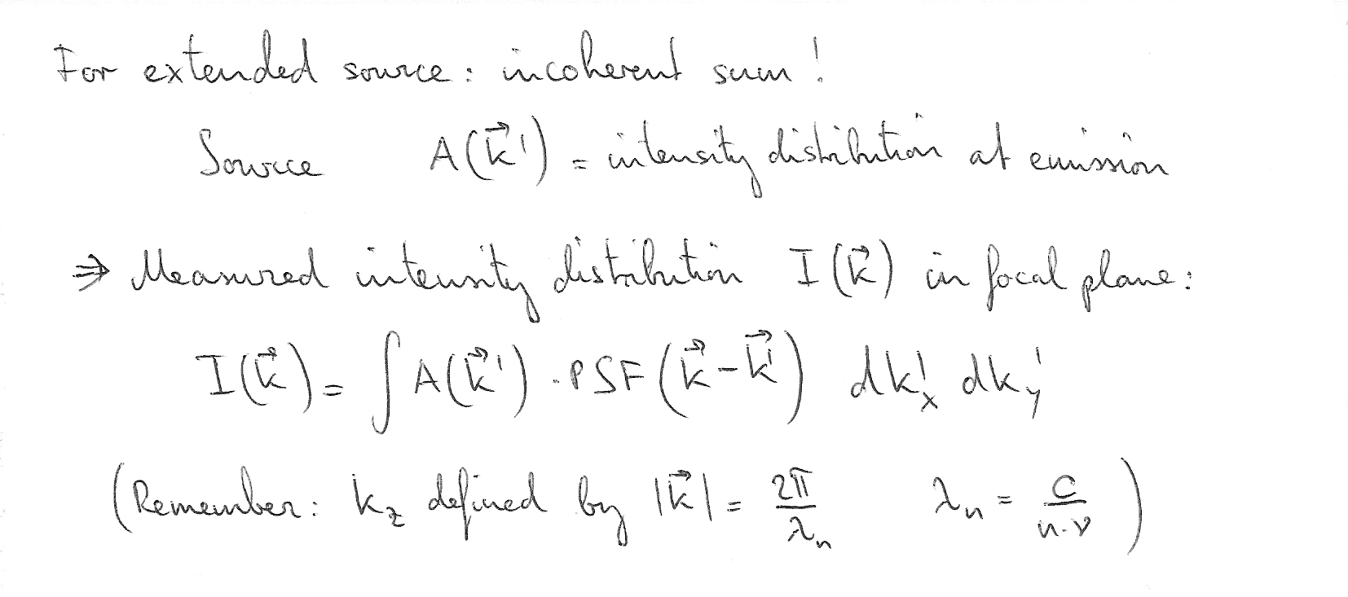
Image of an extended source

Slide 43
Define optical transfer function (OTF)
Imaging through any optical system: in intensity units
Image = Object ⊗ Point Spread Function
I ( r ) = O ⊗ PSF ≡ ∫ dx O( x - r ) PSF ( x )
Take Fourier Transform: F ( I ) = F (O ) F ( PSF )
Optical Transfer Function is the Fourier Transform of PSF:
OTF = F ( PSF )
convolved with

Slide 44
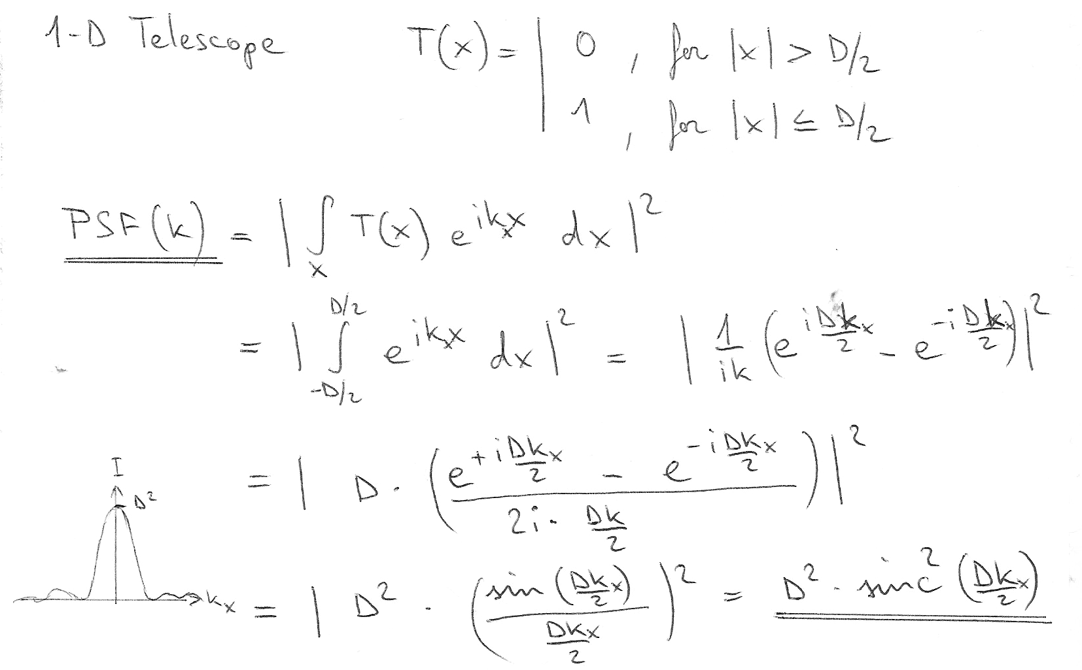
PSF of ‘1-D’ telescope

Slide 45
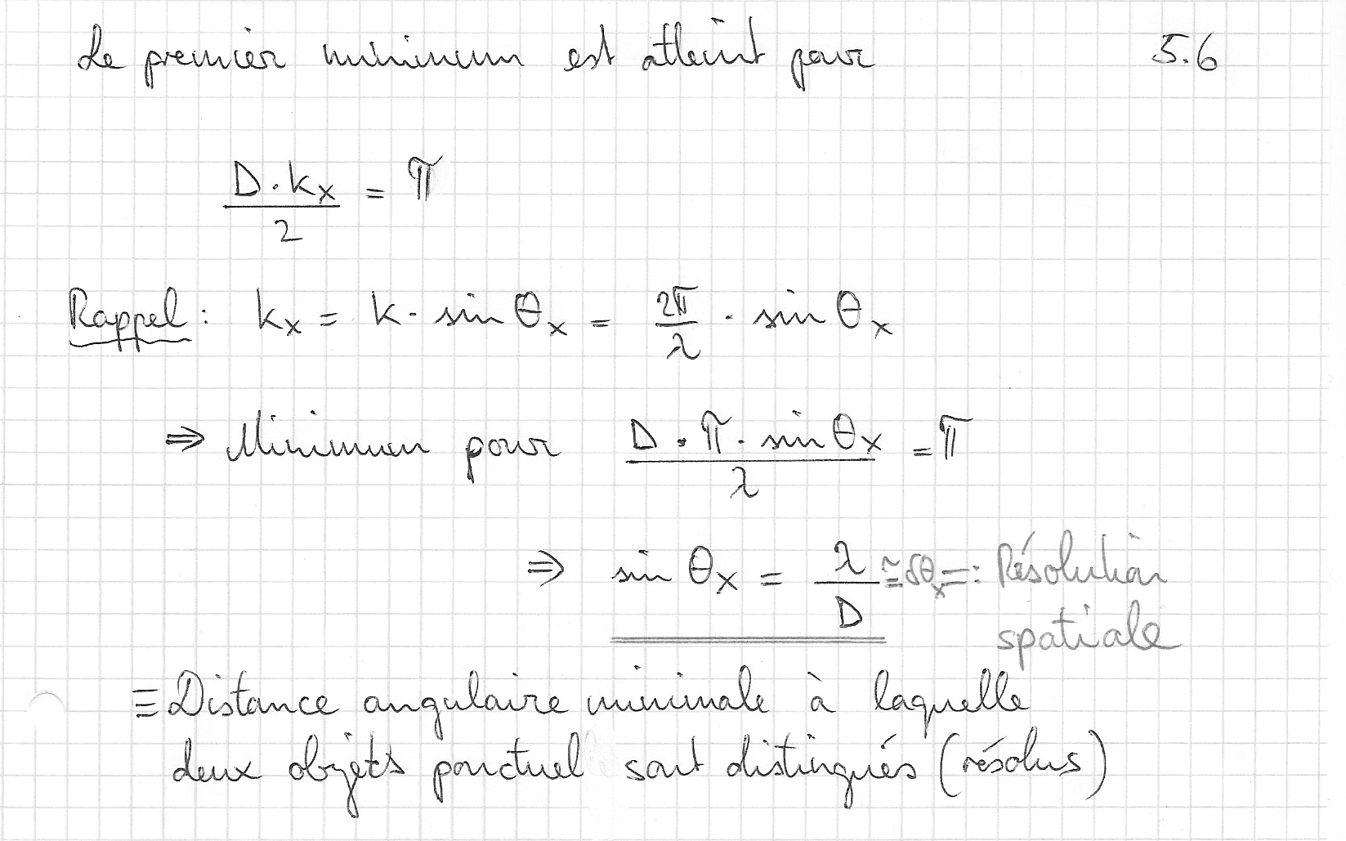
PSF of ‘1-D’ telescope

Slide 46
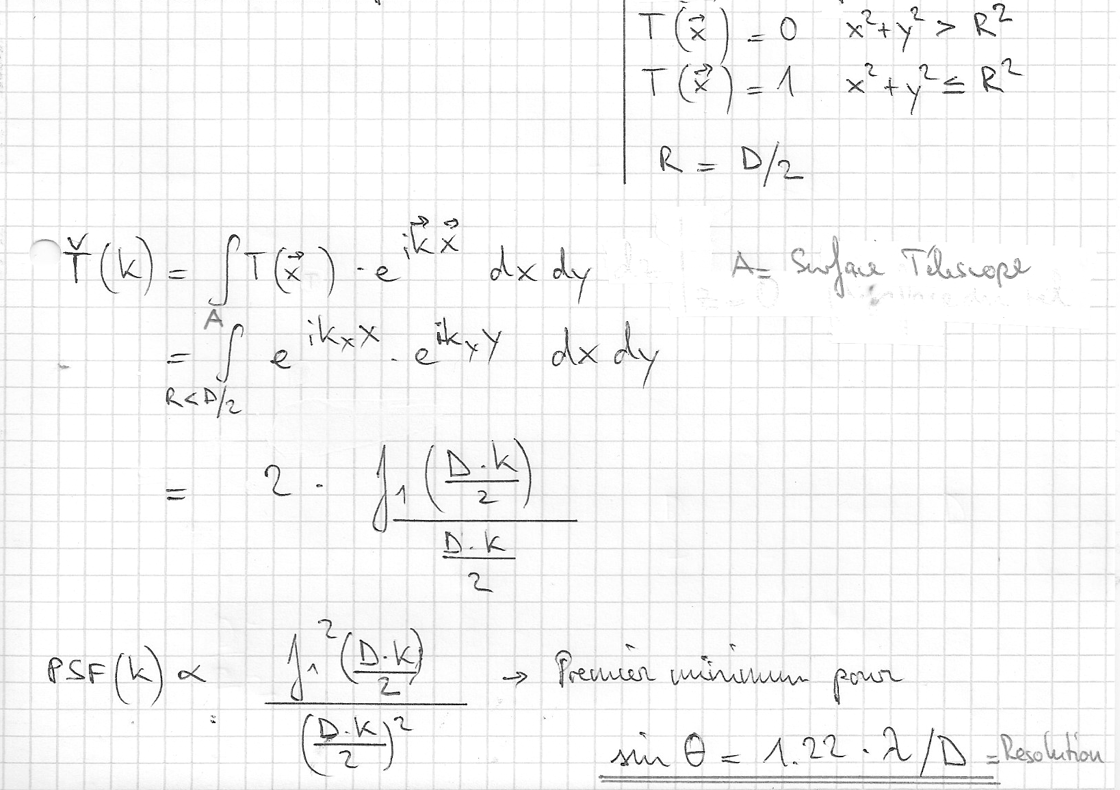
PSF of ‘2-D’ telescope

Slide 47
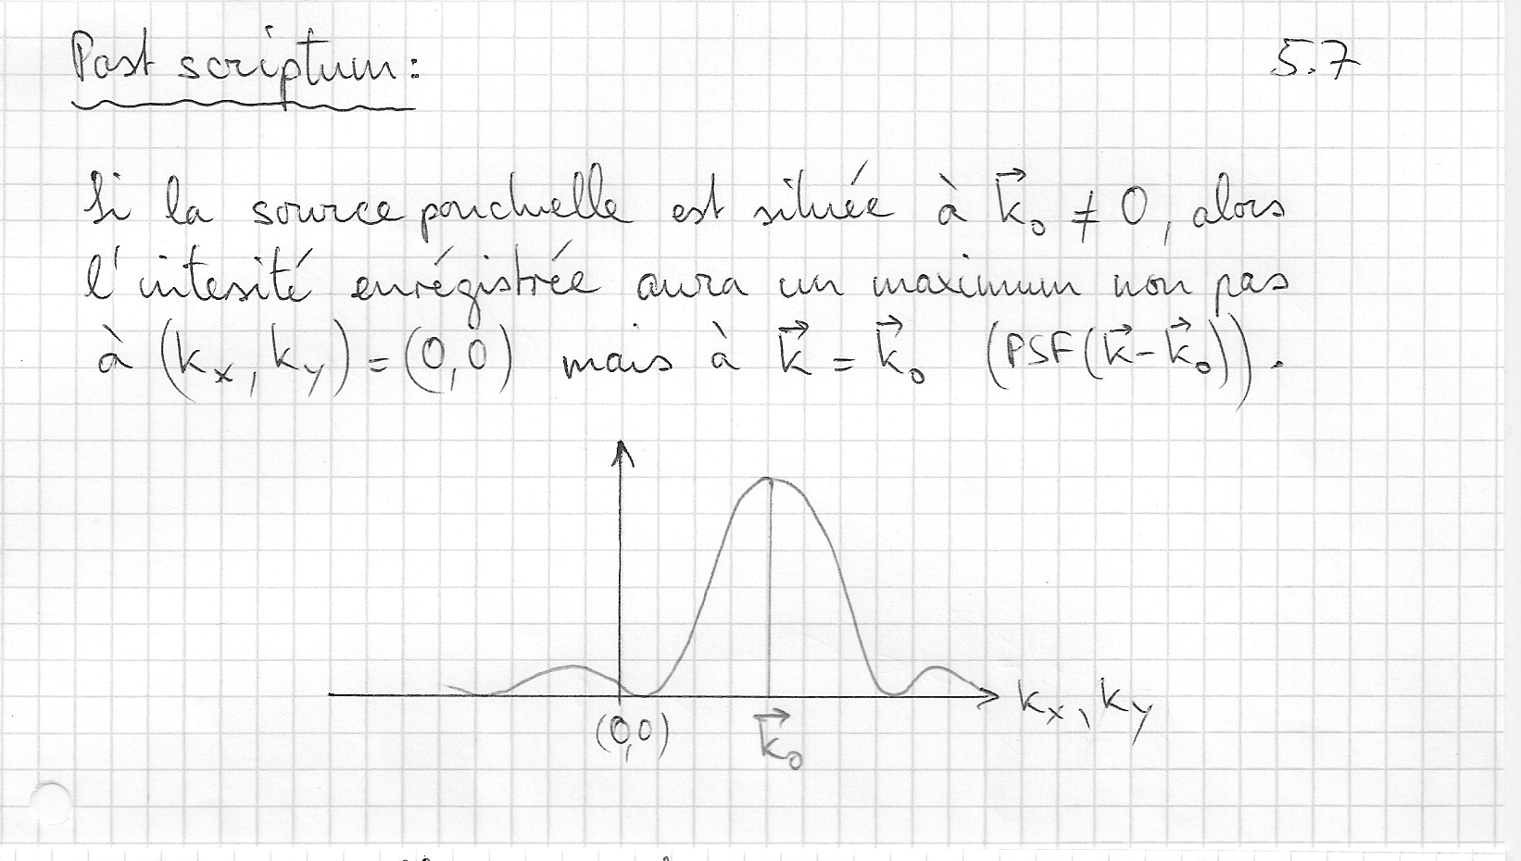
Image formation

Slide 48
Exercises

Slide 49
Exercise 1
Compute data rate (bytes per seconds) to observe the ‘whole’ universe:
  Solid angle of 4π
  Visible range (400 nm – 700 nm)
  Spectral resolution λ/Δλ = 10’000
  Spatial resolution 1 arcsec
  2 polaristations
  16-bit resolution

Slide 50
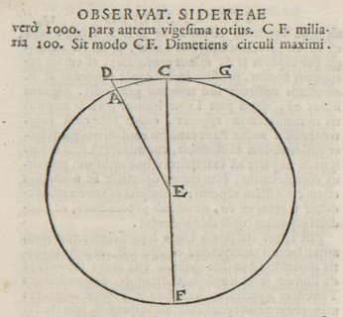
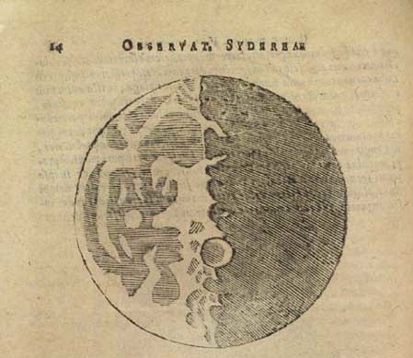
Exercise 2
Estimate the height of the lunar ‘mountains’ using Galileo’s approach and knowing that R_{M} = 3476 km:

Slide 51
Exercise 3
Compute the image size of a 10-arcsec galaxy in the focal plane of a telescope with effective focal length of 30m.

Slide 52
Exercise 4
Demonstrate that the mirror shape which reflects a parallel beam into a single focal point is a parabola. Tip: Use Fermat’s principle

Slide 53
Exercise 5
Compute the spatial resolution of the human eye, assuming that the pupil size is of 5mm.
Give an example of an object at the limit of the eye’s resolution.

Slide 54
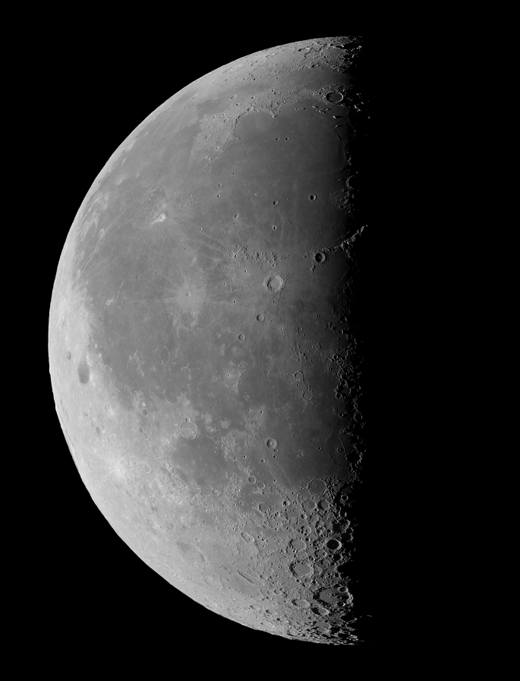
Diametro della Luna= 3476km
d/D=0.035
d
D
h=((1738²+(d/D 3476)² )^{1/2} - 1738=4.25km

