Slide 1
The diversity of exoplanets
Statistical results I
51 Peg b

Slide 2
Occurrence of planets

Slide 3
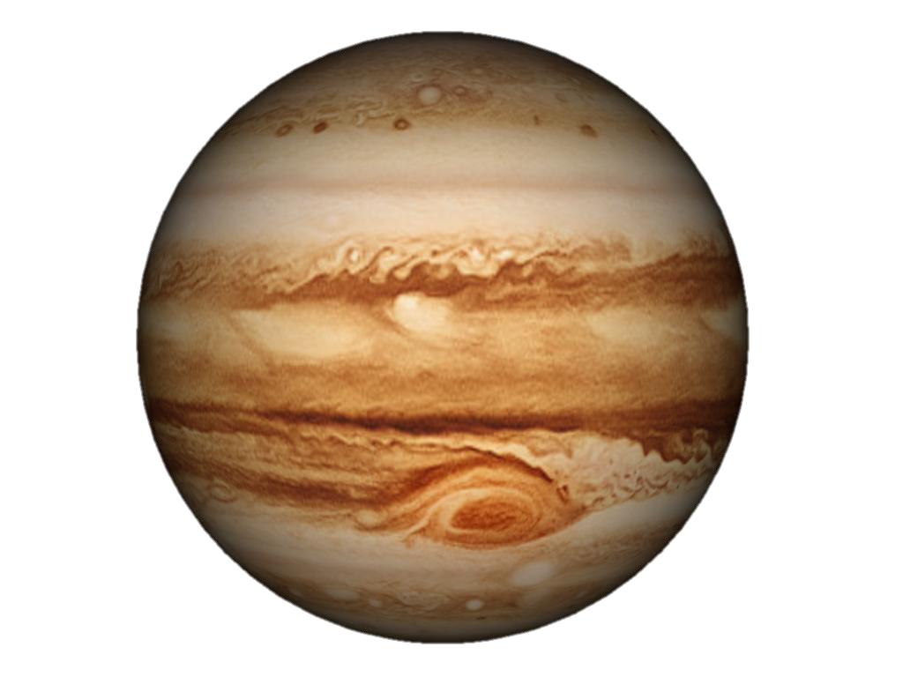
51 Peg b

Slide 4
First new questions to answer
How many hot Jupiters?
Is our system an exception?
How do these hot Jupiters form?
What is the frequency of exoplanets?
Are the systems and what is their structure?

Slide 5
First ‘statistical’ results (as by 2004)
1% of solar-type stars harbour ‘hot jupiters’
At least 7% of solar-type stars have at least one planets
Discovered planets (mainly giant planets) are more frequent around metal-rich stars
Large variety of orbits and systems

Slide 6
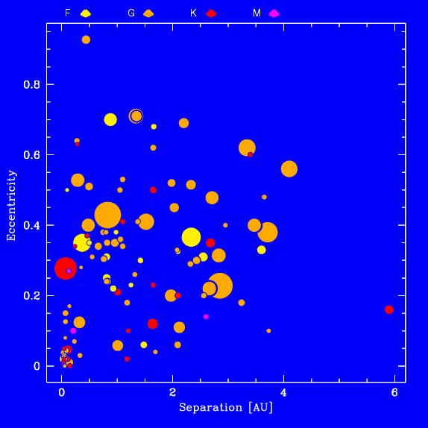
Extrasolar planets: Overview
1995-2004: > 130 planets
Statistical properties
  Percentage
    ~7% of observed stars
  Mass distribution
    0.2 M_{Jup} < M_{pl} < 20 M_{Jup}
  Period
    2.5 d < P <
  Mass-period distribution
  Eccentricity-period distribution
    0 < e < 0.93
  Proprerties of host stars
    metallicity, mass
  Planets in binaries
  ->Improve statistics
  ->Improve precision

Slide 7
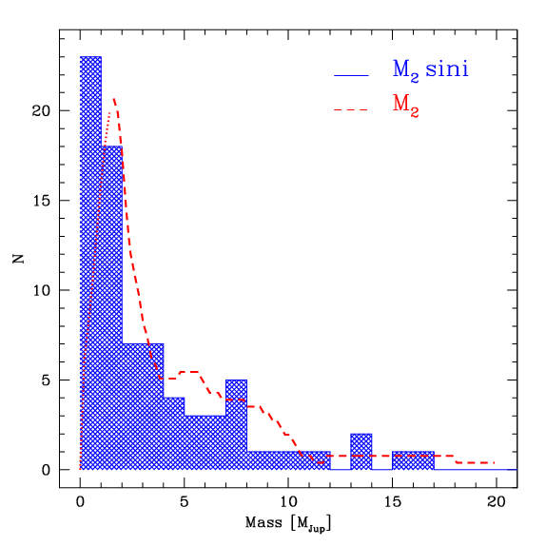
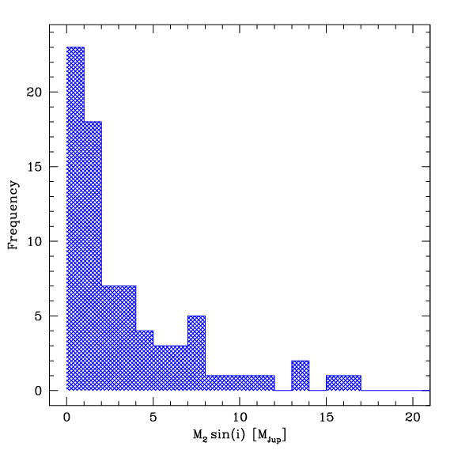
Planetary mass function
~ 1/m^{x} x=1-2
f(m₂)~f(m₂sini)
(Jorissen et al. 2001)
- Tail up to ~20 M_{Jup}
- 1 planet/star?
D-burning limit????

Slide 8
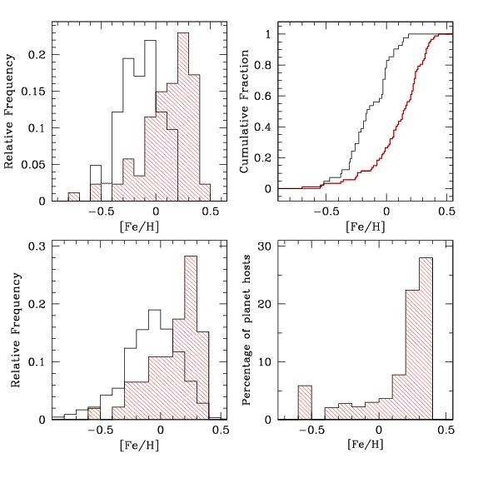
Metallicity of planet host stars
Stars with planets are more
metal rich than “single” stars of the solar neighbourhood
(Gonzalez 1997)
Homogeneous high-resolution spectroscopic abundance analysis
Planet-comparison stars (Well-defined Coralie sample)
Normalisation by the number of stars in each metallicity bin (Santos e al. 2001,2003,2004)
Huge increase of planet frequency with metallicity
PLANETS
COMPARISONS

Slide 9
Distribution, mass, separation

Slide 10
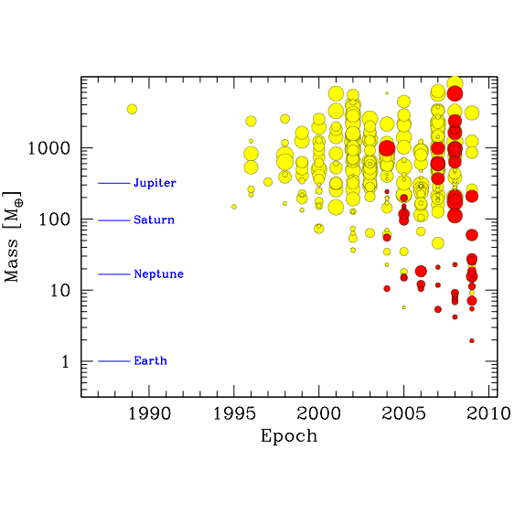
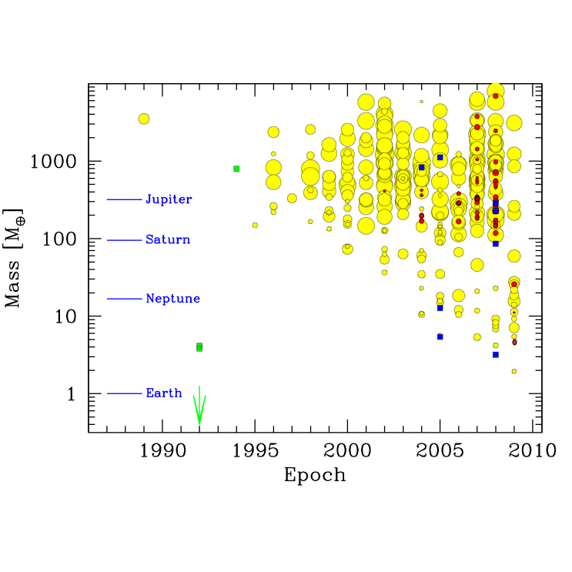
51 Peg b
.
Alpha Cen Bb

Slide 11
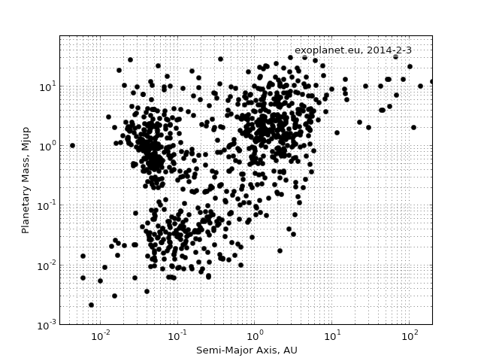
The Exoplanet Census as of 2014
From exoplanet.eu

Slide 12
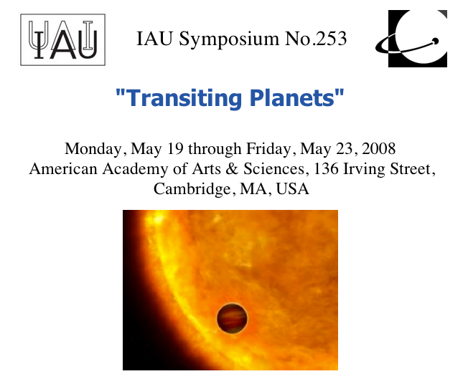
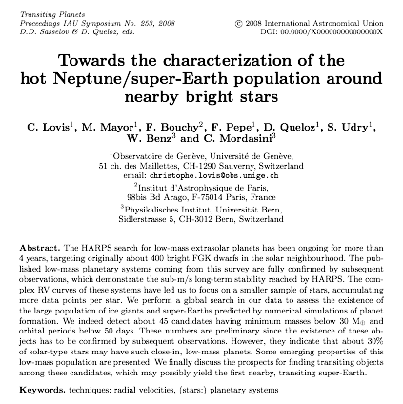
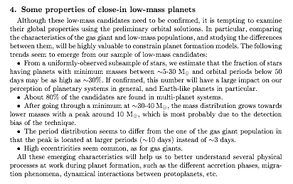
2008: The Rise of Low-Mass Exoplanets

Slide 13
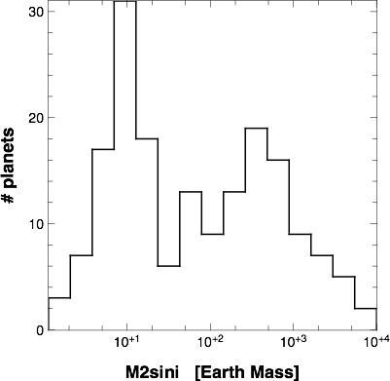
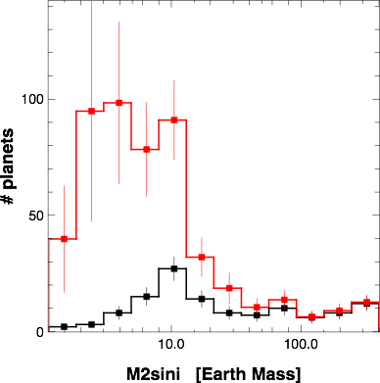
Exoplanet Populations from the HARPS-CORALIE RV Surveys
Mayor et al. 2011

Slide 14
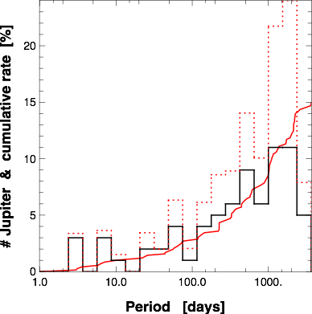
Exoplanet Populations from the HARPS-CORALIE RV Surveys
Giant planets
M > 50 M⨁
Mayor et al. 2011

Slide 15
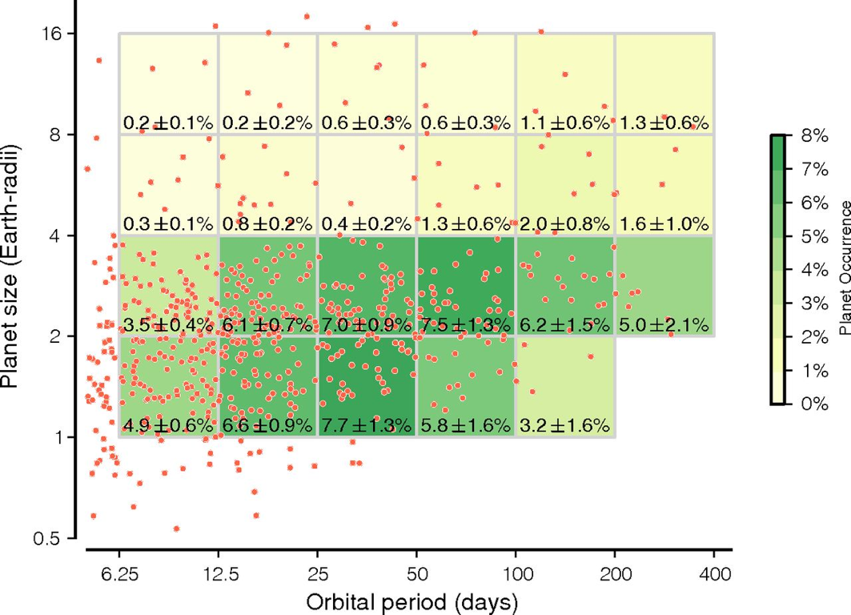
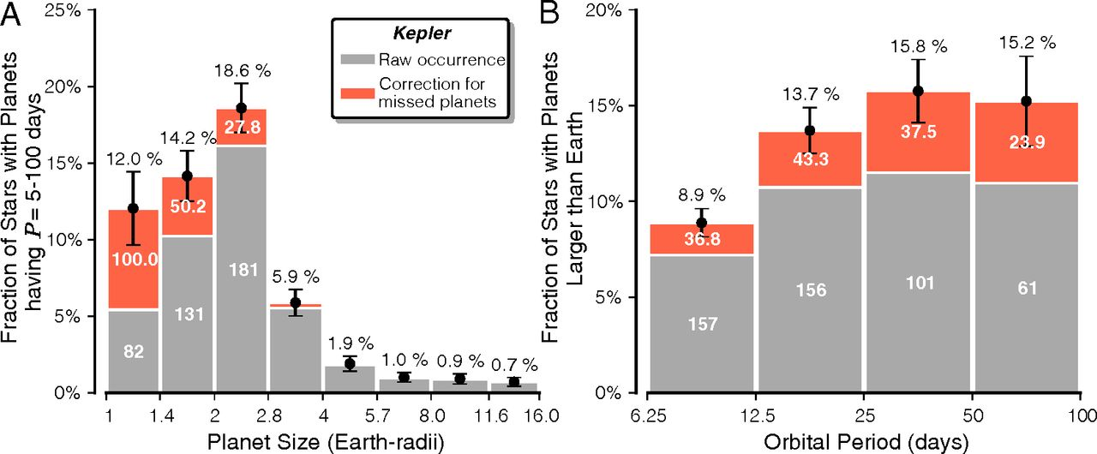
Exoplanet Populations from Kepler
Petigura et al. 2013

Slide 16
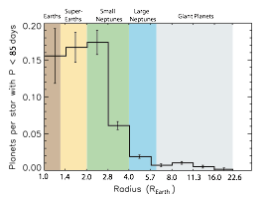
Exoplanet Populations from Kepler
Fressin et al. 2013, see also Dong & Zhu 2013

Slide 17
HARPS / Kepler Comparisons
HARPS (radial velocities) provides the de-biased and normalized distribution of planet minimum masses down to m_{P} sini ≈ 3 M⊕ for periods < 50 days
Kepler (transits) provides the de-biased and normalized distribution of planet radii down to R_{P} ≈ 1 R⊕ for periods < 50-100 days
The common metric between the two surveys is the average number of planets per star (NPPS) as a function of mass/radius

Slide 18
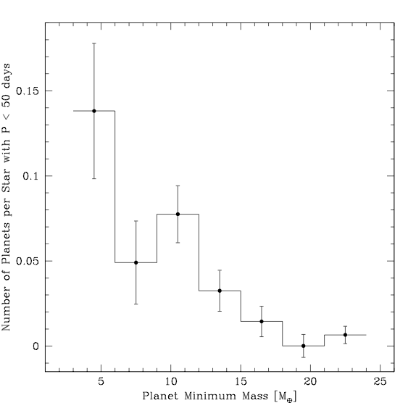
Unbiased, Normalized Mass and Radius Distributions
Occurrence rate for
P < 50 d, R = 1.25-6.0 R⊕ :
f = 0.39 +/- 0.02 planet per star
Occurrence rate for
P < 50 d, Msini = 3-30 M⊕ :
f = 0.33 +/- 0.05 planet per star
Kepler
HARPS
From Fressin et al. 2013
From Mayor et al. 2011

Slide 19
Summary of HARPS-KEPLER results
1% of stars have a hot jupiter
50 – 70% of stars orbit at least one planet
30% of stars have a planet with < 30 MEarth .. Within 100 days period …
…
…
…
…
…

Slide 20
The variety

Slide 21
The variety of exoplanets
Hot Jupiters
Gas and ice giants
Super Earths and mini Neptunes
From exoplanet.eu

Slide 22
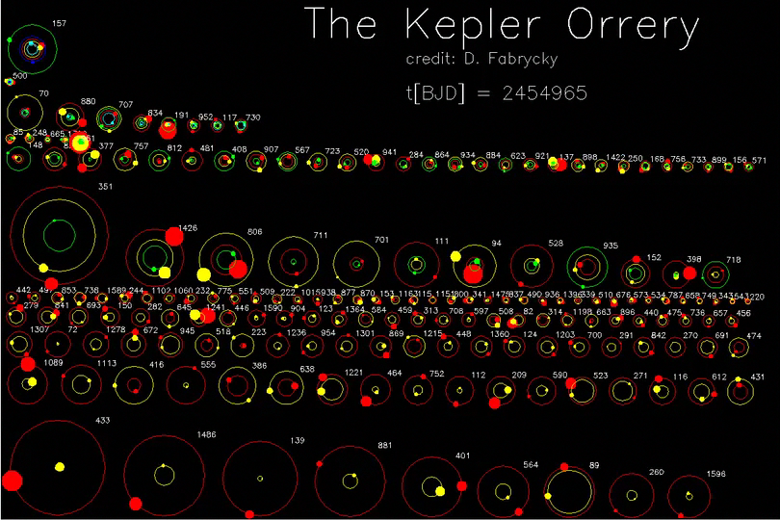
The variety of exoplanetary systems

Slide 23
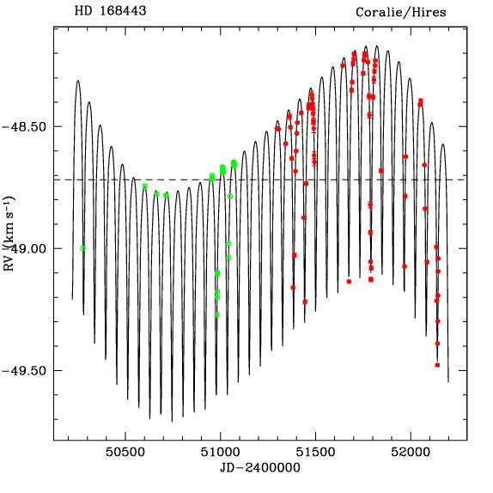
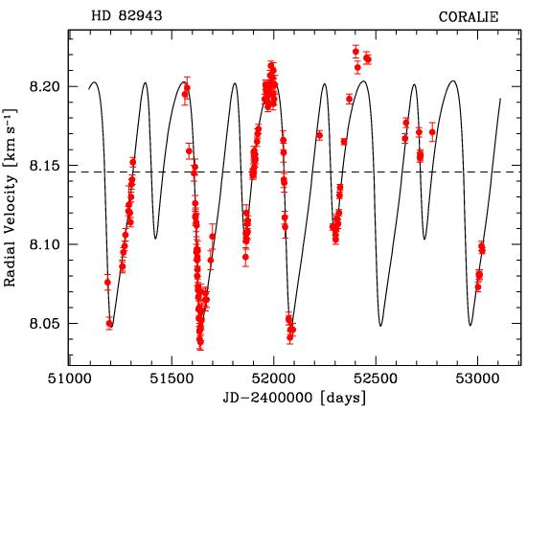
Multi-planetary systems: different “kinds”
Hierarchized
Resonant
P2/P1 = 440d/220d = 2
P1=58 d
P2=1750 d
M1=7.7 M_{Jup}
M2=17 M_{Jup}

Slide 24
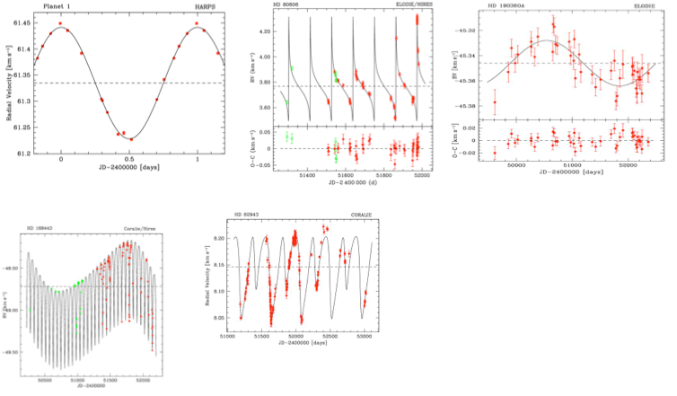
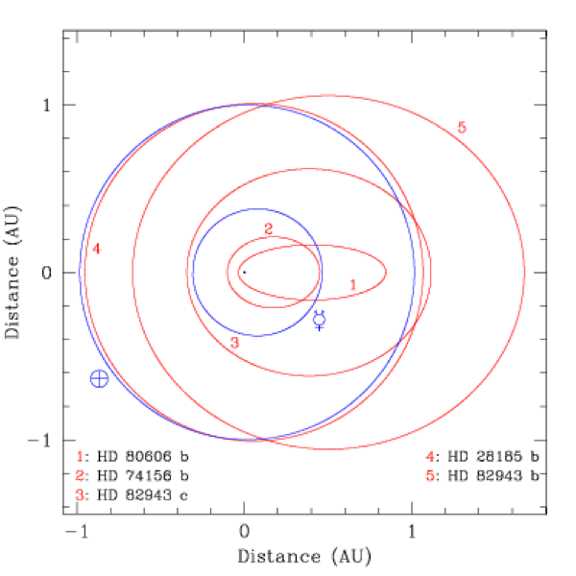
(Multi-)planetary systems: different “kinds”

Slide 25
Ultra-compact systems

Slide 26
Planets in binaries

Slide 27
Mass-radius relation

Slide 28
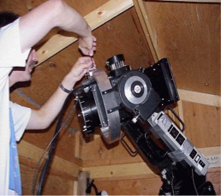
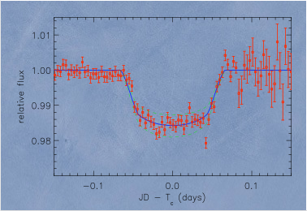
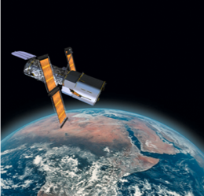
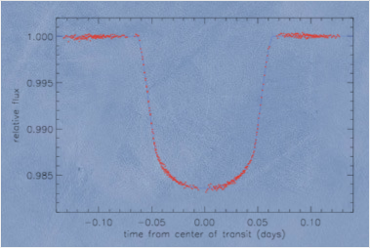
The first transiting planet HD209458

Slide 29
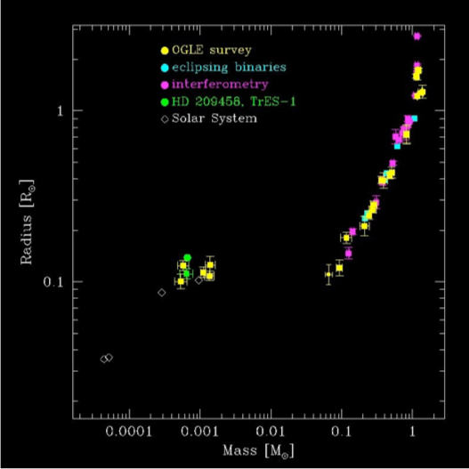
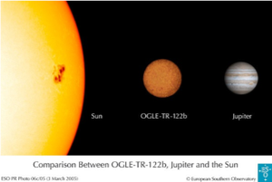
The first transiting planet HD209458
Precise masses and radii
Constraints on physics of intérior of the object
Constraints for planetary formation processes

Slide 30
Complete M-R plot (TBD Maxime?)

Slide 31
Density – Toblerone (TBD)

Slide 32
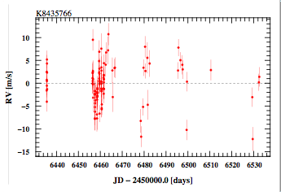
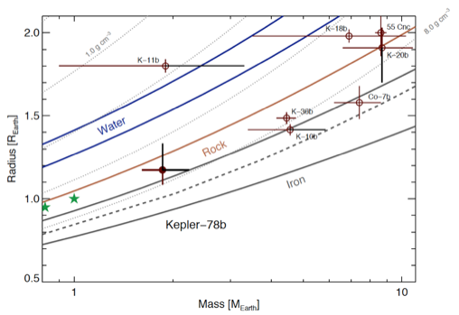
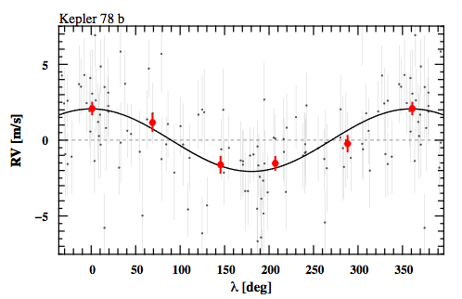
The example of Kepler 78b

Slide 33
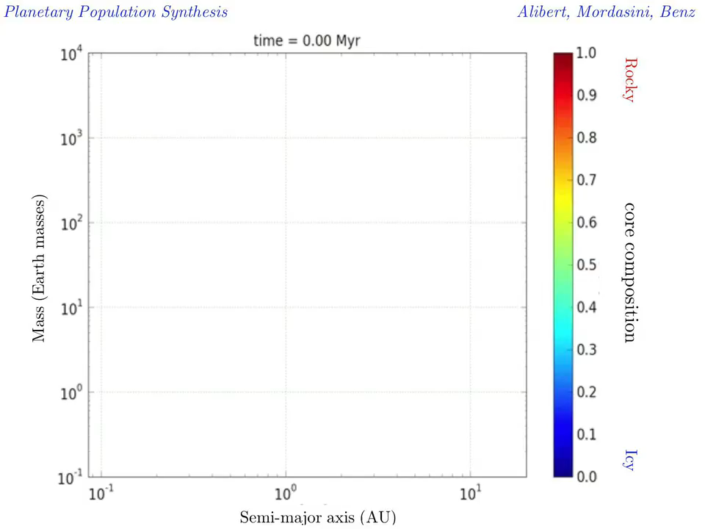
Mass-distance relation from theory

Slide 34
Mass distribution from theory

Slide 35
Mass-Radius relation from theory
Mordasini 2013

Slide 36
Metallicity distribution from theory

Slide 37
Predictions from theory

Slide 38
Excercises
A
B
C

